Slide 1
Innovations in EAC Tracking
Powerledger’s REC Marketplace and the Path to 24/7 Carbon-Free procurement.
Bryan Gower
Chief Client Services Officer (CCO), M-RETS
Ben@mrets.org

Slide 2
Background
Mission: M-RETS validates the environmental attributes of energy to serve as a trusted centralized gateway to environmental markets.
Independent non-profit 501(c)(4) with a stakeholder board.
M-RETS tracks in all states and provinces.
Notes:
M-RETS is a mission-driven environmental attribute tracking platform providing the data that is leading the drive toward economy-wide decarbonization. The M-RETS Renewable Energy Certificate (“REC”) and Renewable Thermal Certificate (“RTC”) registries provide key data that serve new and existing voluntary and compliance markets across North America.2
M-RETS occupies a unique space in the registry platform market as an independent 501(c)(4) with a board that includes state regulators, investor-owned, cooperative and municipal utility representatives, and other diverse experts. A key part of the M-RETS mission is to provide leadership in renewable energy markets by providing scalable and replicable solutions that help solve environmental problems at a local, regional, national and global level.

Slide 3
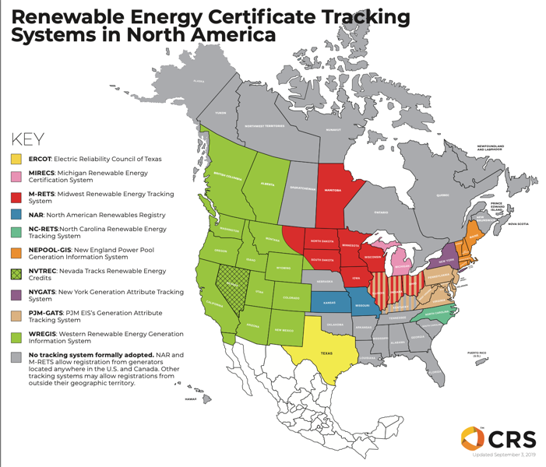
M-RETS Geographic Footprint

Slide 4
RECs are an unnecessary pain point
Growing market demand
Voluntary customers want better solutions
REC systems need to evolve
Data access and standards
Notes:
Certain consumers are demanding more granular data integrations on RECs such as hourly data to support evolving sustainability goals. These evolving goals place the highest value on quantifying the benefits of their decisions toward decarbonizing their environmental footprint.
M-RETS believes existing REC markets are uniquely situated to begin and sustain this process in a way that does not disrupt – and hopefully supports – existing markets. There is still a reluctance to adopt these new innovative approaches, some even say we are waiting on regulators…
Data access and standards or at the very least harmonization are critical (issue across energy)
Utilities, customers, and regulators should spend less time figuring out/accessing data and more on solutions
Evolution away from volumetric goals towards measuring and valuing contributions to decarbonization

Slide 5
What is Missing?
Data and process standards
Exchange platform
Greater market buy in
3rd party applications
Notes:
Data and Process Standards – M-RETS is working with Energy Tag and LF Energy to promote the need for standards. On the process standards side, the need for documented emissions standards and documentation of when certain data is not available.
Exchange platform – increased need for liquidity to support 24/7 matches when customers are long or short on certain hours
Greater Market buy in - this cannot just be google and iron mountain. There is a lack of interest from many of the important service providers.

Slide 6
Resources
A Path to Supporting Data-Driven Renewable Energy Markets https://www.mrets.org/wp-content/uploads/2021/02/A-Path-to-Supporting-Data-Driven-Renewable-Energy-Markets-March-2021.pdf
A timely new approach to certifying clean energy https://cloud.google.com/blog/topics/sustainability/t-eacs-offer-new-approach-to-certifying-clean-energy
Beyond 100 % renewable: Policy and practical pathways to 24/7 renewable energy procurement https://www.sciencedirect.com/science/article/abs/pii/S1040619019303008
Modernizing How Electricity Buyers Account and are Recognized for Decarbonization Impact and Climate Leadership, https://cdn.catf.us/wp-content/uploads/2022/08/16103856/corporate-electricity-procurement-report.pdf

Slide 7
THANK YOU
Contact: Bryan@mrets.org

