Slide 1
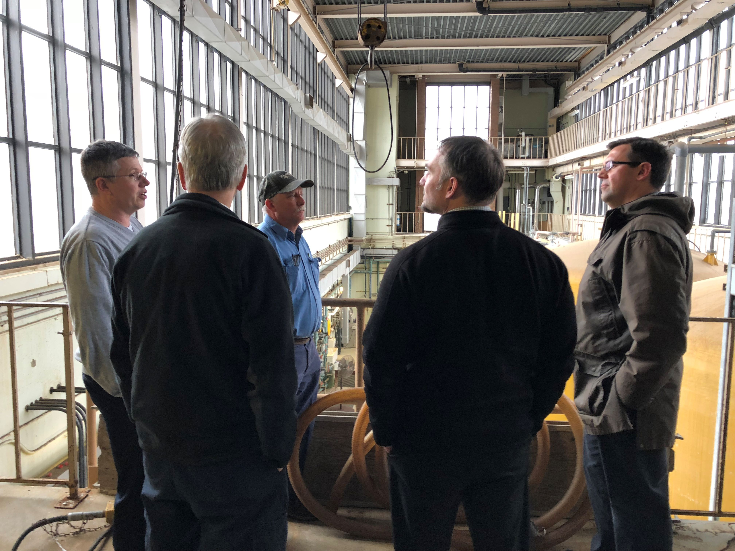

2024 NECPUC Conference water
Infrastructure energy program
(WIEP)
Presented by:
Sharon L. Nall, P.E.

Slide 2
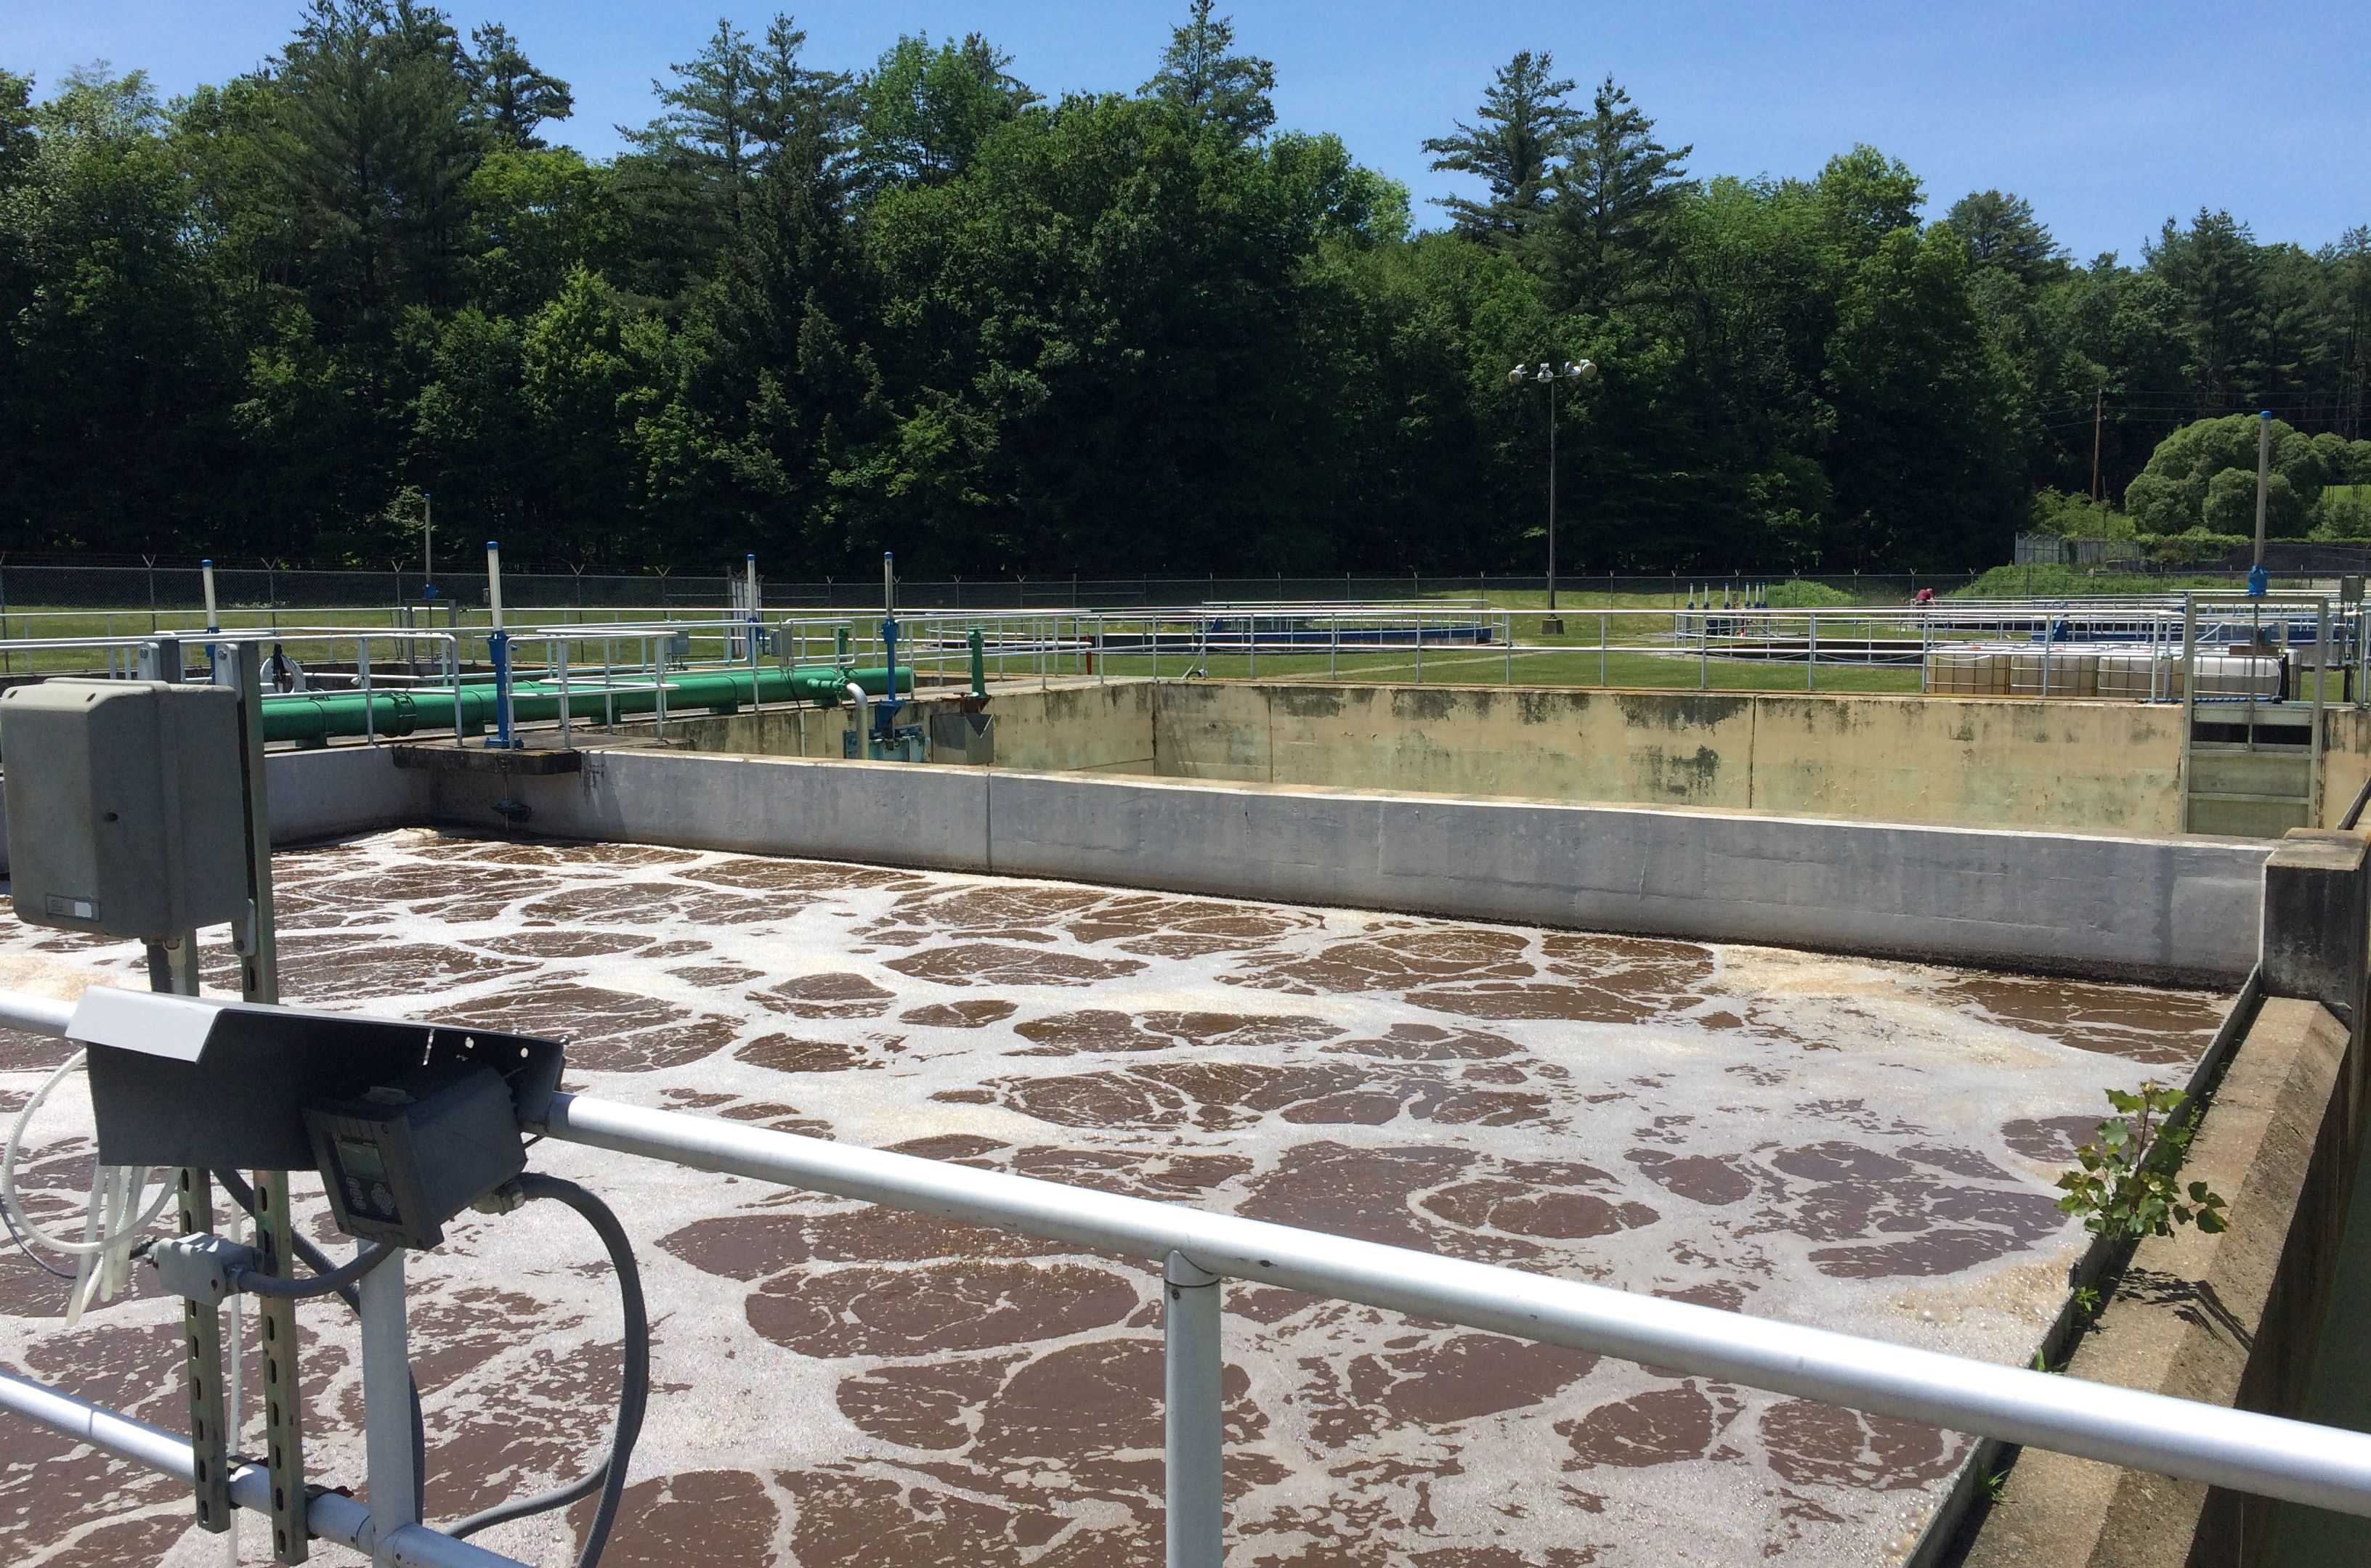
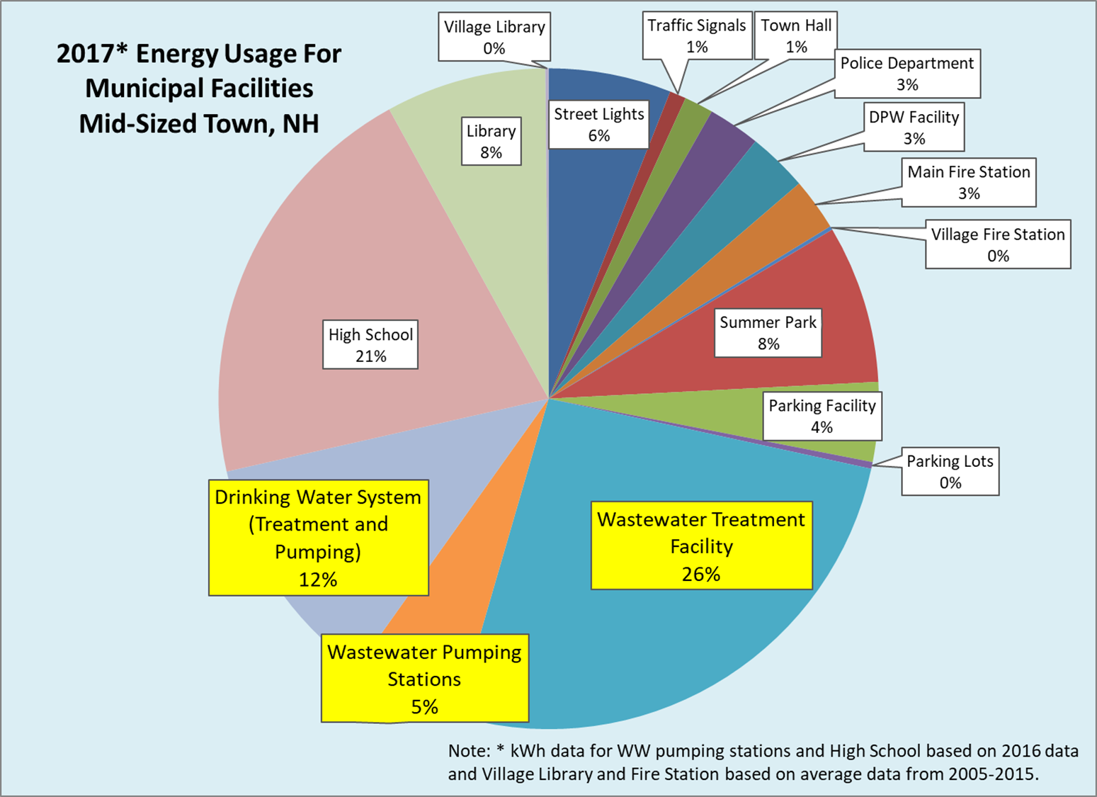
Why WIEP?
Inherently inefficient water infrastructure
Beyond meeting permit limits
High energy use
Reduce GHG emissions
Reallocate money from energy costs to infrastructure investments

Slide 3
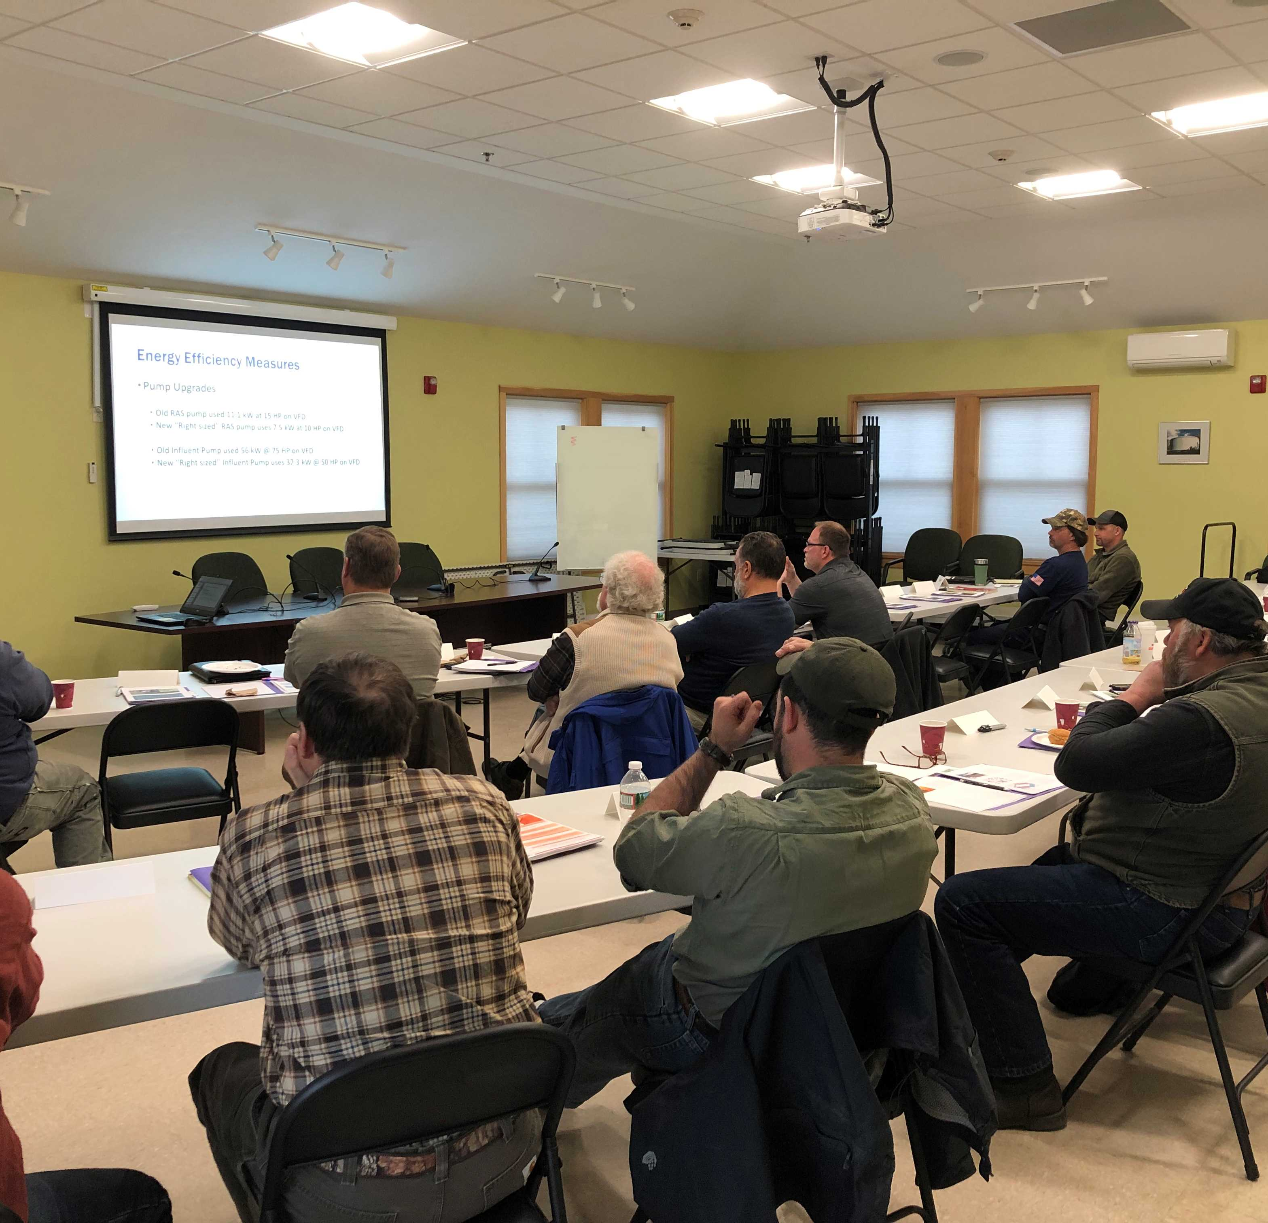
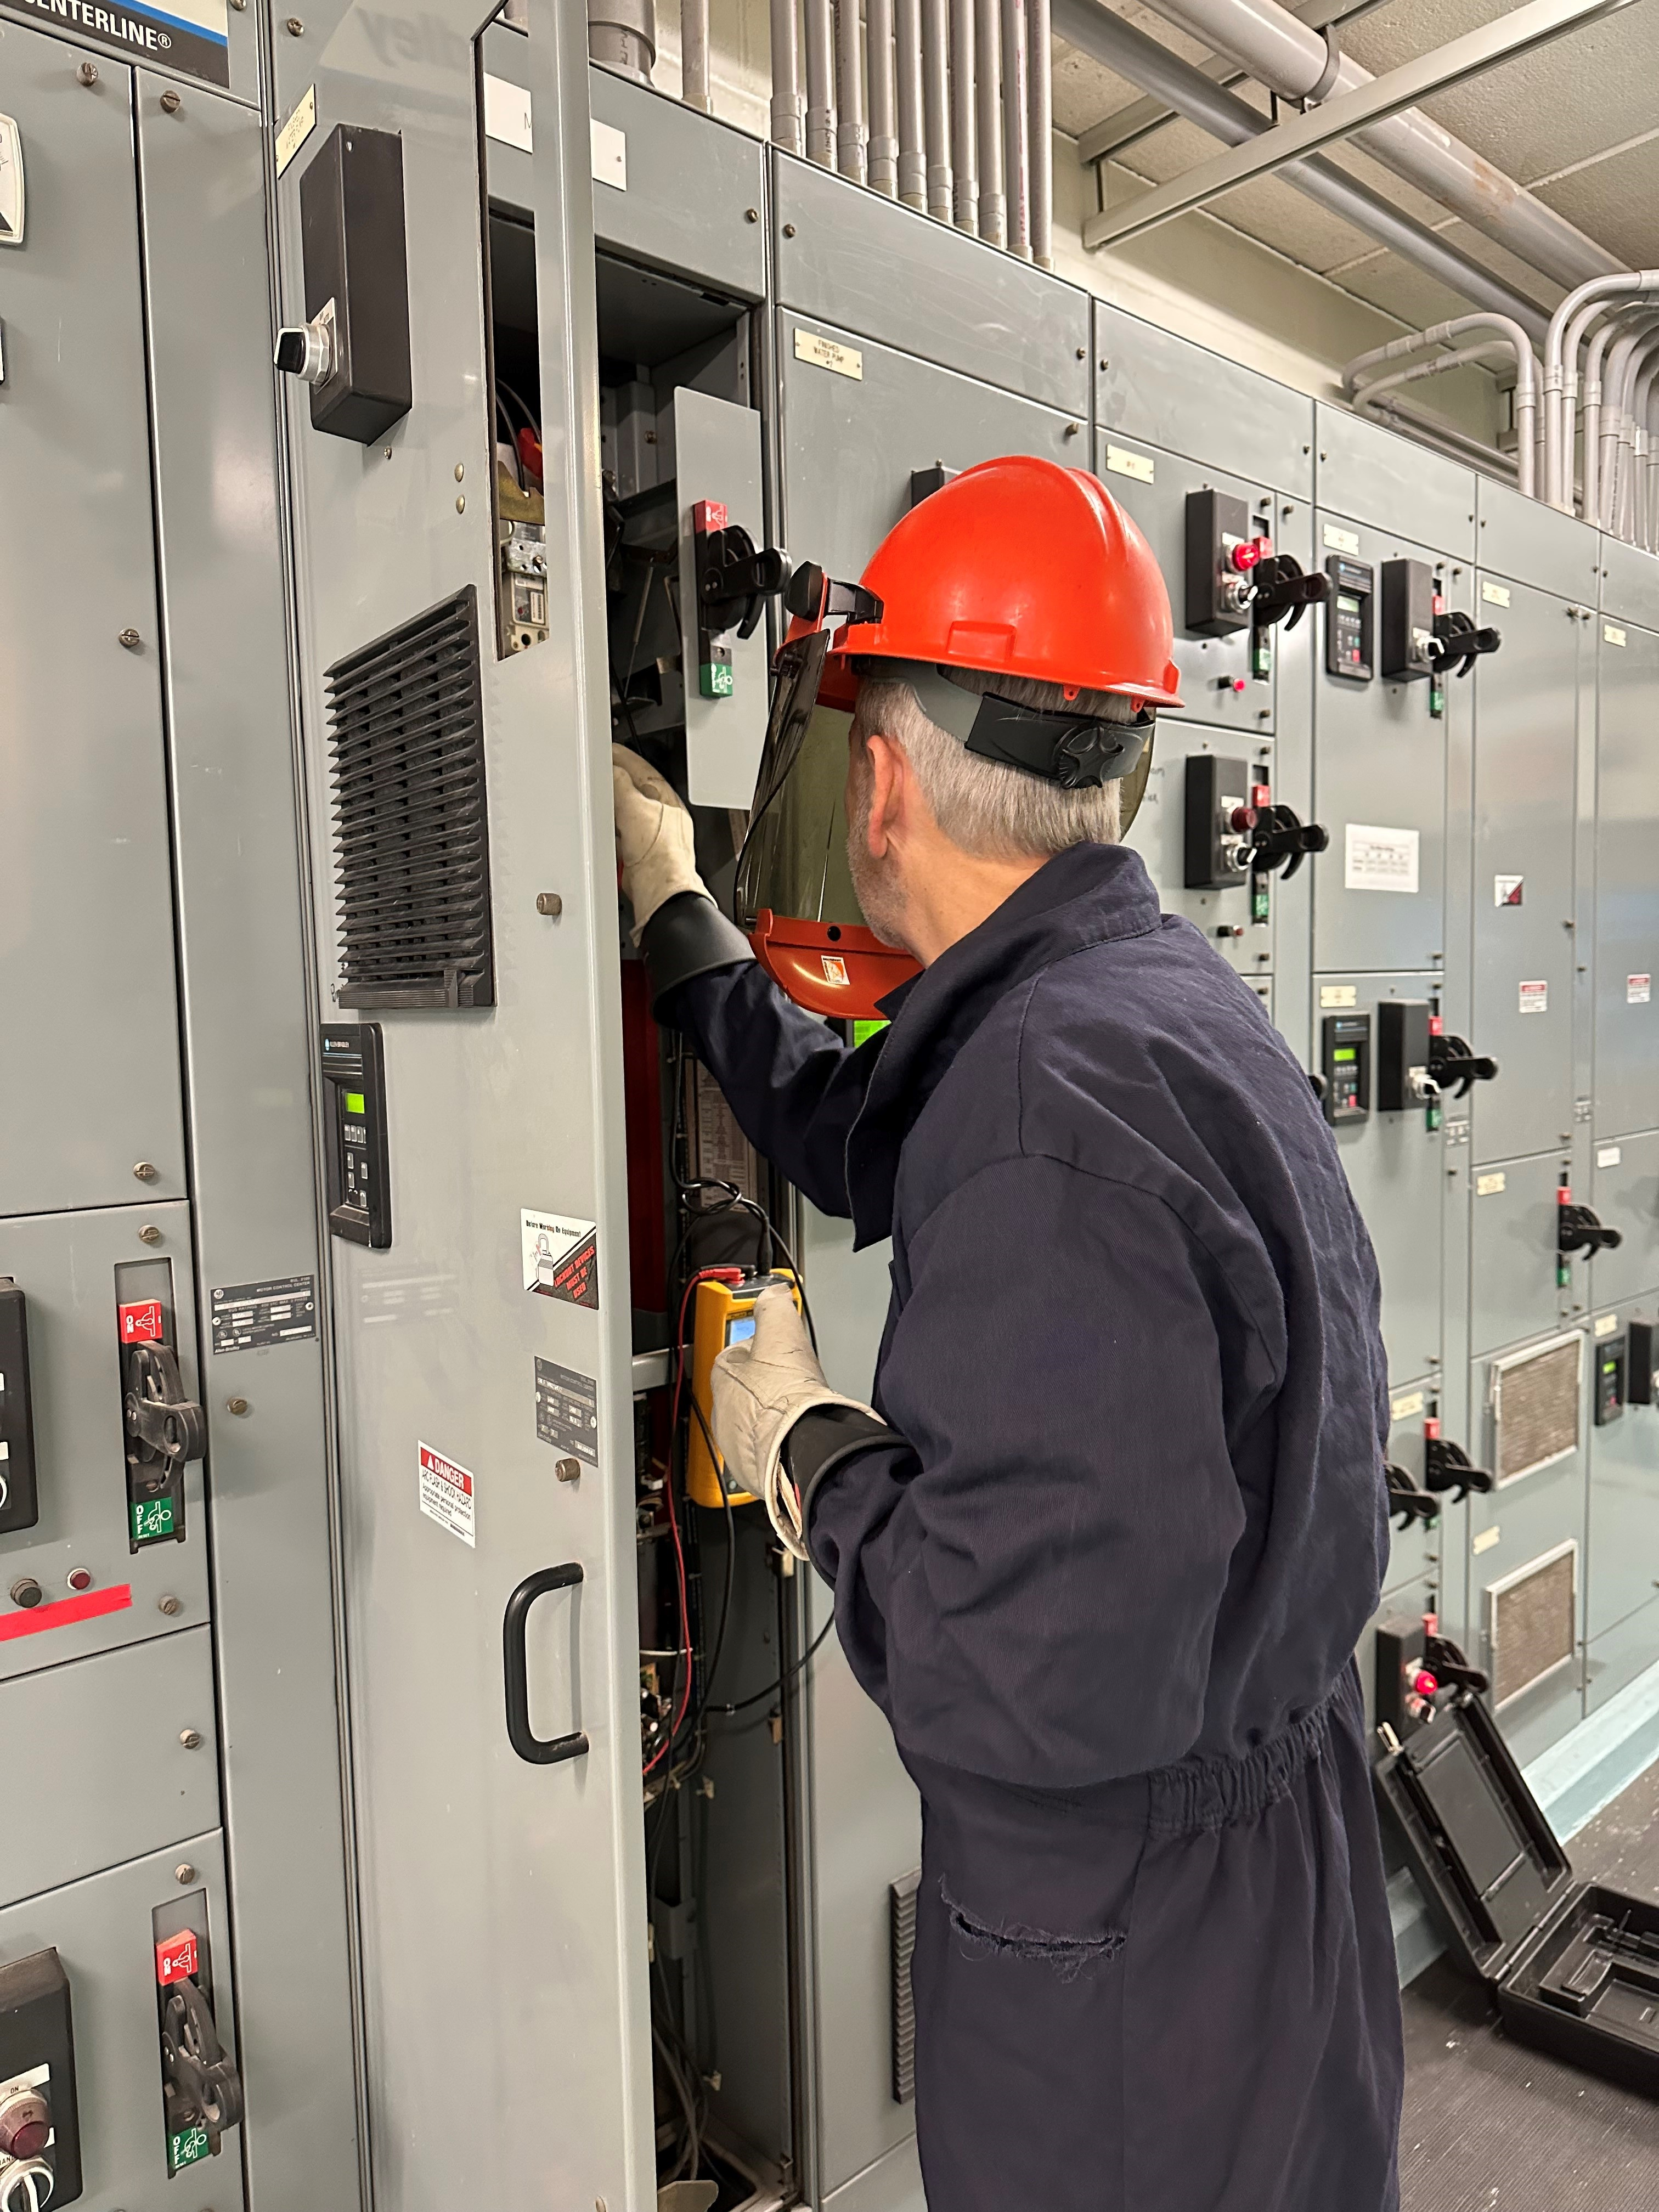
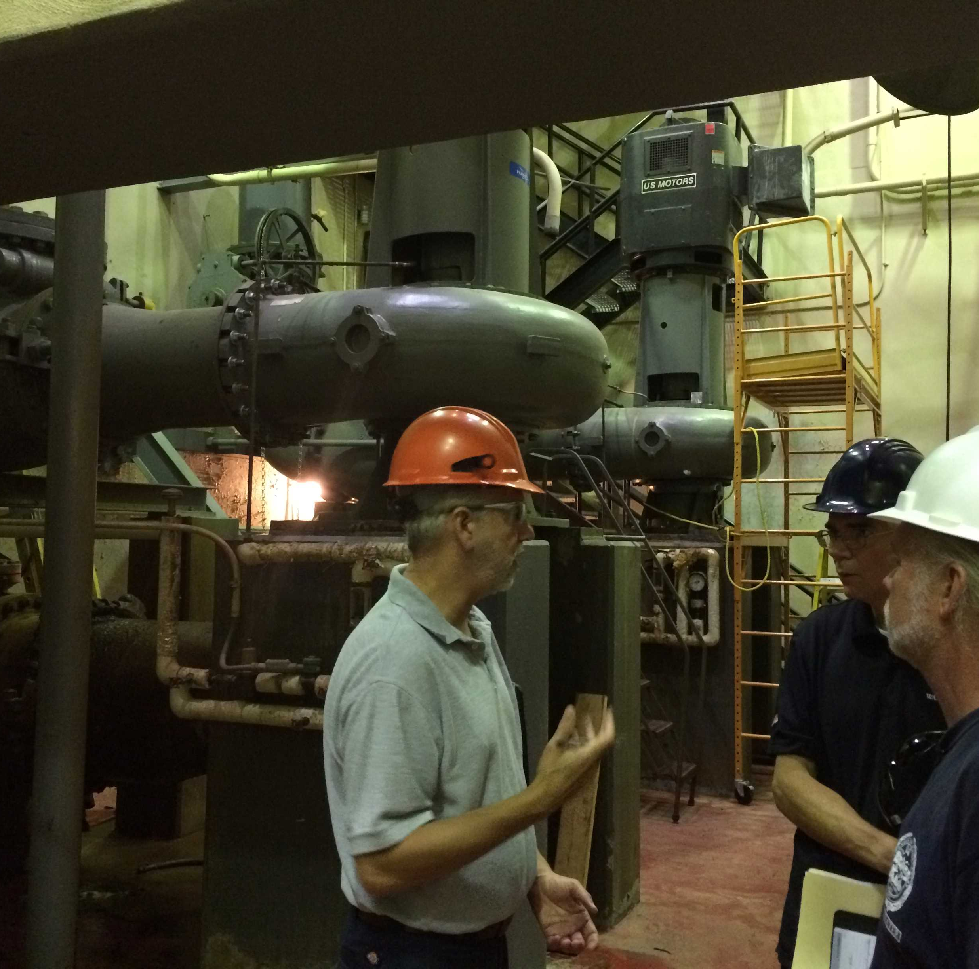
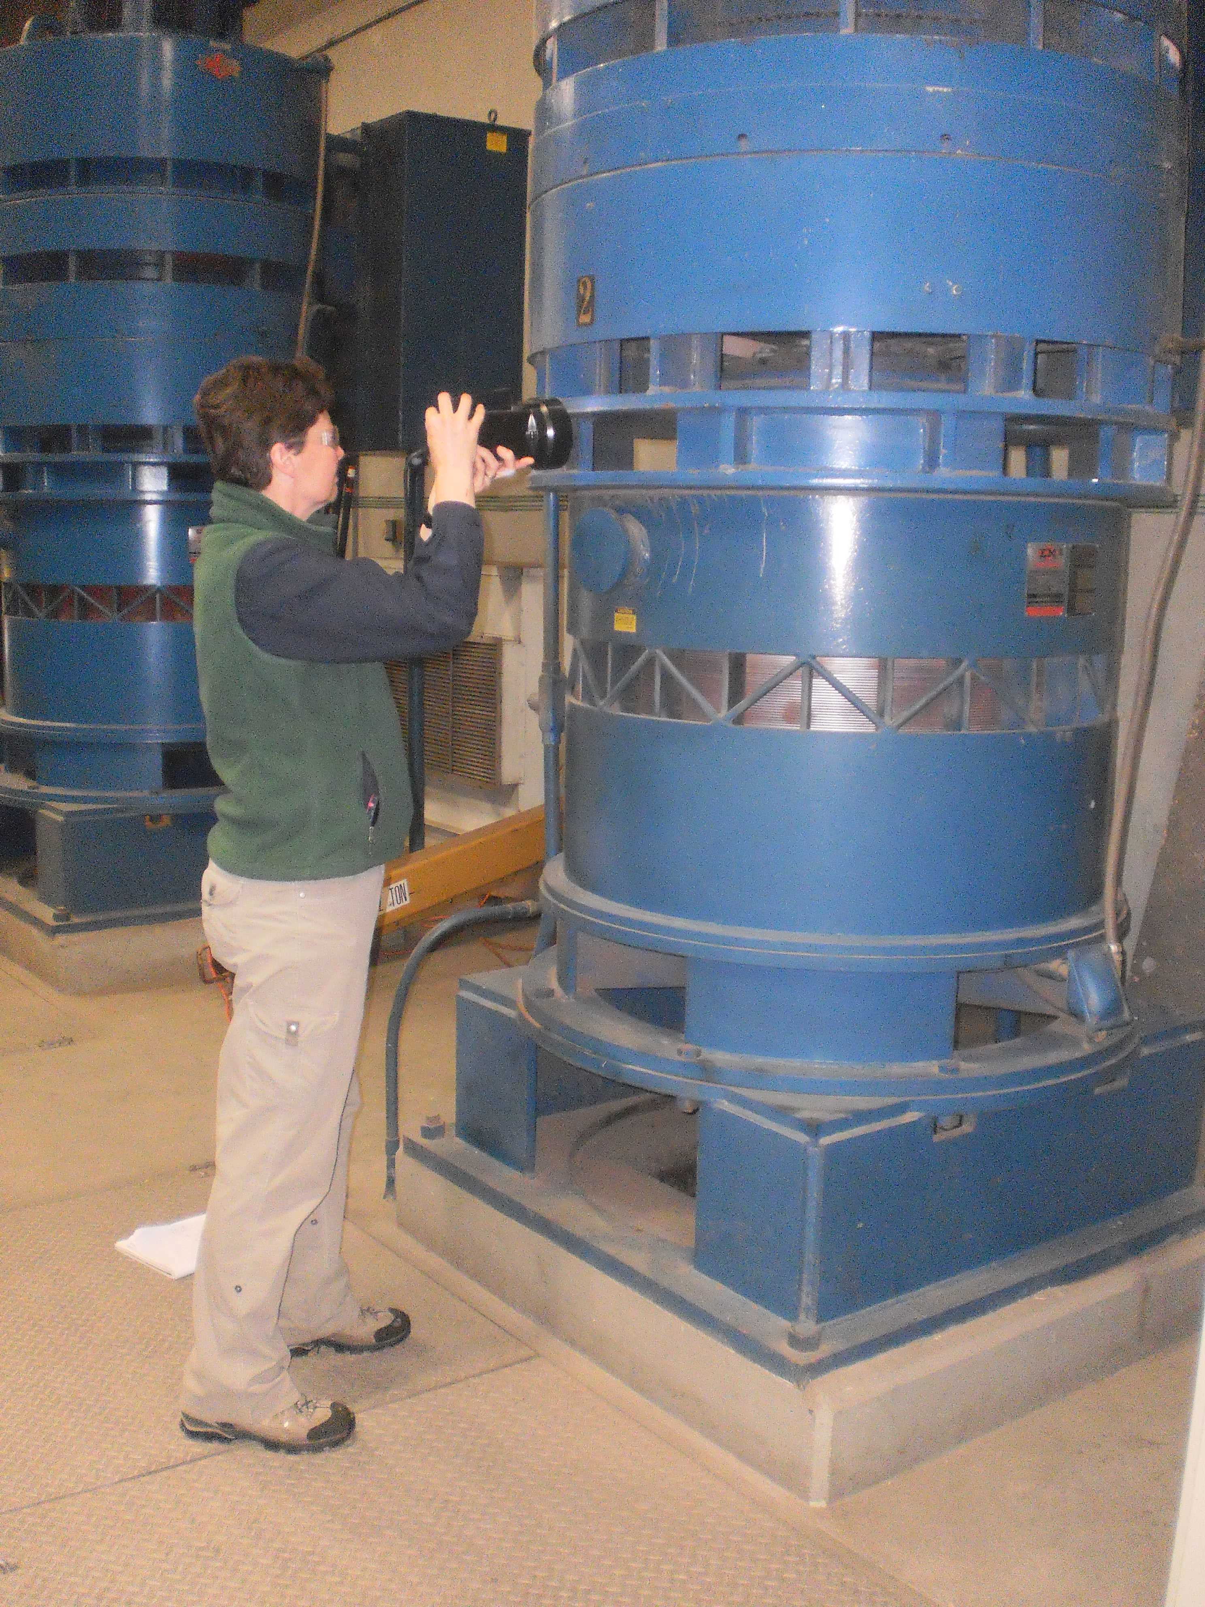
What’s Included?
Education
Comprehensive Process Level
Energy Audits
Technical Assistance
Implementation Assistance
Funding Assistance
Partnerships

Slide 4
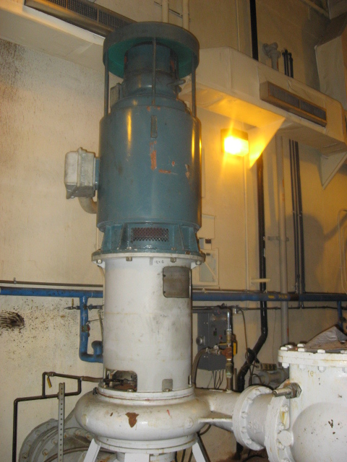
Energy Audit Findings
Wastewater
28% Overall Energy Use (average)
3-59% Range of ID’d EE savings
3.1 year average simple payback
    (Before incentives)
53 WWTP audits
7 Pump Station only systems
Potential Savings

Slide 5
EE Implementation Costs = $8M
Energy Cost Savings = $2M/year
Does not include solar or other RE projects

Slide 6
Energy Audit Findings
Drinking Water
23% Overall Energy Use (average)
2.5 year average simple payback (Before incentives)
41 audits
Potential Savings

Slide 7
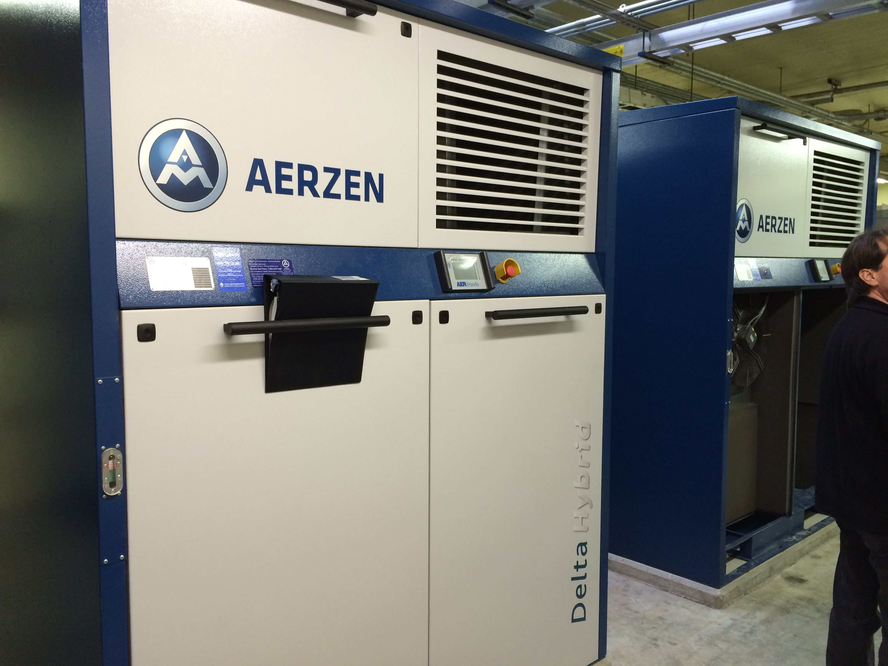
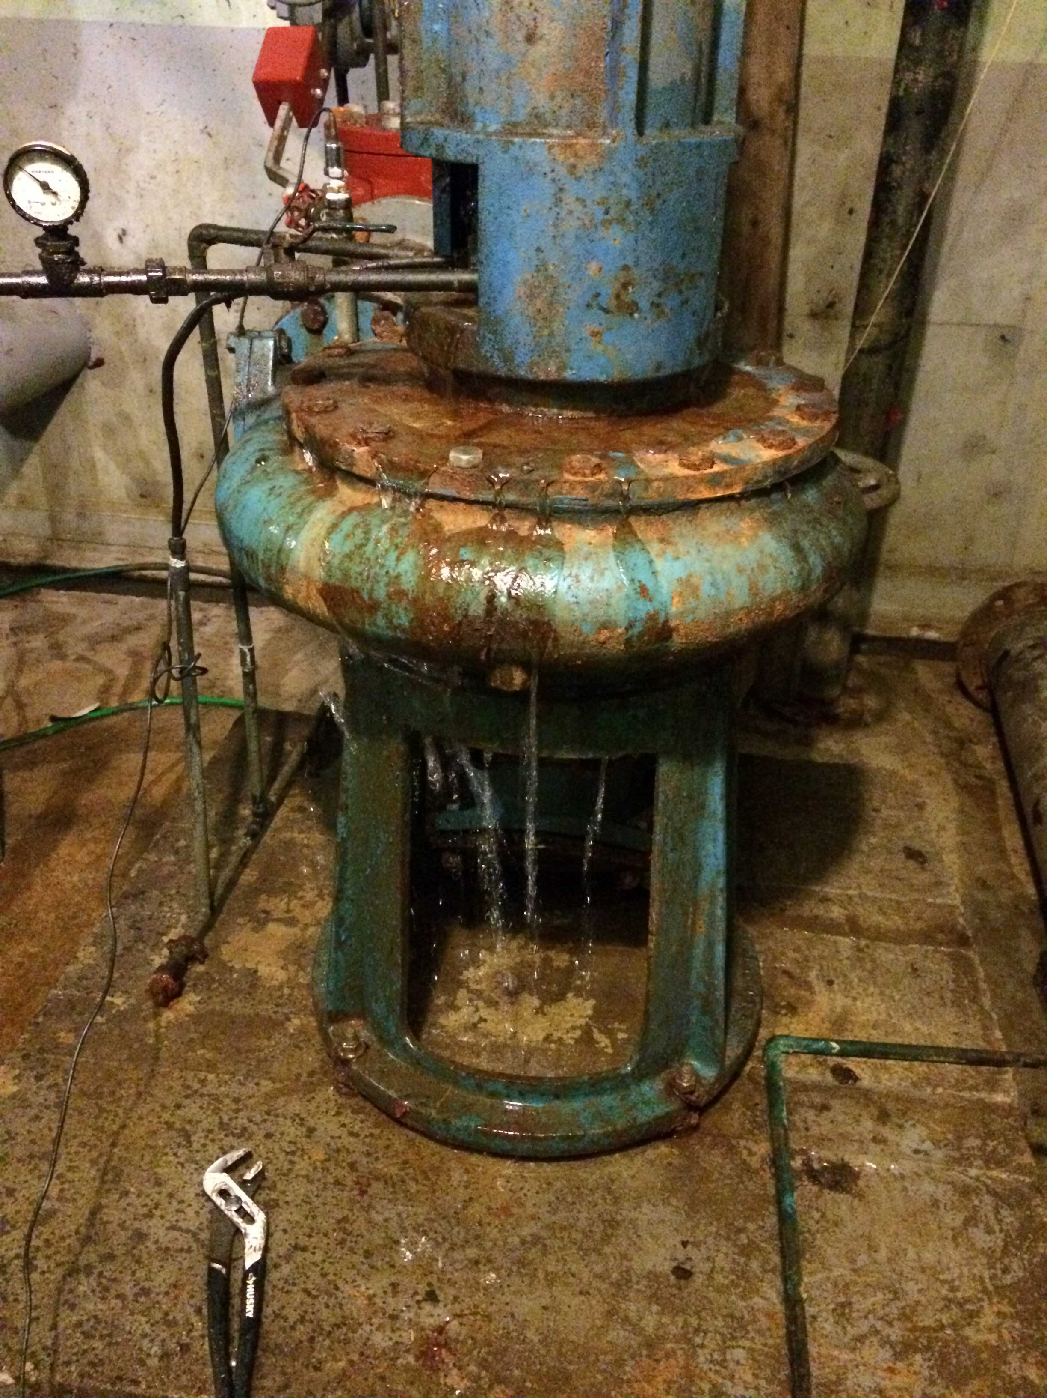
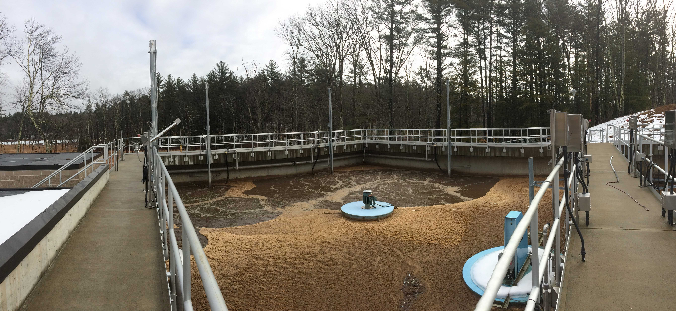
Barriers to implementation
Lack of Funding
Authority to borrow
Competing priorities
Lack of understanding of:
  Energy use
  Asset management
  Business case development

Slide 8
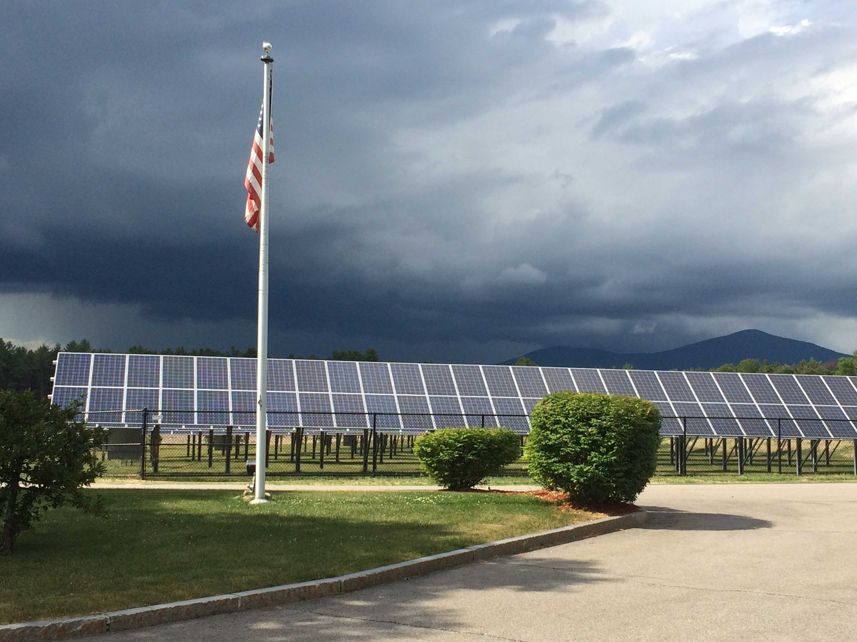
Beyond
Energy efficiency

Slide 9
Net Zero
Energy Use
Potential

Slide 10
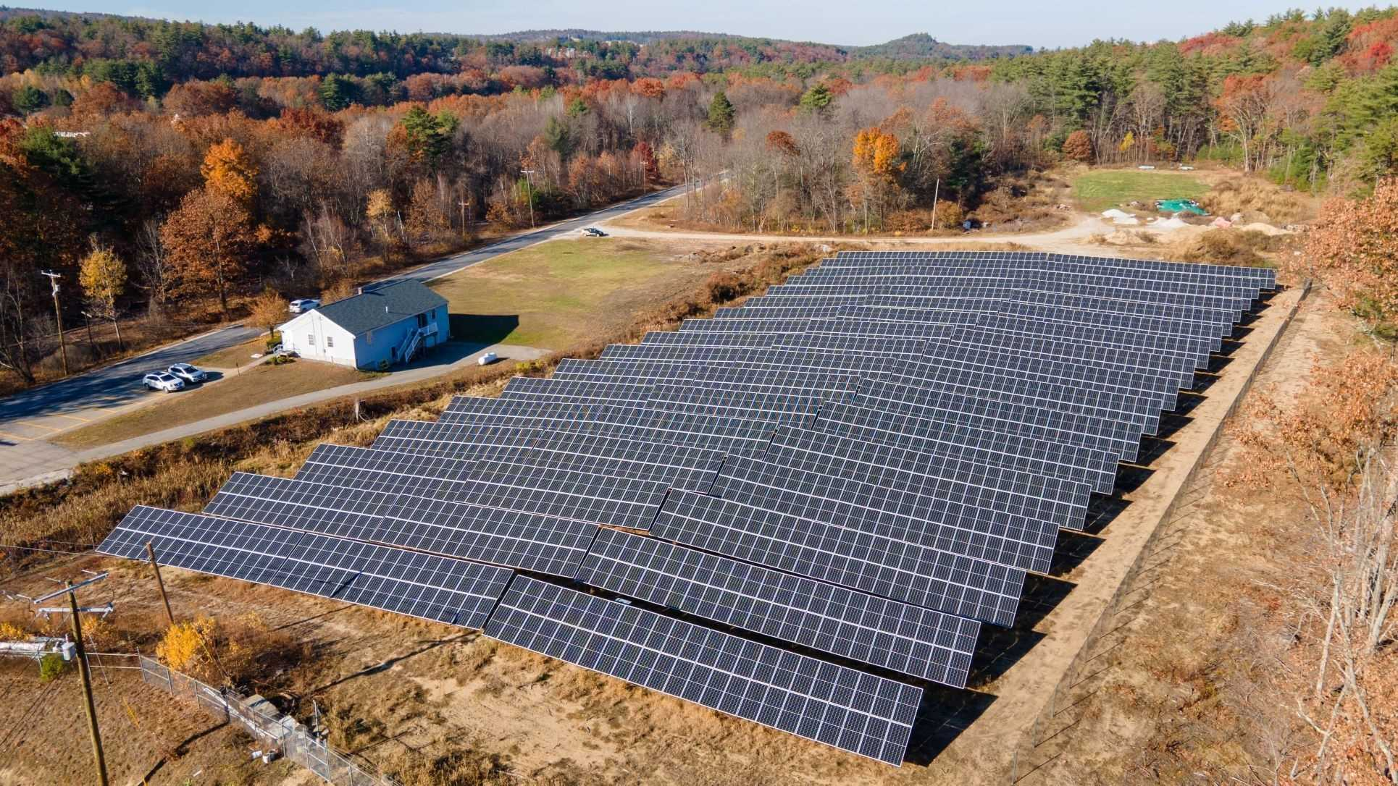
Beyond
Energy efficiency
10 DWS solar arrays proposed at cost of $7.8M
12 WWTP solar arrays proposed at cost of $10.4M
Total kWh savings 6.103MkWh for 22 facilities
Through EE + RE
    Achieving net zero energy use facilities
    Cost savings should be invested back into aging infrastructure

Slide 11
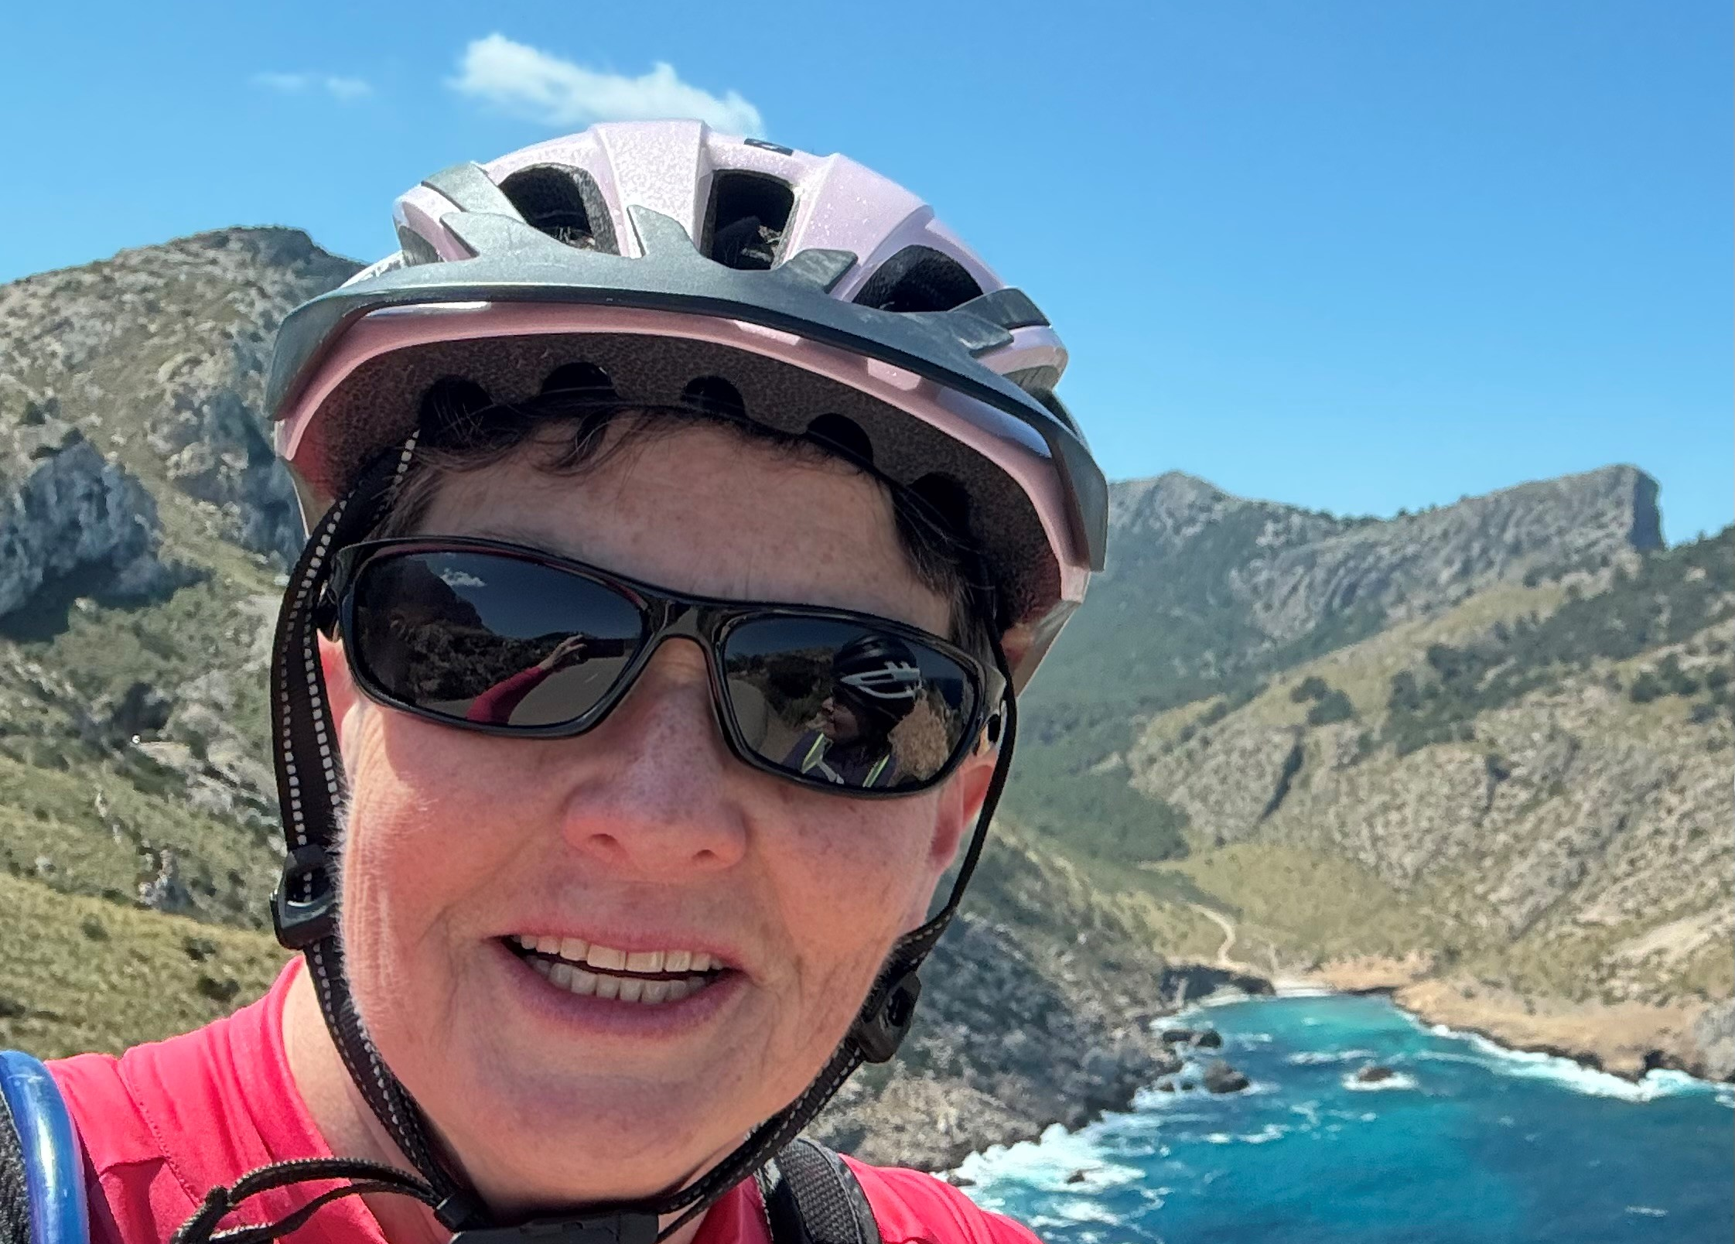
2024 NECPUC Conference water
Infrastructure energy program
(WIEP)
Sharon L. Nall, P.E.
Sharon.L.Nall@des.nh.gov

