Slide 1
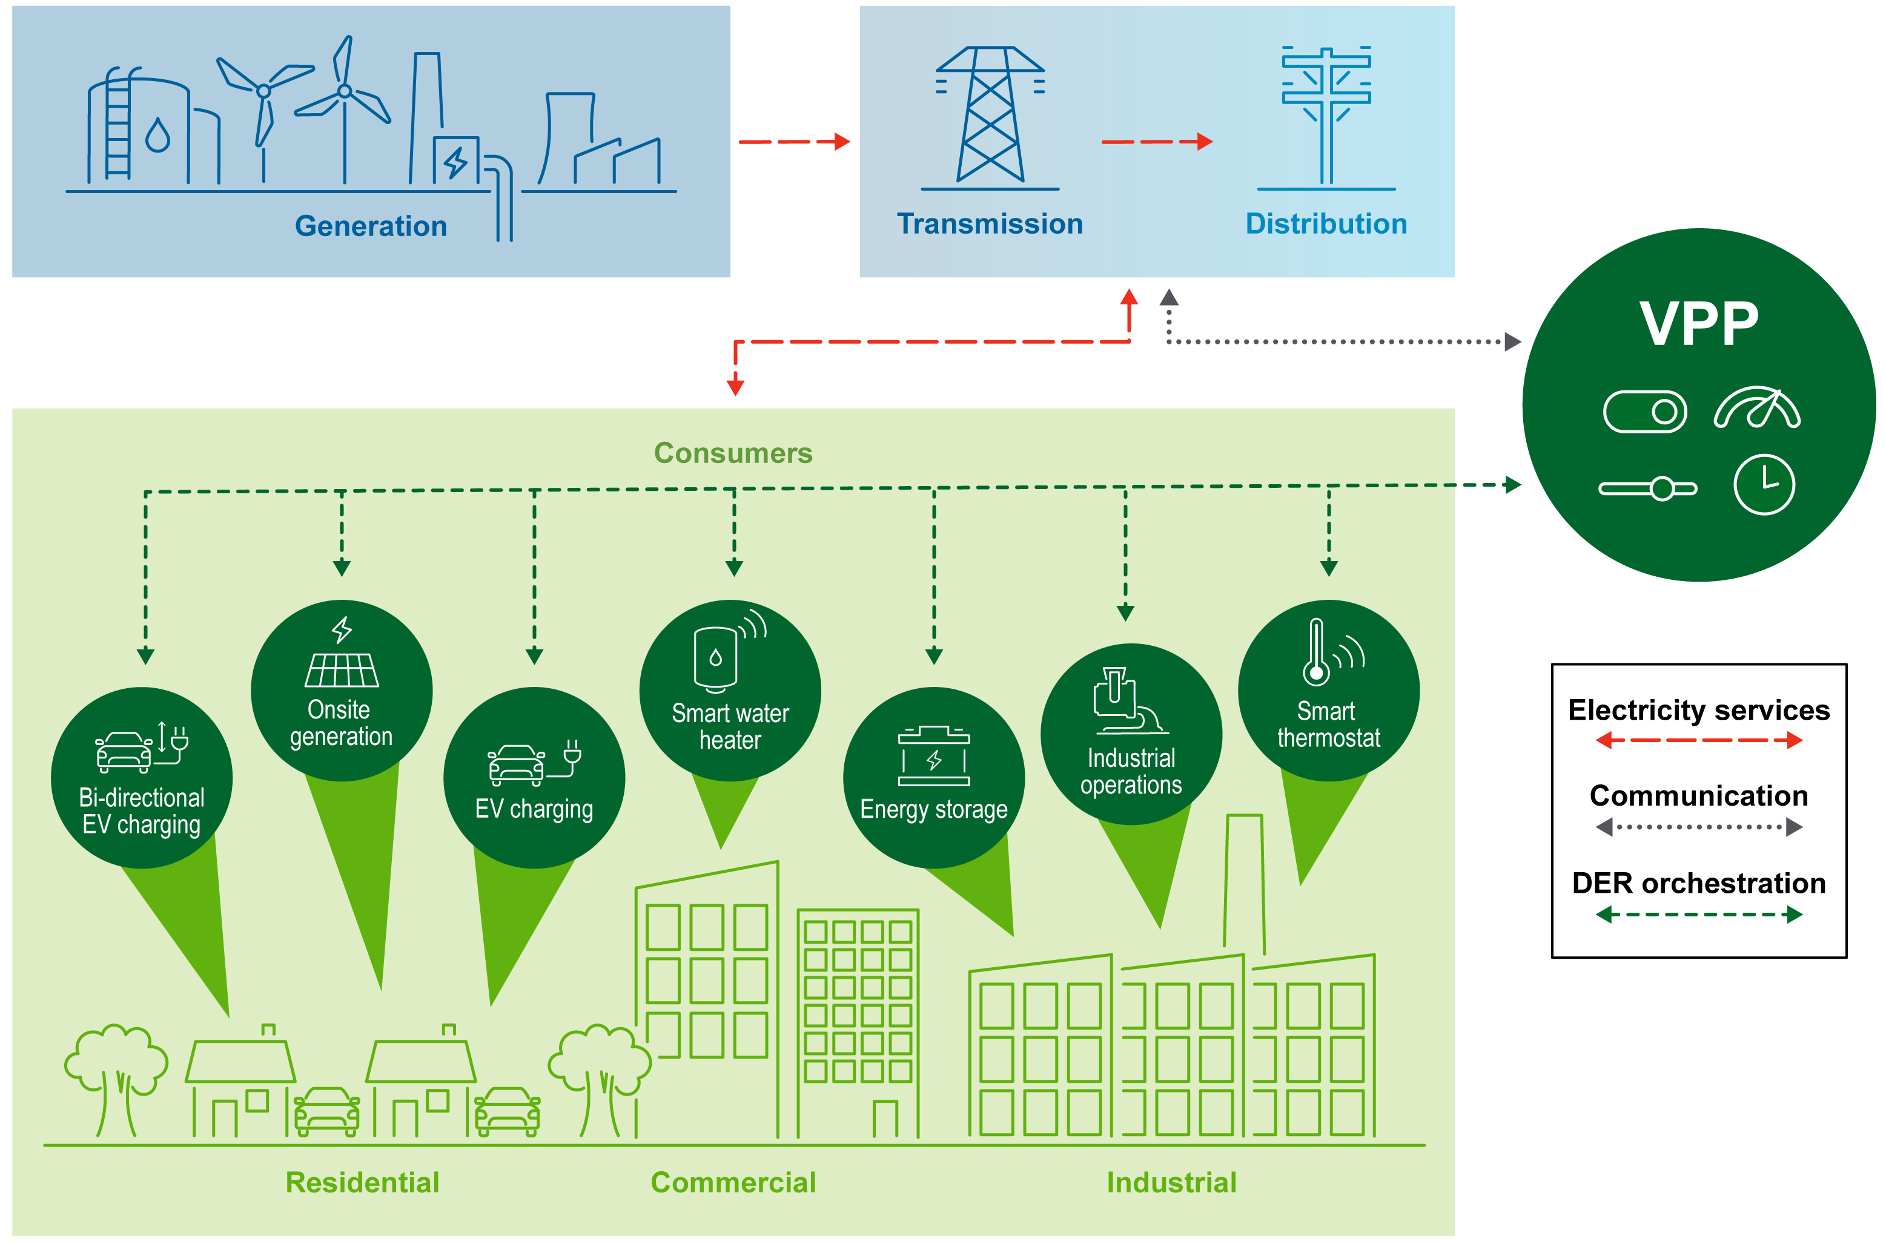
What is a VPP?

Slide 2
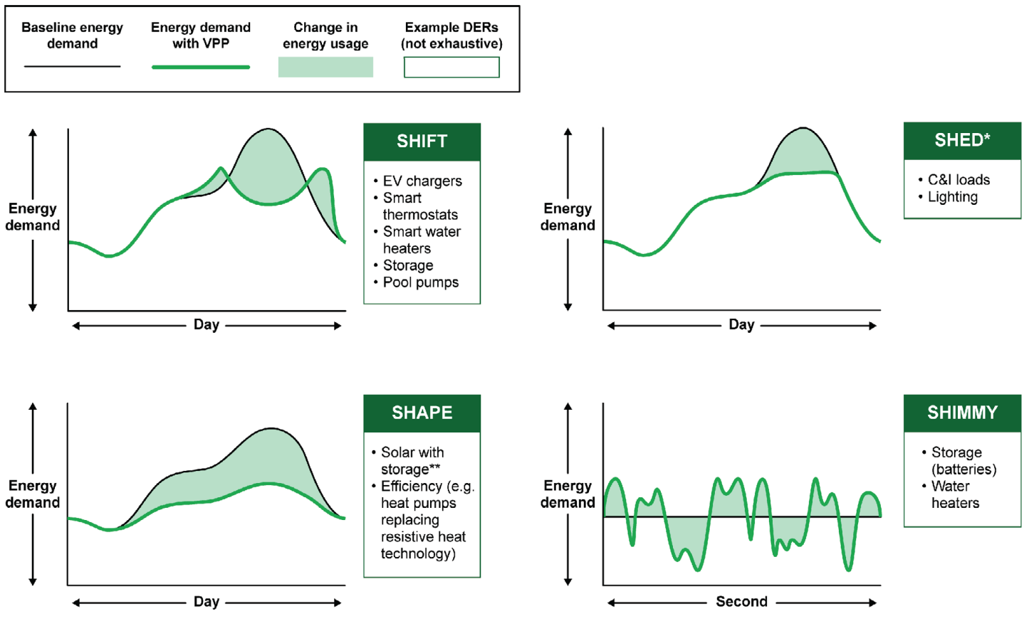
One critical function of VPPs is to use DERs to reduce demand peaks
Source: Adapted from Lawrence Berkeley National Laboratory and NASEO-NARUC Grid-Interactive Buildings Working Group.

Slide 3
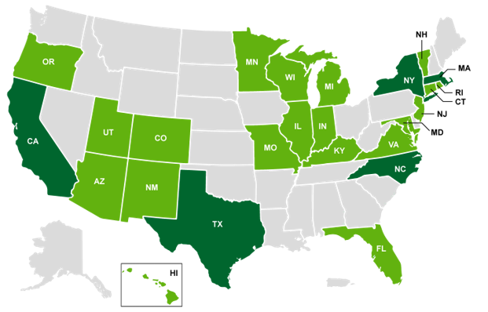
VPPs are concentrated in a few states with favorable market mechanisms in wholesale and retail markets
Number of 3rd party VPPs procured by utilities in each state (2022)
VT
More than 10
1 to 10
No data
Source: Wood Mackenzie Grid Edge Service. Industry interviews.

Slide 4
Pathways to Commercial Liftoff
Virtual Power Plants | September 2023

