Slide 1
Subsidizing the Energy Transition:
Cost of Internalizing the Externality
NECPUC 76th Symposium: Plenary Session
May 20, 2024

Slide 2
Subsidies Govern the GHG transition
Subsidies keep prices for customers below market levels or for suppliers above market levels, or reduce costs for customers and suppliers
Subsidies assume form
  Federal Tax Credits (ITC, PTC, tax shield)
  State sponsored procurements (wind, solar, storage, wire)
  Mandates (RPS)
  Regulations (Permitting exemptions)
Subsidies are baked into the topology of the transition

Slide 3
History of Federal Support for Electricity Transition
Price-Anderson Act
Established accident liability limits for the nuclear industry
FERC Order 636
Securitizing stranded cost liabilities
Clean Energy Transition
Decarbonization goals, new technologies, Climate funding through IRA ($369 billion), IIJA ($62 billion)
1957
1978
1992
Late 1990s-2010s
Last 10 years
Public Utility Regulatory Policies Act (PURPA)
Natural Gas Policy Act
Deregulation of wellhead price controls
Standard Market Design
NRC, The Price-Anderson Act: 2021 Report to Congress, page xvii, https://www.nrc.gov/docs/ML2133/ML21335A064.pdf
DOE, The Infrastructure Investment and Jobs Act: https://www.energy.gov/sites/default/files/2022-09/FECM%20Infrastructure%20Factsheet-revised%209-27-22.pdf
IRS, Fact Sheet, https://home.treasury.gov/system/files/136/FactSheet-Implementing-IRA-Climate-CleanEnergy-TaxIncentives.pdf.

Slide 4
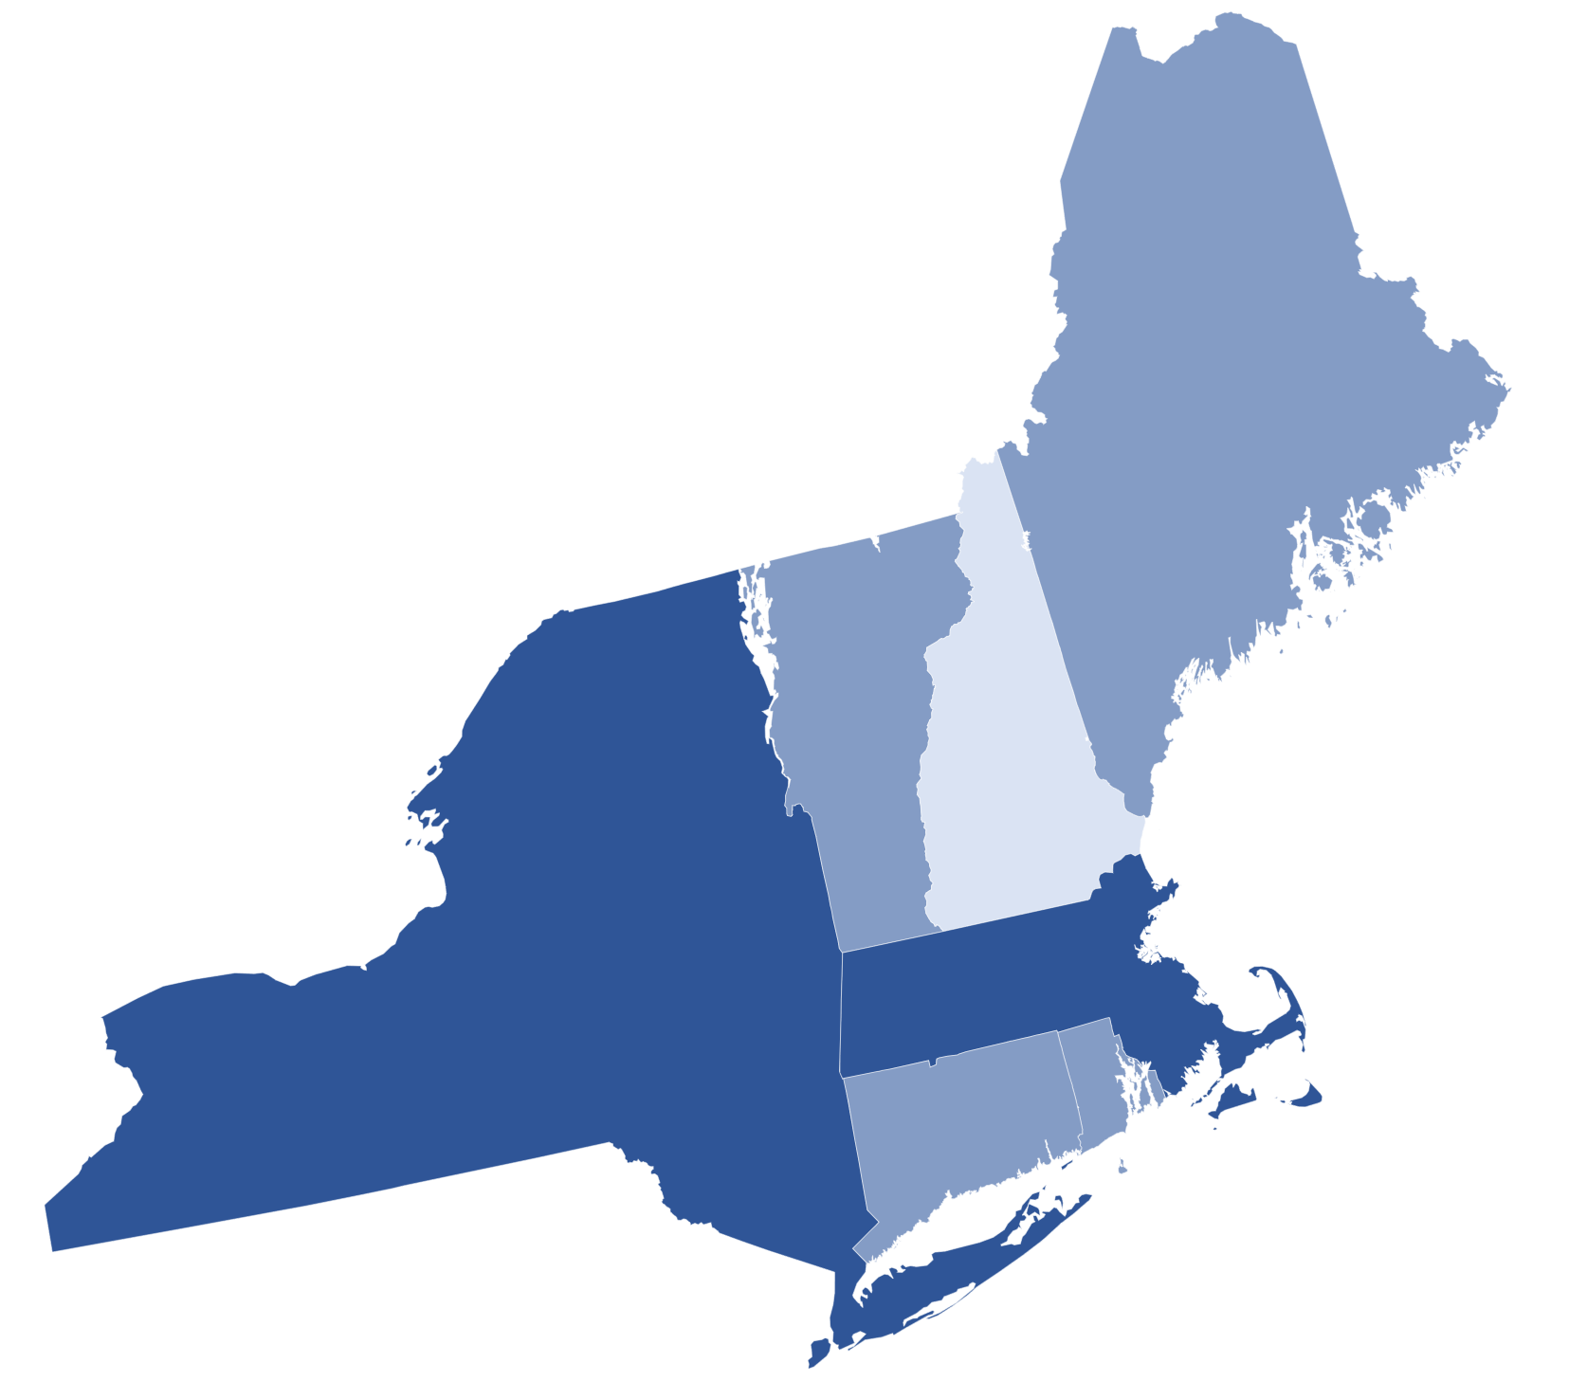
Northeast 2050 Decarbonization Targets
Aggressive emissions reduction targets through 2050
  5 of 6 NE states have legislative mandates
State policies drive ISO-NE's resource mix
Uncertainty factors re pace of change
NH*
80% by 2050
VT
80-95% by 2050
ME
80% by 2050
NY
Net Zero by 2050
MA
Net Zero by 2050
 | Net Zero by 2050
 | 80% Reduction by 2050
 | Aspirational
RI
80% by 2050
CT
80% by 2050
NCEC, Northeast Climate Goals Drive Opportunity for Clean Energy Deployment, June 2021,
https://www.necec.org/blog-details/northeast-climate-goals-drive-opportunity-for-clean-energy-deployment

Slide 5
Status of Gas for Generation
Share of electric demand served by gas-fired generation has increased
  Rapid anticipated marginalization of gas fleet
  Ascension of Variable Energy Resources through 2040
ISO-NE, New England’s Changing Resource Mix and Planning for the Future Grid, August 21, 2023,
https://www.iso-ne.com/static-assets/documents/2023/08/8-21-neppa-keynote-gvw-isone.pdf

Slide 6
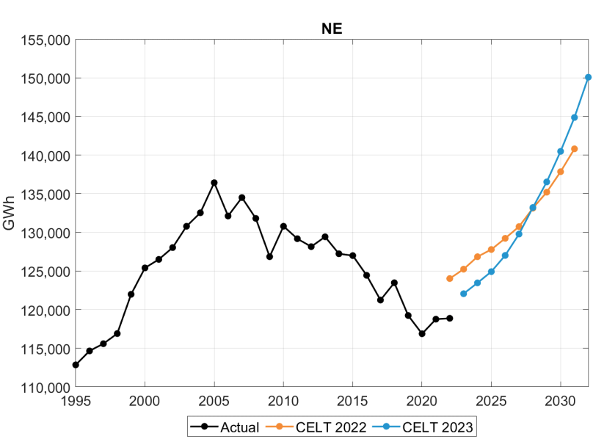
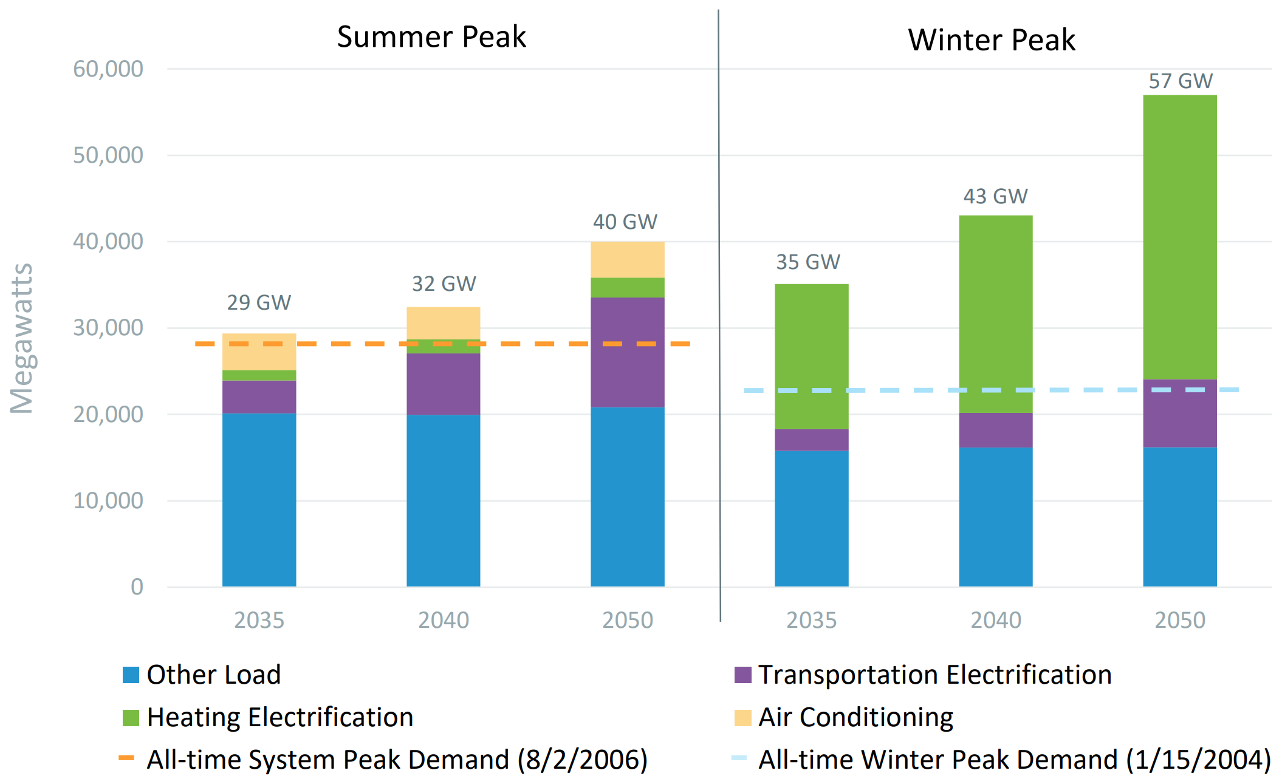
Electricity Demand
Heating electrification will cause ISO-NE to shift from Summer to Winter-peaking
2005-22: Declining demand due to efficiency improvements
2023+: Nationwide trends reflected in New England (Electrification, data centers, EV)
ISO-NE, 2023 Final Draft Energy and Seasonal Peak Forecasts, APRIL 14, 2023, page 17. https://www.iso-ne.com/static-assets/documents/2023/04/lf2023_finaldraft.pdf
ISO-NE, The Changing System Over the Next Ten Years and Beyond, APRIL 26, 2023, page 13. https://www.iso-ne.com/static-assets/documents/2023/05/ebc_presentation_final.pdf

Slide 7
Clean Energy Transition in NE
ISO New England’s Role in the Clean Energy Transition, March 30, 2023. Page 7
https://www.iso-ne.com/static-assets/documents/2023/03/clg_mtg_ethier_iso_energy_transition_ppt_mar_30_2023_final.pdf

Slide 8
Recently Announced OSW Clearing Prices
New Jersey's 3rd solicitation, January 2024:
  Leading Light Wind: 2,400 MW
  Attentive Energy : 1,342 MW
  Levelized OREC Purchase Prices: $139/MWh (LLW); $165/MWh (Attentive)
New York's 4th solicitation, February 2024:
  Empire Wind: 810 MW
  Sunrise Wind: 924 MW
  Weighted average all-in : $150/MWh
NJBPU Board Orders, https://www.nj.gov/bpu/pdf/boardorders/2024/20240124/8A%20ORDER%20Solicitation%203%20Invenergy.pdf, https://www.nj.gov/bpu/pdf/boardorders/2024/20240124/8A%20ORDER%20Solicitation%203%20Attentive.pdf
NYSERDA Announcement, https://www.nyserda.ny.gov/About/Newsroom/2024-Announcements/2024_02_29-Governor-Hochul-Announces-Two-Offshore-Wind-Project_Awards

Slide 9
Ratepayer Subsidy from Offshore Wind

Slide 10
Annual Subsidy Allocated to Participating State Retail Load

Slide 11
Key Takeaways
Material subsidies are an integral part of the energy transition and cannot be avoided
Both Federal and state subsidies are required to effectuate the transition in New England
State procurement goals necessitate long term ratepayer support for OSW, utility scale solar, batteries, HVDC transmission
Subsidies will pancake over time in response to heavy VER penetration
Laudable climate goals require financial and ratepayer innovations

Slide 12
Financial Challenges
Who pays, what are they paying for, when do they pay?
Are business-as-usual ratemaking practices realistic to support the transition?
  Issuance of medium term or long-dated state general obligations to securitize all or a part of the GHG transition
  Progressive income tax reform to yield discretionary funds to mute the onus on overburdened communities
  Rate design at the electric and gas distribution company level based on needs test
Is it worth a penny or two per kWh to help save the mother ship?

Slide 13
Key Assumptions for Offshore Wind Subsidy
PPA Term- 20 years
Inflation Rate – 2.50%
Nominal Discount Rate – 4.00% (Social discount rate)
“Present Value” Year - 2029
Market Value of PPA Products
  Wholesale energy $40.00 / MWh (Level nominal $)
  Tier 1 RECs $40.00 / MWh (Level nominal $)
OSW Project Assumptions
  Project 1 2 3 4 5 6
  First Year 2025 2030 2032 2034 2036 2038
  Capacity (MW) 800 1,200 1,200 1,200 1,200 1,200
  LCOE (Nom $/MWh) $150 $150 $150 $150 $150 $150
  Annual Capacity Factor 47% 47% 47% 47% 47% 47%
This is a speaker note not tobe included in the deck for presentation

