Slide 1


Slide 2

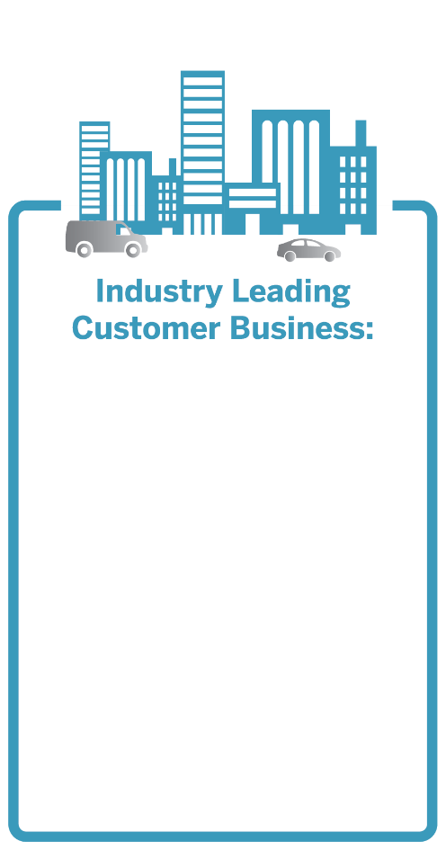
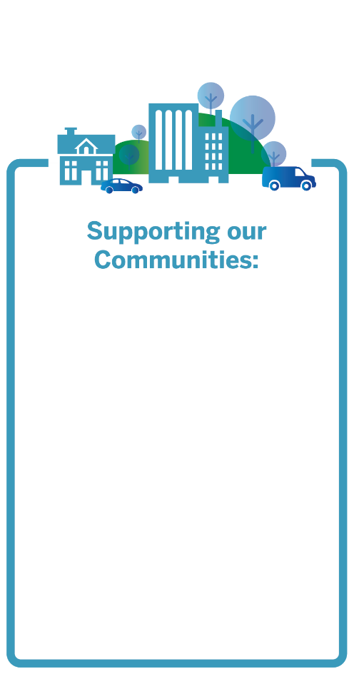
About Constellation
#1 provider of carbon-free 24/7 energy in the United States
Lowest carbon emissions and carbon intensity generator in the United States
32,400 MW of total generating capacity
~78 million metric tonnes of carbon avoided through our fleet
94.3% capacity factor at nuclear plants
Ability to extend fleet to 80 years – providing 24/7 carbon-free power through 2050 and beyond
#1 in market share for Commercial and Industrial customers
#2 retail electricity provider
#3 in market share for mass market customers
Top 10 natural gas provider in the U.S
Serve ¾ of the Fortune 100
2 million total customers
215 TWh of load served
Operate in 48 states and the District of Columbia
Fortune 200 company, based on $24.9 billion in operating revenues in 2023
Approximately 14,000 employees nationwide
Investing in local communities through $207 million in local property taxes and $87 million in state payroll taxes
Employees volunteered nearly 102,000 hours in 2023
Increasingly diverse workforce, with strong diverse hiring and promotion rates and community workforce development partnerships

Slide 3



A Customer’s Sustainable Energy Journey
Step 3: 24/7 Carbon-Free Energy
(Eliminating emissions)
Goal to match energy consumption with nearby (same regional pipeline or grid) low-carbon/renewable energy purchases
Sample Solutions:
Local offsite renewable electricity
Hourly carbon free energy matching
Local Renewable Natural Gas (RNG)
Dev/Future Solutions:
Carbon Capture & Sequestration (CCS)
Direct Air Capture (DAC)
Step 2: 100% Renewable Energy
(Reducing emissions)
Goal to reduce energy usage and/or match energy consumption with low-carbon/ renewable energy purchases
Sample Solutions:
Energy efficiency
Offsite renewables electricity
Electrification applications
Fuel switching to low-carbon fuels such as Renewable Natural Gas (RNG)
Step 1: Carbon Neutrality
(offsetting emissions)
Goal to be 100% carbon neutral
Sample Solutions:
RECs
Carbon Offsets
Source: https://www.greenbiz.com/article/5-predictions-corporate-renewable-energy-market-2021
© 2023 Constellation Energy Resources, LLC. The offerings described herein are those of either Constellation NewEnergy, Inc. or Constellation NewEnergy-Gas Division, LLC, affiliates of each other.
Brand names and product names are trademarks or service marks of their respective holders. All rights reserved. Errors and omissions excepted.

Slide 4
Hourly Matching Supports the Evolution of Clean Energy Procurement
Today, most U.S. grids rely on a diverse set of generation resources to match supply with customer consumption on a 24/7 basis, and unabated fossil resources are relied on to supply much of the firm and dispatchable power when renewable generation is not available.
Hourly tracking of carbon-free energy (CFE) brings focus to the technologies, policies, and market mechanisms needed to balance carbon-free generation and load and to reliably and affordably decarbonize the U.S. electric grid.
Hourly matching supplements annual matching, giving buyers, generators, and policy makers the ability (but not obligation) to track progress toward decarbonization in every hour of the year.
From Annual Matching…
…To Hourly Matching

Slide 5
Hourly Matching Supports Grid Reliability
Buyers who do not incorporate time- or location-matching principles in their procurement goals are relying on other customers, many of whom may be indifferent to their climate goals, to help balance the grid.
Full decarbonization of the power grid will only be achieved when clean generation is available to meet all customer demand at all times.
Hourly carbon-free procurement sends a market signal to retain and expand clean resources able to deliver at times of high customer demand, reducing the need for grid operators to rely on fossil generation to maintain grid reliability.
5

Slide 6
New England Load Match
Renewable generation equal to 100% of load on an annual basis would only match about 73% of hourly New England regional load. The hourly time-match of renewable generation begins to deviate from the annual total at a roughly 40% annual RPS target.
The declining load match of each increment of wind/solar above 40% highlights the challenges of a renewable-only program in eliminating carbon emissions resulting from electricity consumption in New England.
A 24/7 carbon-free electricity requirement will maintain existing and incentivize new firm zero-emission generation in order to fully decarbonize the electric sector over time at the lowest cost.
Assumes RPS of 70/30 Wind/Solar
Based on 2021 ISONE data for hourly load, hourly Wind gen, and hourly Solar gen
6

Slide 7
Operationalizing Hourly CFE
Customers work with Constellation to have their electricity consumption matched with attributes (e.g., RECs or EFECs) from carbon-free generators in their grid each hour.
Each hour’s match is reported on demand through Constellation's Energy Manager portal, with hourly time-stamped attributes retired at year-end in PJM GATS (the GIS equivalent for PJM).
Existing sustainability solutions – on or offsite renewables, storage, efficiency products – can be integrated into the overall portfolio, and hourly CFE can be added into existing supply products without a long-term commitment.
From Annual (Compliance)
To Hourly(Voluntary)
7
© 2024 Constellation Energy Resources, LLC. The offerings described herein are those of either Constellation NewEnergy, Inc. or Constellation NewEnergy-Gas Division, LLC, affiliates of each other. Brand names and product names are trademarks or service marks of their respective holders. All rights reserved. Errors and omissions excepted.
Notes:
If matched at 100% both reduce your Scope 2 to zero.
Annual claim for RECs w PPA = Facility is 100% renewable annually. Buyer supported the development of new build renewable
Hourly claim for RECs w PPA and HCFE matching = Facility is 100% carbon free each hour. Buyer supported the development of new build renewable

Slide 8
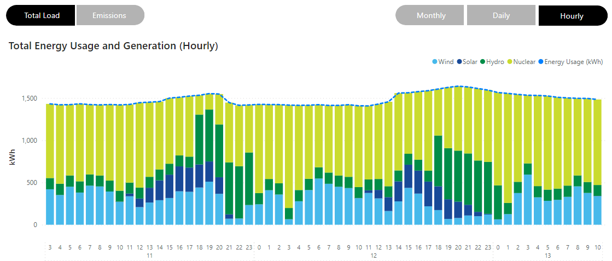
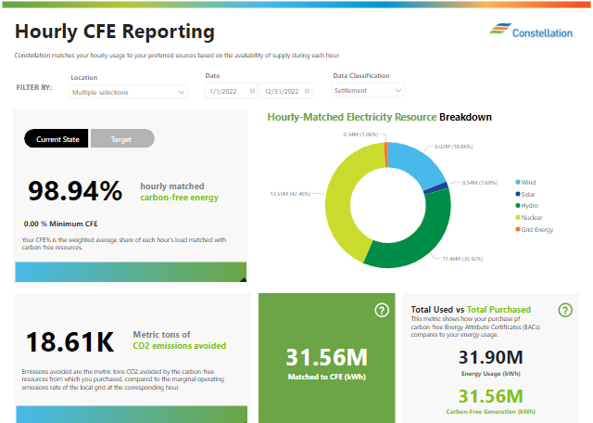
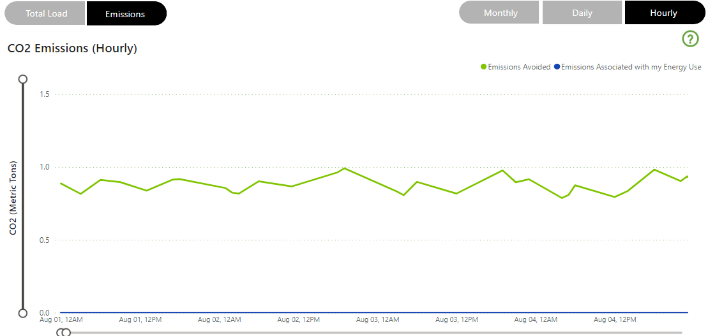
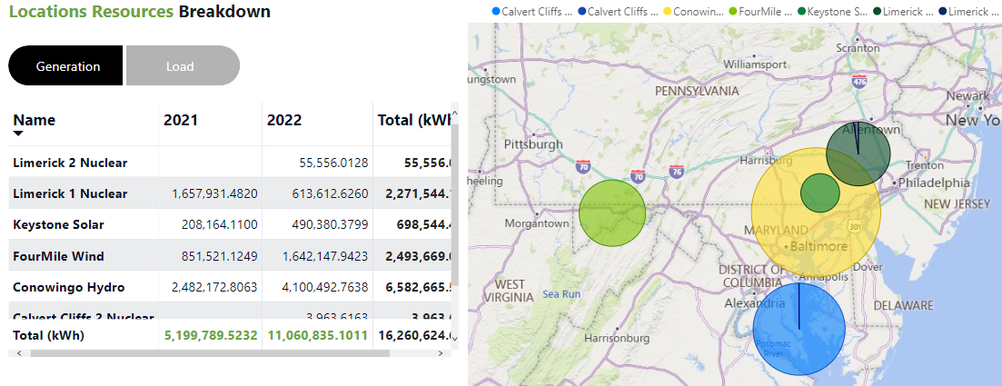
The Constellation Hourly CFE Platform
Launched August 2022
8
© 2023 Constellation Energy Resources, LLC. The offerings described herein are those of either Constellation NewEnergy, Inc. or Constellation NewEnergy-Gas Division, LLC, affiliates of each other. Brand names and product names are trademarks or service marks of their respective holders. All rights reserved. Errors and omissions excepted.

Slide 9



























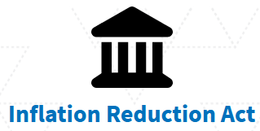





The Hourly Matching Ecosystem Is Developing Rapidly
Technology & Infrastructure
Suppliers
Buyer Community
Constellation
Agreements signed with Microsoft and ComEd
Policy Initiatives
Stakeholder Initiatives
Standards
White House Executive Order 14057
100% CFE + 50% Hourly-Matched by 2030
UN 24/7 CFE Compact
137 Signatories and counting
EnergyTag
Standards and guidelines for Granular Certificates (GCs)
24/7 Carbon-Free Transition Tariffs Project
CRS Clean Energy Accounting Project
137 Signatories and counting
45V Clean H2 Standards
Require hourly matching for electrolytic H2 production
24/7 CFE Interest Group
24/7 CFE Buyers Forum
GHG Protocol Updates
Reporting of hourly CFE under consideration
MA Clean Peak Standard
Hourly CFE is an evolution of existing policy

Slide 10
Tracking Systems Are Taking Up the Challenge
Tracking System | Resources Tracked | Number of RE Generating Facilities* | Hourly Functionality Available | Current Plans to Implement or Expand Hourly Tracking
PJM-GATS | All | 364,936 | Yes | Yes
M-RETS | RE and alternative energy | 3,402 | Yes | Yes
WREGIS | RE | 10,140 (includes ~160,000 aggregated DG units) | No | Yes
ERCOT | RE | 381 | No | Yes
NAR | RE | 884 | Yes (Pilot) | Still in pilot
NYGATS | All | 1,957 | No | No
NC-RETS | RE | 1,393 | No | No
MIRECS | RE | 241 | No | No
Source: CRS, updated to reflect recent initiatives
*Figures as of May 2023
Implementation of hourly tracking in the NEPOOL GIS will be considered by the Members Committee in July

Slide 11
Disclaimer
The information contained herein has been obtained from sources which Constellation NewEnergy, Inc. and Constellation NewEnergy-Gas Division, LLC (collectively, “Constellation”) believe to be reliable. Constellation does not represent or warrant as to its accuracy or completeness. All representations and estimates included herein constitute Constellation’s judgment as of the date of this document and may be subject to change without notice. This material has been prepared solely for informational purposes relating to our business as a physical energy provider. We are not providing advice regarding the value or advisability of trading, or soliciting or accepting orders for, swaps, options or futures, or any other activity which would cause us or any of our affiliates to be considered a commodity trading advisor or introducing broker under the Commodity Exchange Act. These materials are not intended as a recommendation of, or advice in connection with, a municipal financial product or an issuance of municipal securities. Constellation is not a municipal advisor (within the meaning of the Securities and Exchange Commission’s rules as to the Registration of Municipal Advisors), is not making any financial recommendations to you and is not providing any financial advice. Constellation is not your agent, advisor or fiduciary. Constellation has not assumed, and does not owe, a fiduciary duty to you (within the meaning of the Securities and Exchange Commission’s rules as to the Registration of Municipal Advisors, or otherwise) with respect to the information and material contained herein. You should discuss information of a financial nature with internal or external advisors and experts that you deem appropriate before taking any action related thereto. Constellation does not make and expressly disclaims, any express or implied guaranty, representation or warranty regarding any opinions or statements set forth herein. Constellation shall not be responsible for any reliance upon any information, opinions, or statements contained herein or for any omission or error of fact. All prices referenced herein are indicative and informational and do not connote the prices at which Constellation may be willing to transact, and the possible performance results of any product discussed herein are not necessarily indicative of future results. This material shall not be reproduced (in whole or in part) to any other person without the prior written approval of Constellation.
© 2024 Constellation. The offerings described herein are those of either Constellation NewEnergy, Inc. or Constellation NewEnergy-Gas Division, LLC, affiliates of each other. Brand names and product names are trademarks or service marks of their respective holders. All rights reserved.

