Slide 1
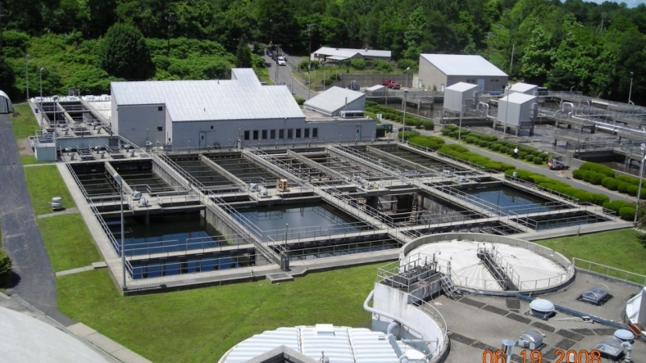
Decarbonization Strategies Where do we Start?
Jen Muir, P.E.
JKMuir, LLC

Slide 2
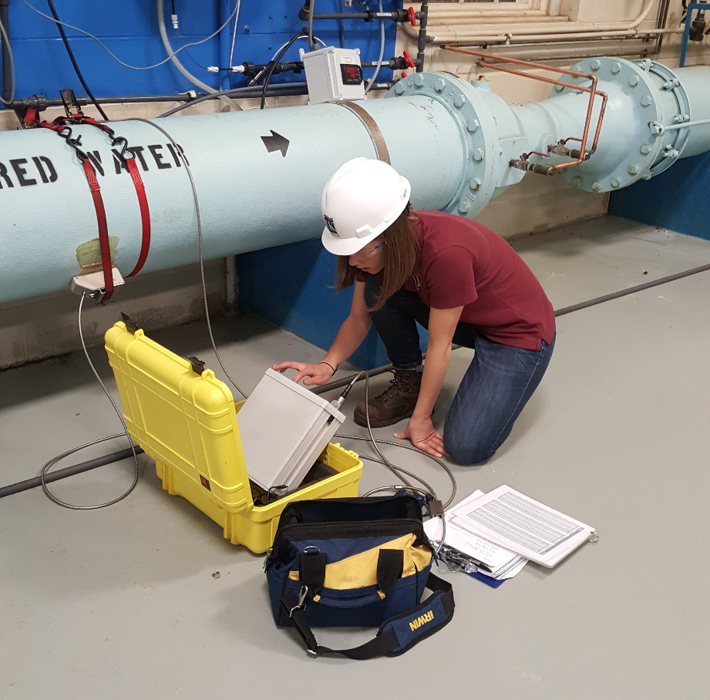
JKMuir Energy & Sustainability Services
Energy Audits
Demand Savings
Energy Management Program
Energy Efficiency Funding
GHG Accounting
Biosolids Analysis
Renewable Feasibility Analysis
Envision Certification
Established in 2008
WBE & DBE certified
Energy & Sustainability focused
National presence
Preferred Vendor:
National Grid, RI Energy, Eversource, United Illuminating,

Slide 3
High Level Principles of Decarbonization
Increase Efficiency
Reduce energy needs in buildings, transport and industry
Build Renewables
Deploy solar, wind, and battery storage on a massive scale
Electrify Things
Rapidly adopt heat pumps and electric vehicles
Decarbonize other sectors
Develop clean, low carbon fuels
Build out carbon sinks

Slide 4
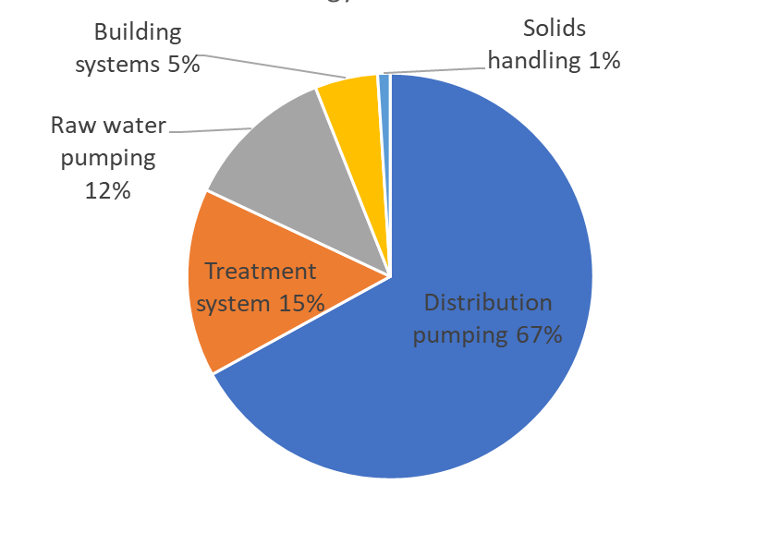
Reducing Energy Needs
Typical WRRFs can reduce energy use by 15-30%¹
Benchmark energy use
Focus on energy intensive processes/equipment
Turn it off (or turn it down)
Implement automated process controls
Right-size equipment
Monitor equipment performance to maintain efficiency
Notes:
Pie chart of energy demand at WWTFs & pie chart of emissions? By process
Facts on ~ opportunity to reduce emissions at WWTFs (how much can you save? US DOE-> 15-30%)
Highlight process pumping, aeration, mixing efficiency, and electrification opportunities
Funding programs that subsidize increased capital costs for these systems
Worth a second slide – programs are still here, utilize them more. Maybe try to throw up some examples for the amount of funding we’ve gotten in recent jobs. GAP 3 funding can be mentioned.

Slide 5
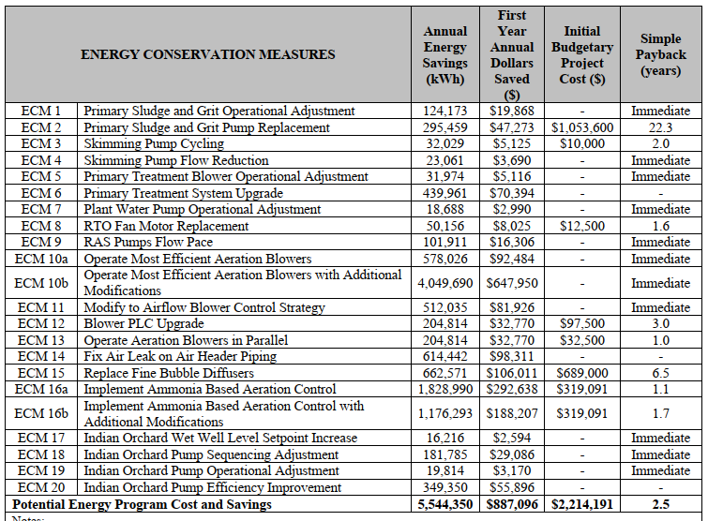
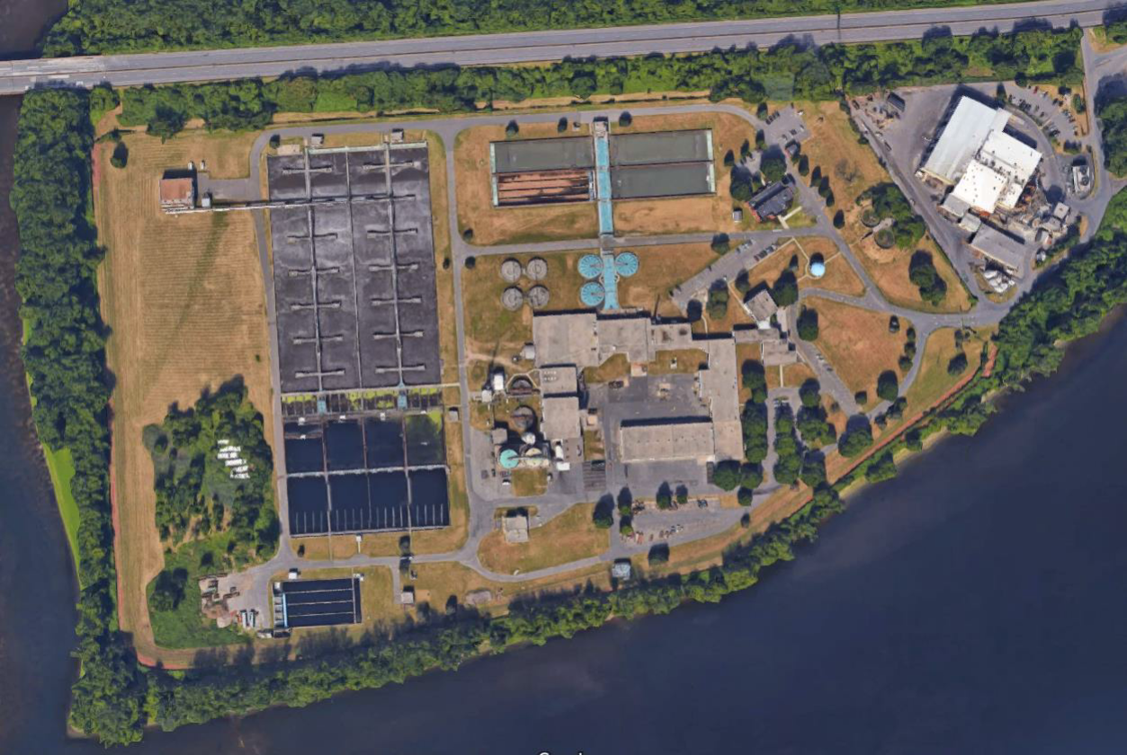
Regional Wastewater Treatment Facility
Energy Evaluation

Slide 6
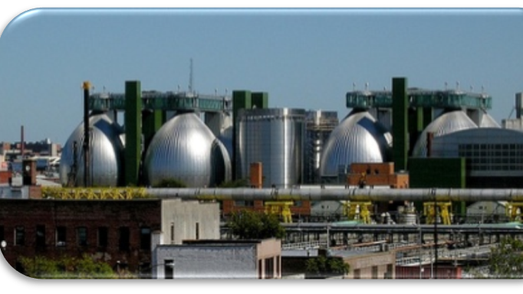
Renewables
Behind the meter installations
Offsetting usage of the plant is key
Solar, cogen, mini hydro, fuel cells
Installation and procurement options, interconnection agreements, PPAs
Creating an environment that facilitates onsite generation

Slide 7
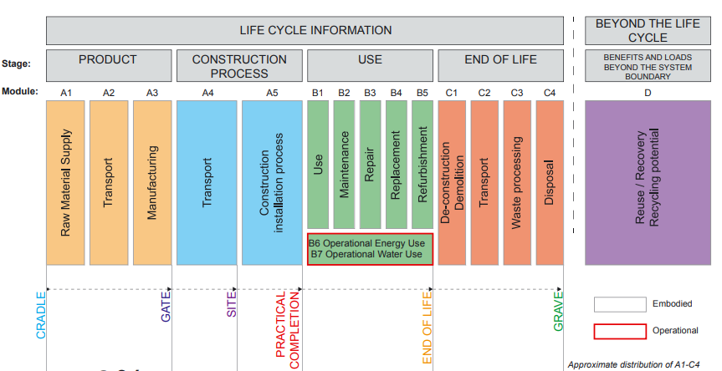
Understanding embodied carbon
Embodied carbon refers to a quantity of CO₂e associated with the materials used to construct and maintain the building throughout its lifespan
Operational carbon refers to the emissions associated with the heating, cooling, and energy use of the building

Slide 8
The growing importance of embodied carbon emissions
As we decarbonize the operational side of the building sector’s emissions, embodied carbon’s share of buildings emissions will grow
Notes:
https://www.arup.com/perspectives/publications/research/section/net-zero-buildings-where-do-we-stand

