Slide 1
From Pilot to Scalable Deployment
Single Transmission Line Tested
Demonstrates a repeatable blueprint for systemwide adoption for enhanced standards for asset management
Improved safety, reliability with situational awareness from real-time conductor data
Improved customer affordability with more effective maintenance scheduling and avoided congestion charges
Access to point-in-time information relationships for all spans
Enhanced reliability with accurate ratings ensuring no overestimation of capacity that also puts public safety at risk
Quantifiable business case for cost benefit as compared to existing practices
Compliance and Due Diligence with Proven Technology
Pathway to Accelerate Change

Slide 2
The Ostrich or The Scrambler?
FERC 881

Slide 3
Where to focus?
Scalability
The bottlenecks of our system will continue to shift.
A low-cost, scalable solutions is necessary with the changing energy landscape.
Operational Integrity
Cyber security will continue to be a concern. Utilize technical checklists and strive to make integration a blueprint for success and repeatability.
Safety and Reliability
Communication and data transfer between systems is a priority. Cross functional tiger teams can be put in place for greater support throughout the organization.
Resiliency
The AAR/DLR solution provide even greater benefit to the entire system such as enhanced situational awareness and predictive analytics around health of the system.
Incentives
Incentivizing GETs while we are building new transmission could be instrumental in adoption and scale.
Immediate action is needed to reduce spend to keep rates ‘just and reasonable’

Slide 4
Evolution to Revolution
Think Big
Ask Tough Questions
Tiered Approach to Deployment
Value Based Business Case
Compliance
Compliance
Compliance

Slide 5
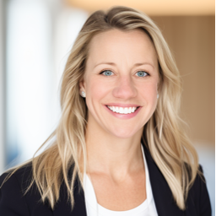
Thank you
Mission Statement:
A utility development and strategy expert who creates, inspires, and ideates the integration of new technologies to the utility portfolio. Driving results through thought leadership in digital transformation and strategic partnerships with c-level executives.
Contact Information:
Principal, Menhorn Group
+1 724 875 1411
tiffany@menhorngroup.com

