Slide 1
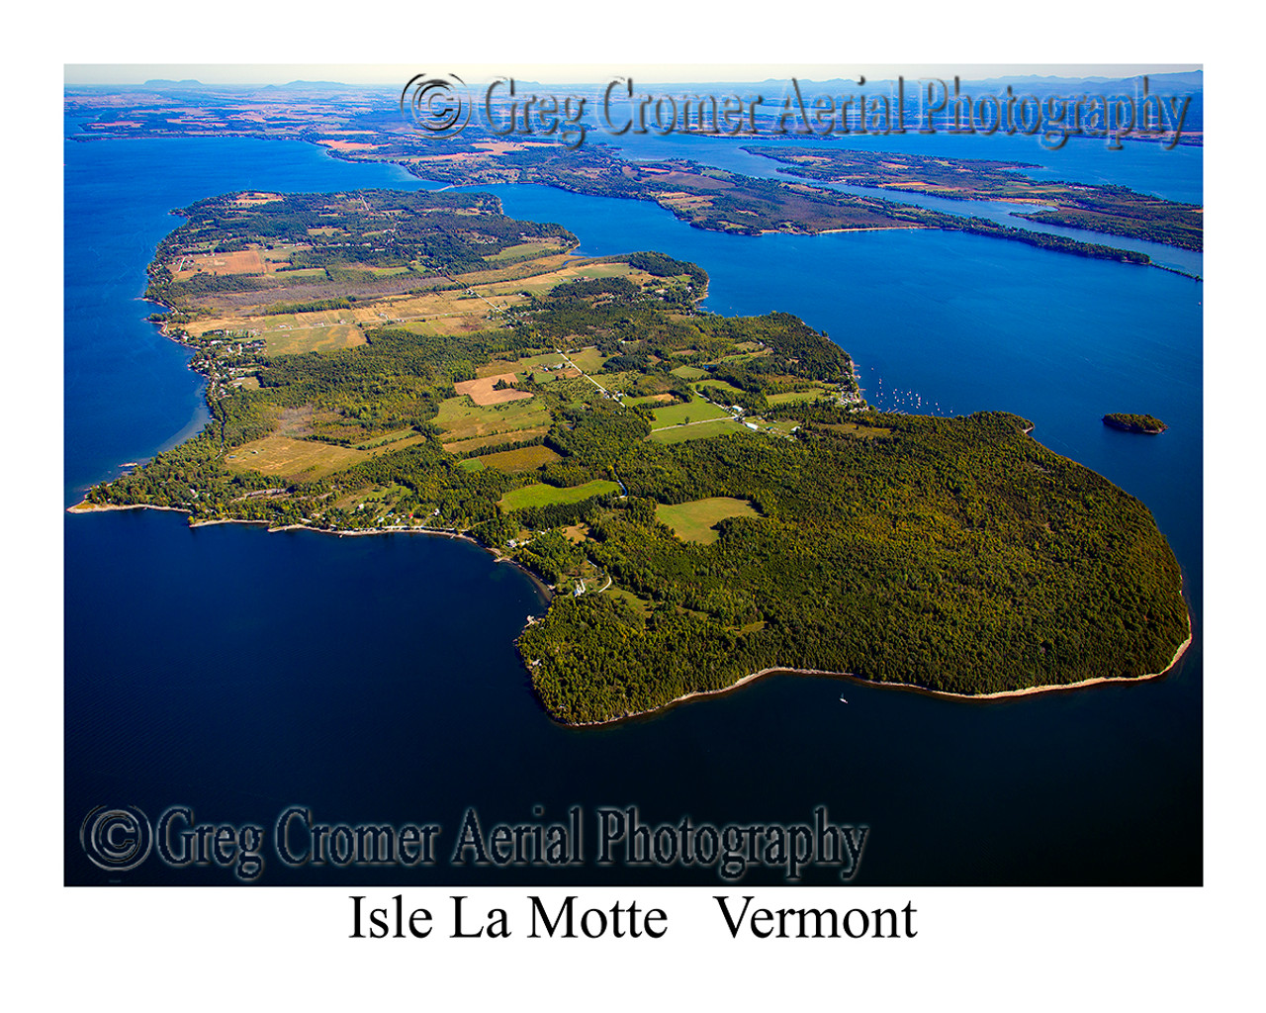
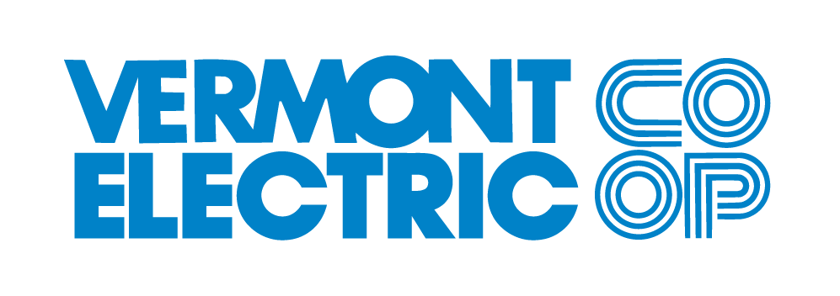
40,000 meters
87 MW peak demand
50 MW distributed renewables
45% fixed income
Founded in 1938, Vermont Electric Cooperative is a member owned electric distribution utility that provides safe, affordable, and reliable energy services.
Isle La Motte, VT
by Greg Cromer Aerial Photography
Lighting the path to affordable clean energy, together.

Slide 2
Can we save millions in
Grid Investment with DER Management?
2040 with management?

Slide 3
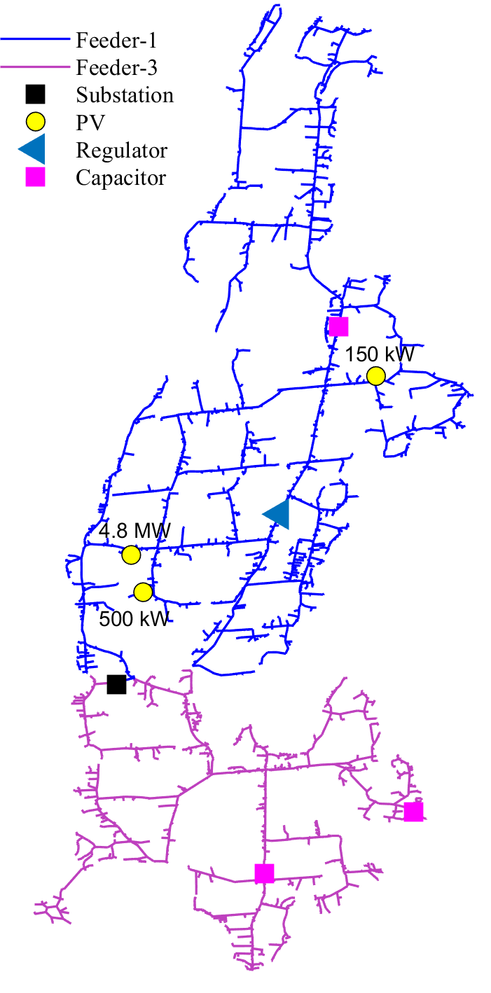
Leveraging the Distributed Grid
South Hero Distribution Substation
Peak Load – 7.4 MW
Solar Generation – 7.5 MW
2 capacitor banks
S. Hero

Slide 4
Oct 2nd – Modeling Impact of Volt/Var Solar Inverter Settings
Power Factor as Substation Reverses Flow
Meter Voltage without and with volt/var settings

