Slide 1
Emerging Opportunities for Managing Water Energy Use

Slide 2
Water use drives energy use
WATER UTILITIES USE ELECTRICITY FOR:
Office facilities
Pumping for conveyance to treatment
Water treatment
Pumping into water towers (which pressurize the distribution system)
Pumping for distribution (sometimes)
Wastewater pumping and treatment
TWO LARGE OPPORTUNITIES FOR ENERGY MANAGEMENT
Conservation through leak detection and efficiency
Load management in coordination with electric utility needs
Notes:
Any efficiency improvements at the site level (home or business) directly reduces the electricity consumption associated with treating and transporting that water, making end-use efficiency improvements especially effective as an energy-saving strategy.
According to the EPA, “Pumping in total, for either surface or ground water systems, typically accounts for 90‐99 percent of energy consumption at a water system.”
There are two big opportunities for energy management: conservation via efficiency improvements and load management (coordinating water operations with the local electric utility to help manage demand).

Slide 3
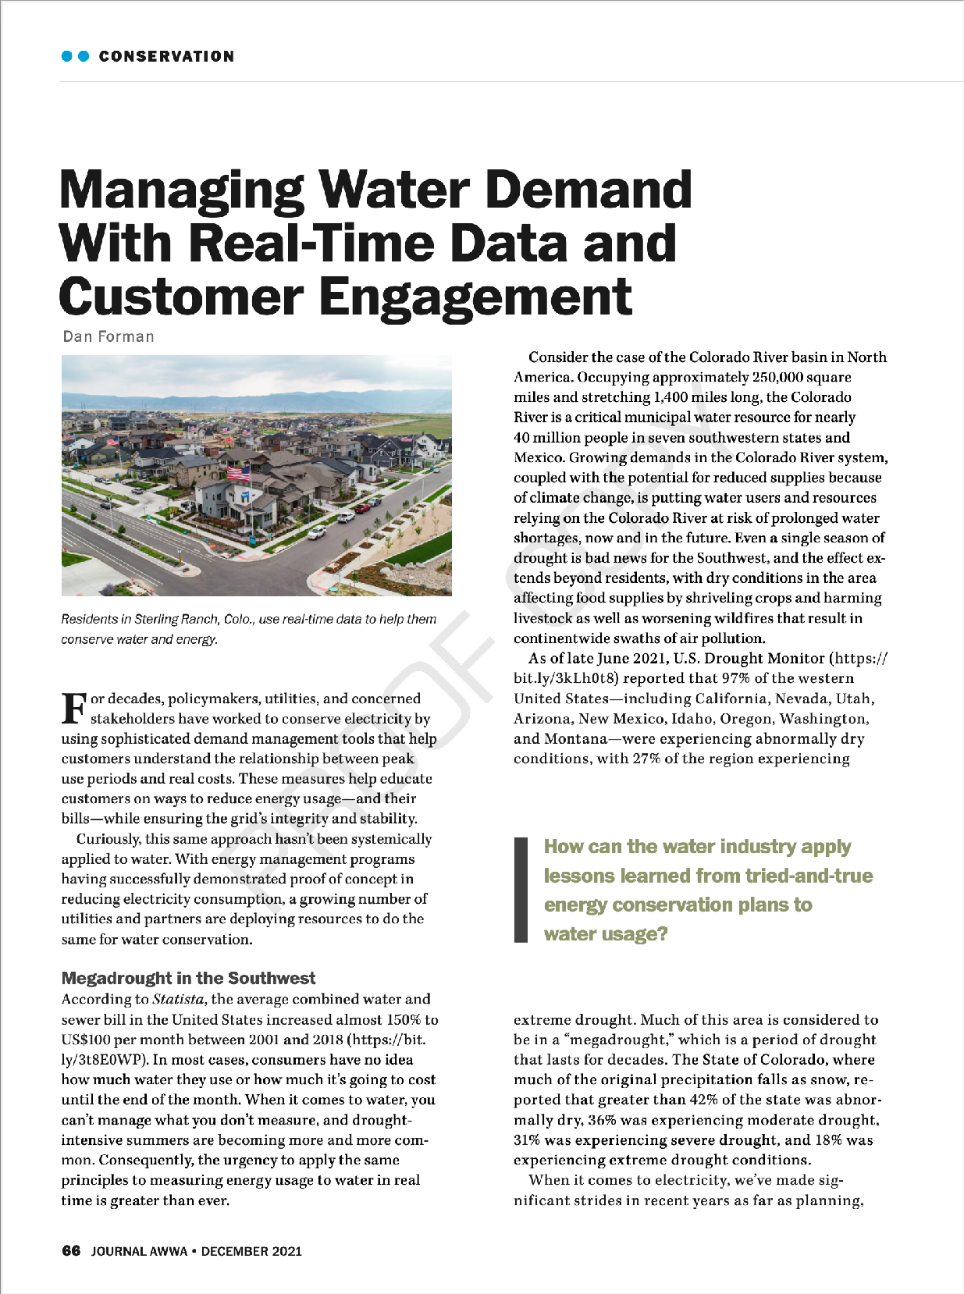
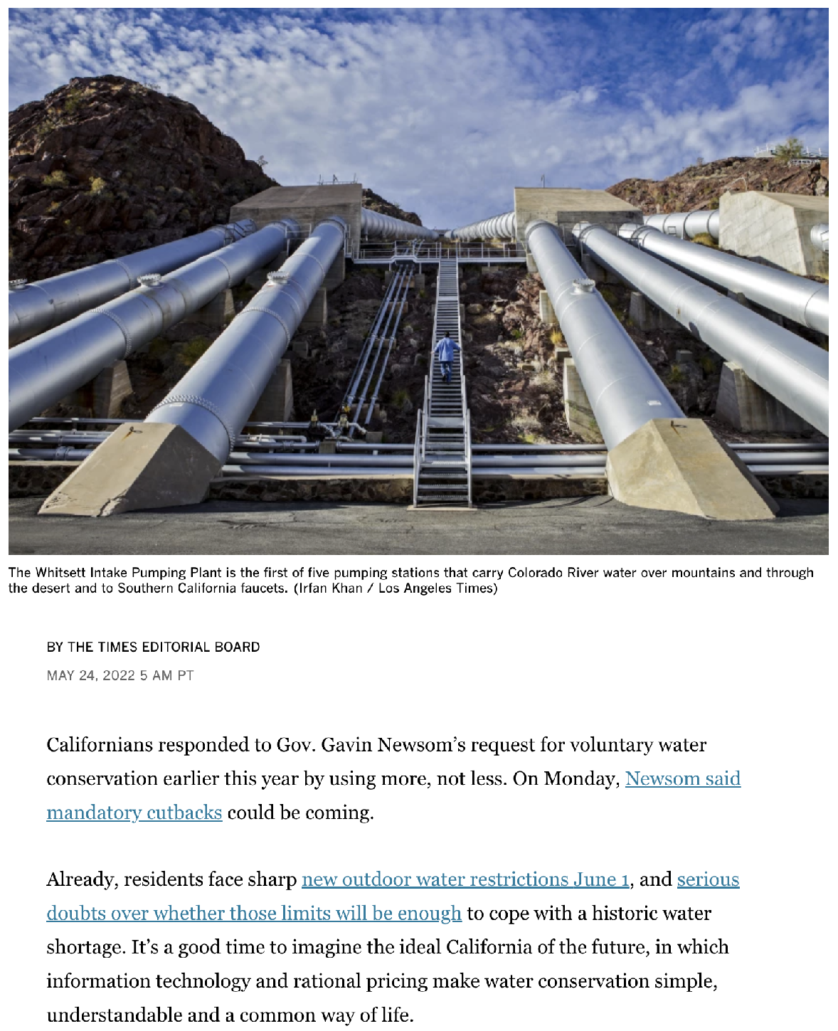
Transparency and timely insights enable conservation
“Water bills arrive monthly or, for most residents in Los Angeles, every other month — far too late to respond to data indicating leaks in the plumbing or unsustainable outdoor watering.”
Notes:
Most customers don’t understand their water consumption and only get one data point every 1-3 months on their bill. By helping customers better understand their usage, and by identifying leaks in a timely way (particularly major leaks as soon as they happen), Copper can uniquely help support residential water conservation efforts. Sterling Ranch is a good example.
More on Copper’s leak detection (including images) here: https://www.copperlabs.com/real-time-data-enables-smarter-faster-water-leak-detection/

Slide 4
Fixing leaks is low-hanging fruit
10% of US homes leak more than 90 gallons per day.
Water utilities with manual or drive-by meters often need to wait for 3 billing cycles to identify leaks.
American household leaks alone waste nearly 900 billion gallons of water annually, representing 12% of total domestic water consumed.
Notes:
Americans are estimated to waste nearly a trillion gallons of water annually just on common leaks around the home. That’s nearly as much as all the water taken from the Colorado River for agricultural resources, and represents some 12% of total domestic water consumed in the US. What’s more, EPA data suggests that a relatively small proportion of homes are responsible for the bulk of water waste, with roughly 10% of U.S. homes leaking more than 90 gallons each day. This should be low-hanging fruit for water utilities.

Slide 5
Pumping optimization for electric load management
PUMPING USES TONS OF ENERGY
Pumping typically accounts for 90‐99% of energy consumption at a water system.
Electric demand charges can often account for half of the total utility electric bill in a municipal or industrial water facility.
PUMPING OPTIMIZATION STARTS WITH BETTER USAGE DATA
Most water utilities don’t have timely, granular customer data, so pumping planning or coordination (including into water towers) is often based on engineering rules-of-thumb.
Improved optimization strategies could meet customer needs while helping electric utilities shed load during peak times or increase demand when needed.
This kind of approach also offers substantial opportunities for water/wastewater utilities to reduce operating costs
Notes:
Most water utilities don’t have granular data that would help them get a detailed understanding of how water demand fluctuates throughout the day at the customer level. As a result, most of the timing and planning around pumping, particularly into water towers, is based on engineering rules of thumb. That’s not necessarily a terrible thing, since towers generally act as massive storage systems to smooth out peaks in water demand while offering resiliency in case of things like fires (where lots of water is suddenly needed unexpectedly), but there are likely opportunities for improved optimization.
Pumping that much water uses a tremendous amount of energy, and better data could enable new pumping strategies that minimize energy waste while also shifting demand to help the utility better manage peak periods. For example, more granular consumption data paired with data on electric utility peaks could enable optimized strategies for pumping water into water towers that meet customer water needs and maintain pressure while also helping electric utilities either shed load during peak times or fill the “belly of the duck” in places with higher solar penetration to keep overall electric demand flatter.
This kind of approach also offers substantial potential benefits for water/wastewater utilities to reduce operating costs, since electric utility demand charges (which are based on peak power demand and are added to the total monthly energy consumption on the electric bill) can often account for half of the total utility electric bill in a municipal or industrial plant.
Copper offers a unique approach to unlocking the data to support these efforts without having to deploy AMI.

Slide 6
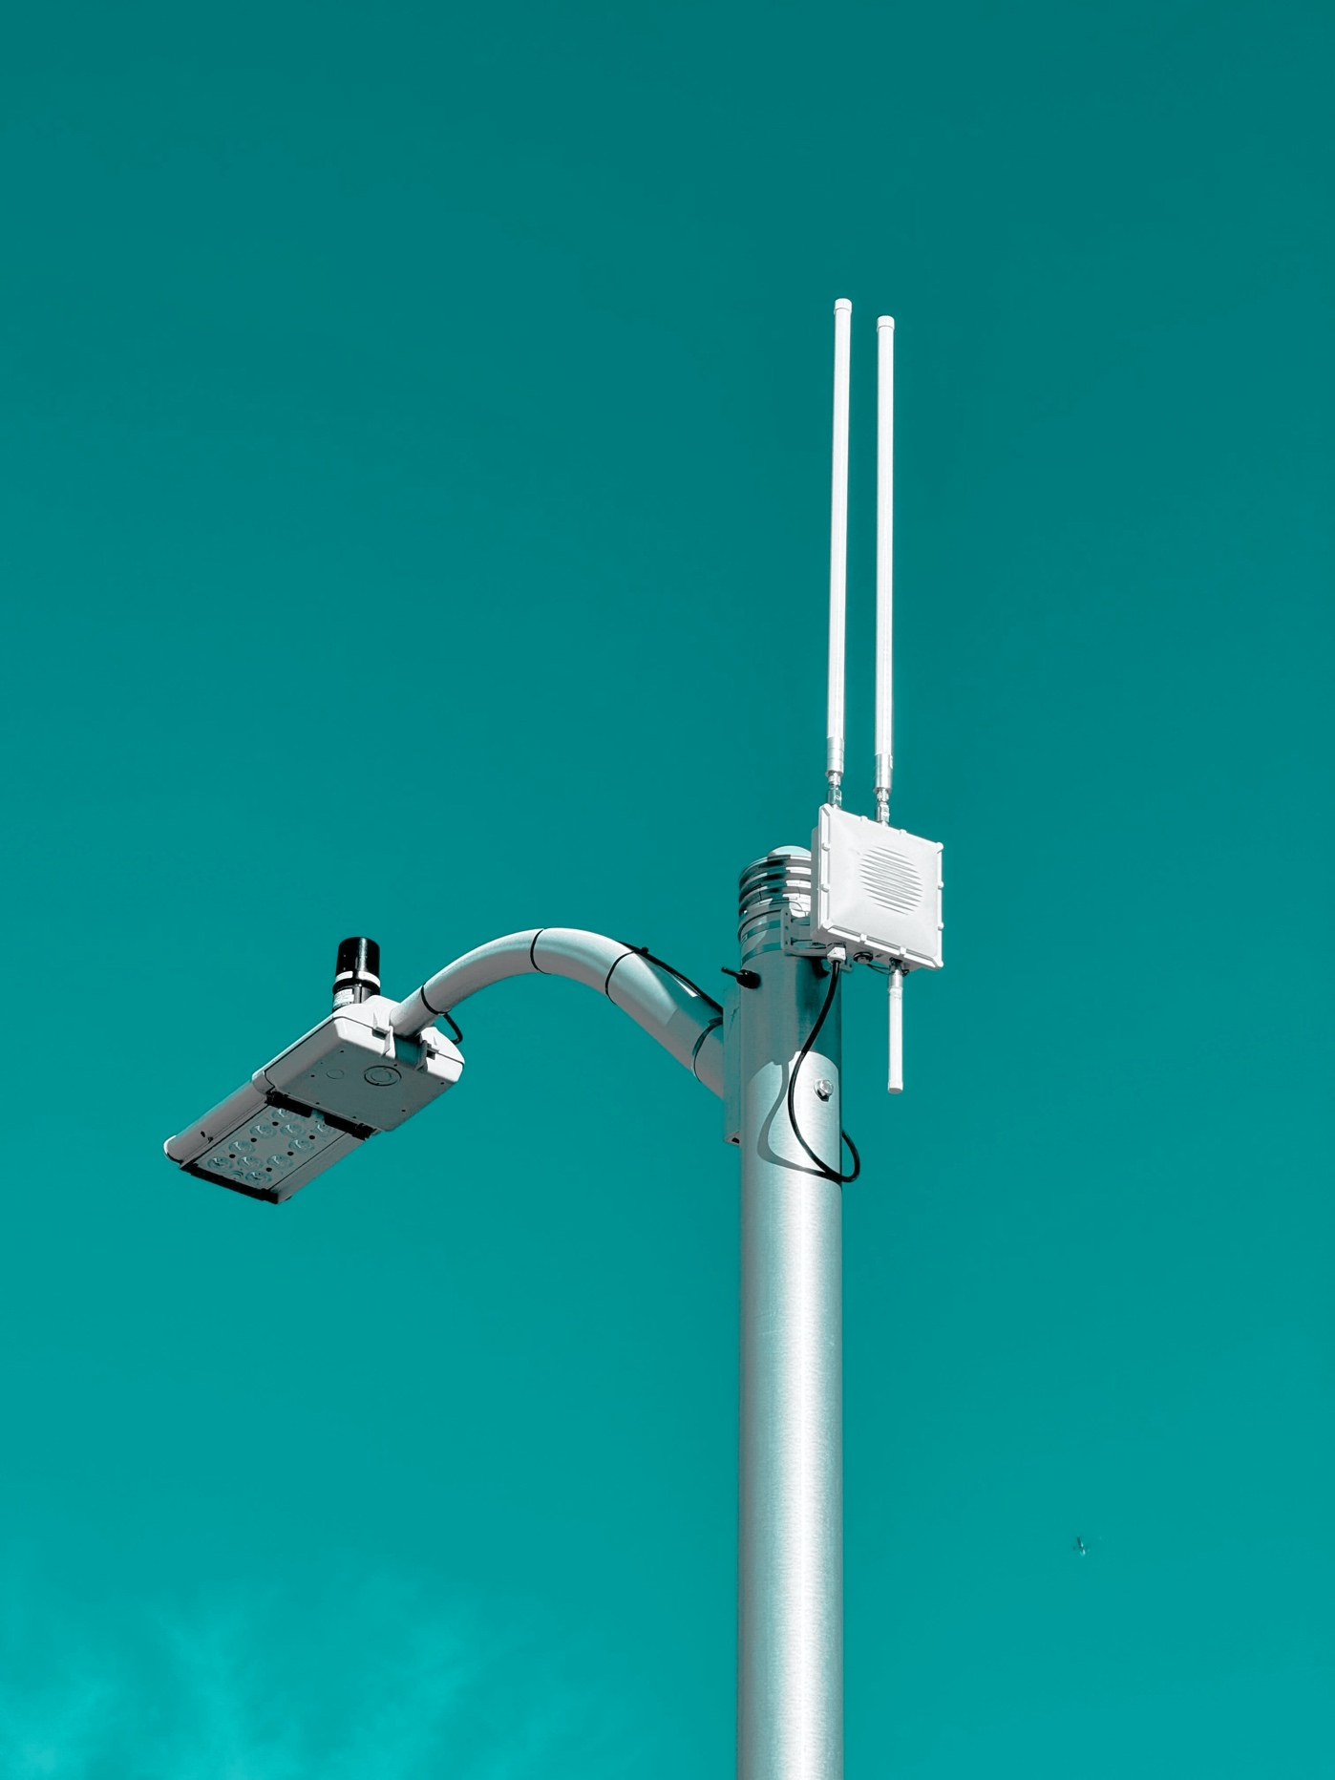
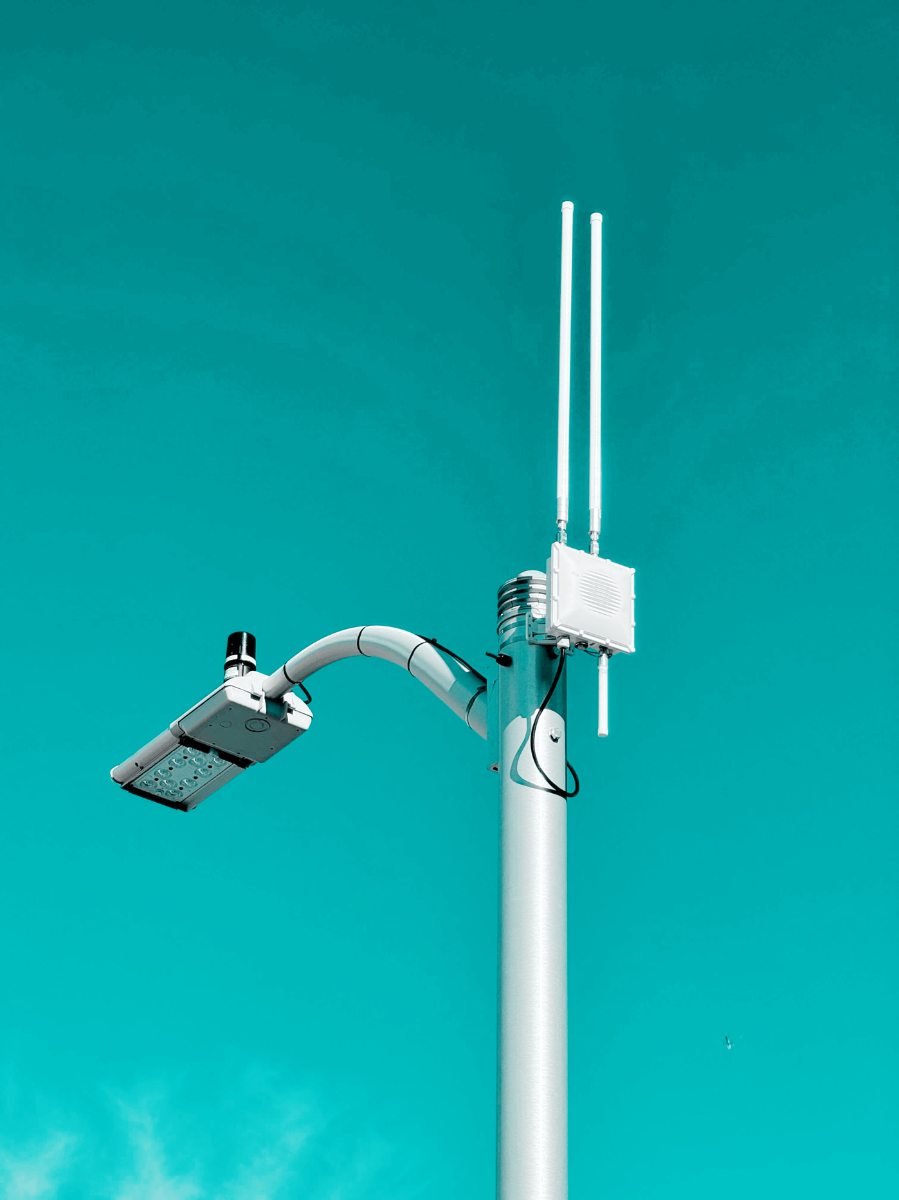
The water-energy nexus requires a new approach to usage data
AN AMX STRATEGY CAN UNLOCK NEW DATA AND USE CASES
Enabled by modern wireless technology that can access and share data from existing water, electric, and gas meters in real-time and at low incremental cost on a single platform.
AMx is a pragmatic, technology-agnostic framework that immediately improves utility data access while removing platform compatibility as a meter differentiator.
An AMx approach helps utilities reduce costs, gain flexibility, and more quickly realize the benefits of granular, timely data.

Slide 7
Thank you!
Dan Forman
dan@copperlabs.com

Slide 8
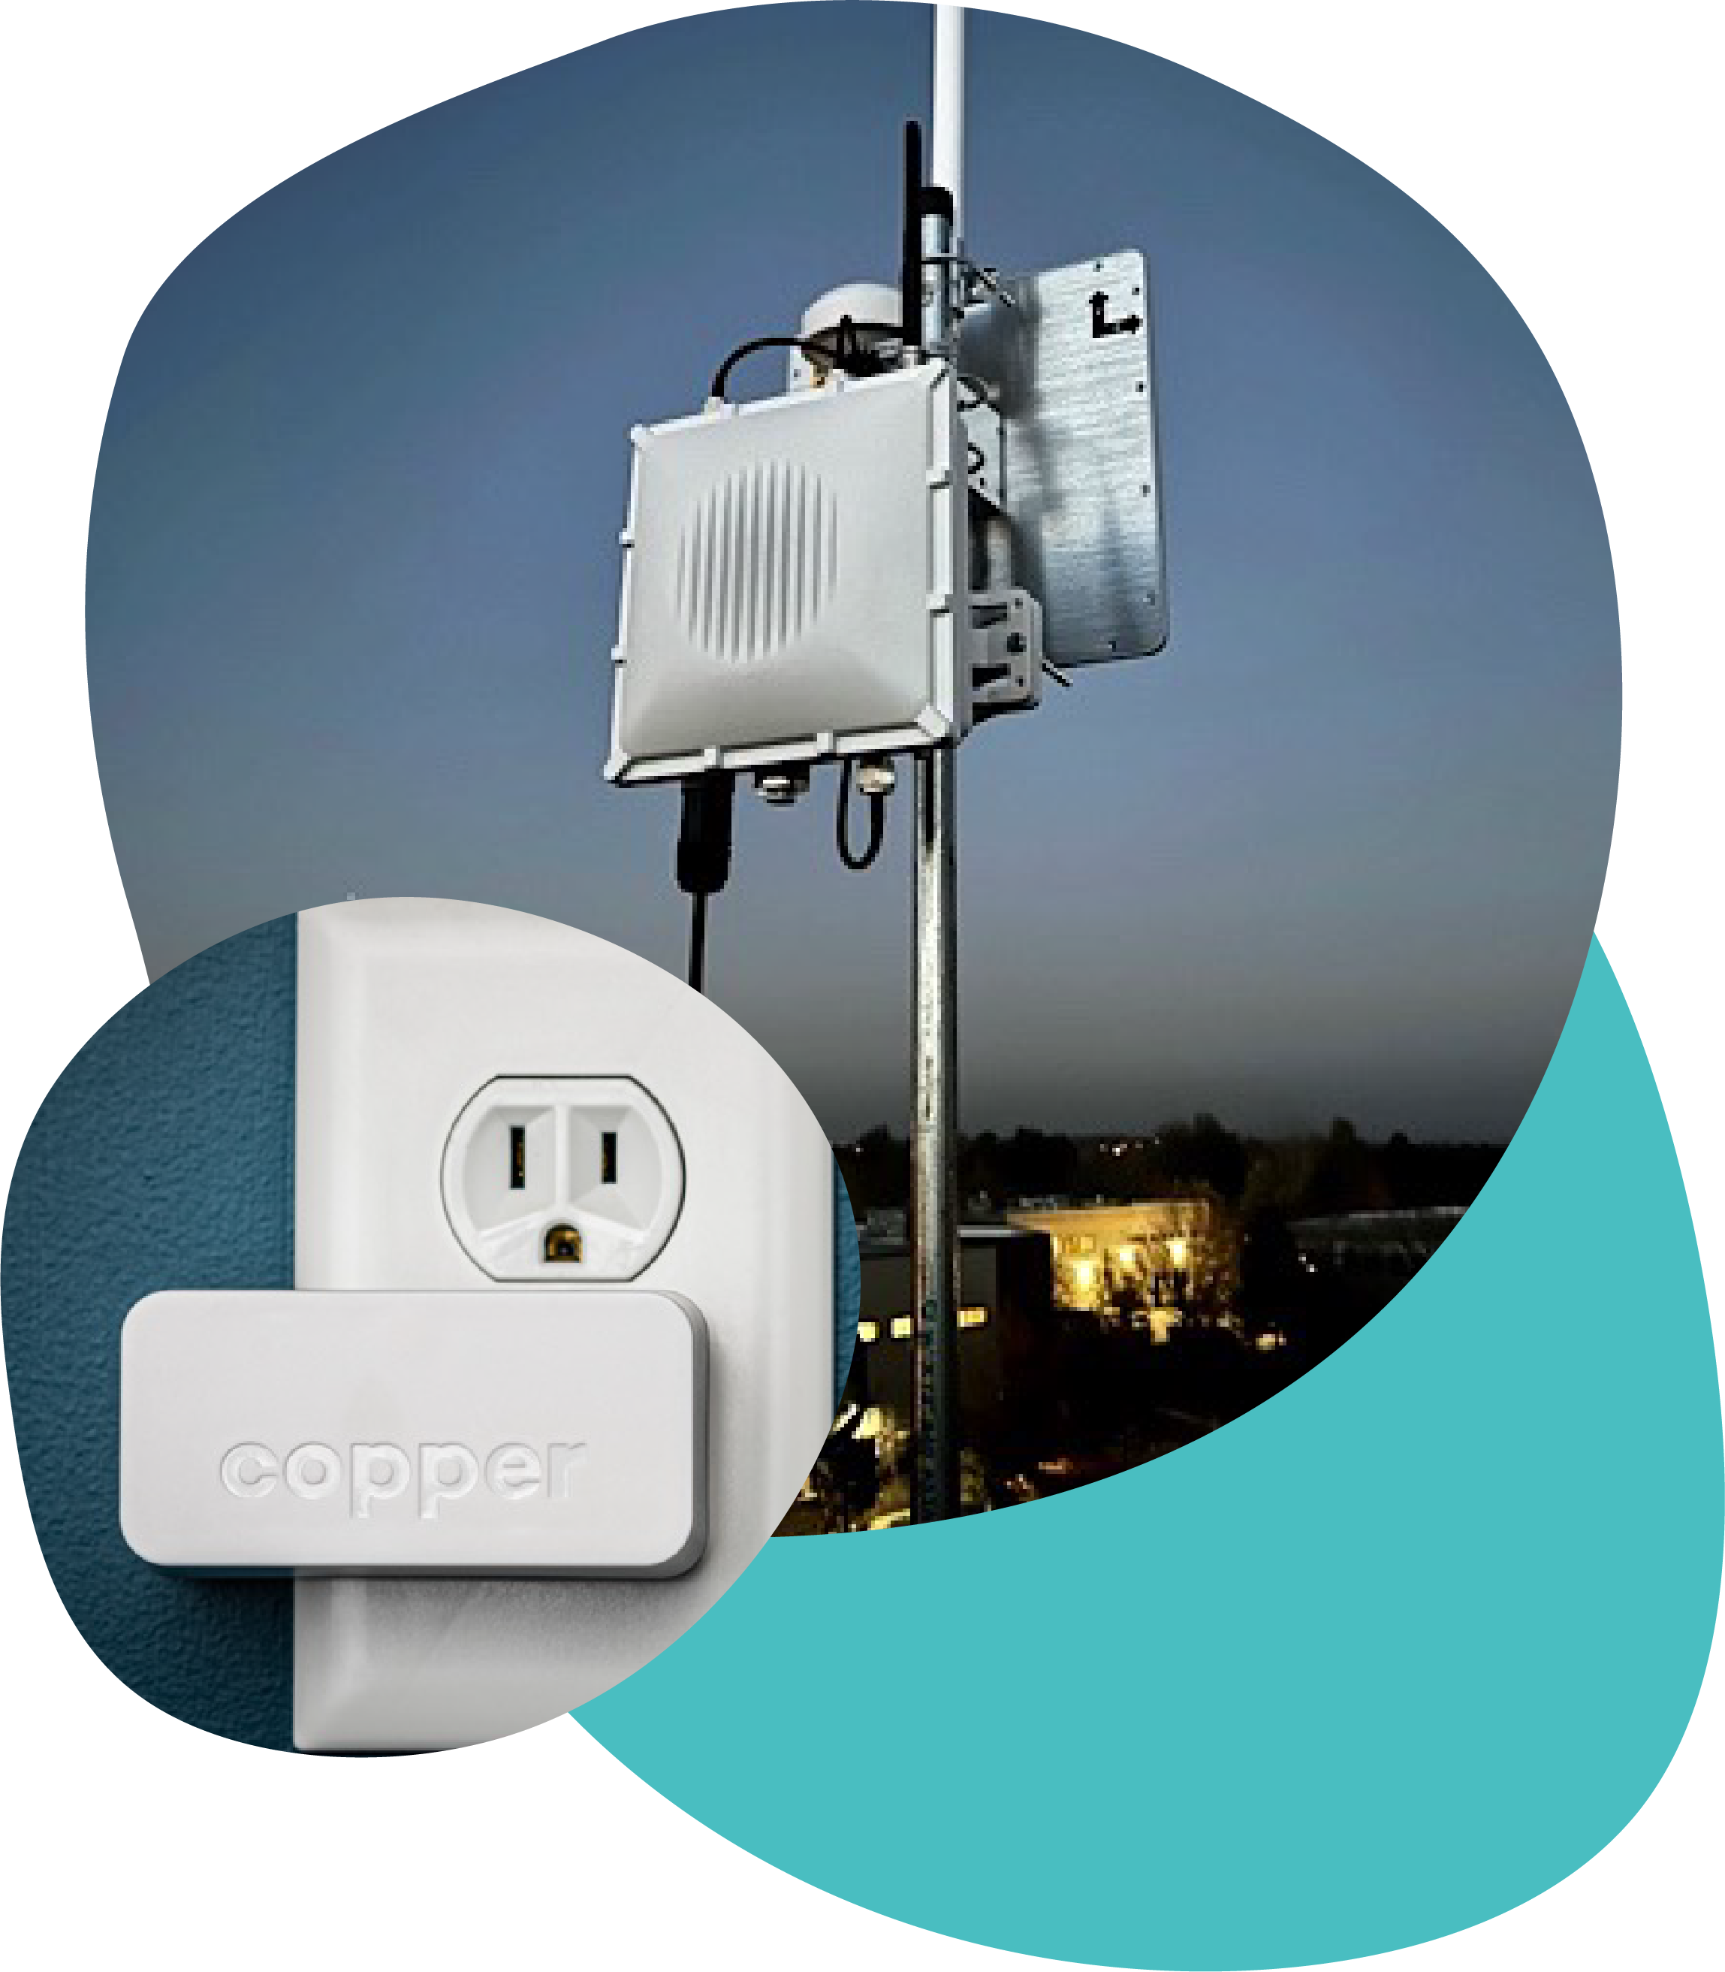
Get more out of utility meters
Copper Labs remotely unlocks data from nearly any electric, gas, and water meter in real-time and shares it instantly with utilities and their customers—no meter retrofits needed.

Slide 9
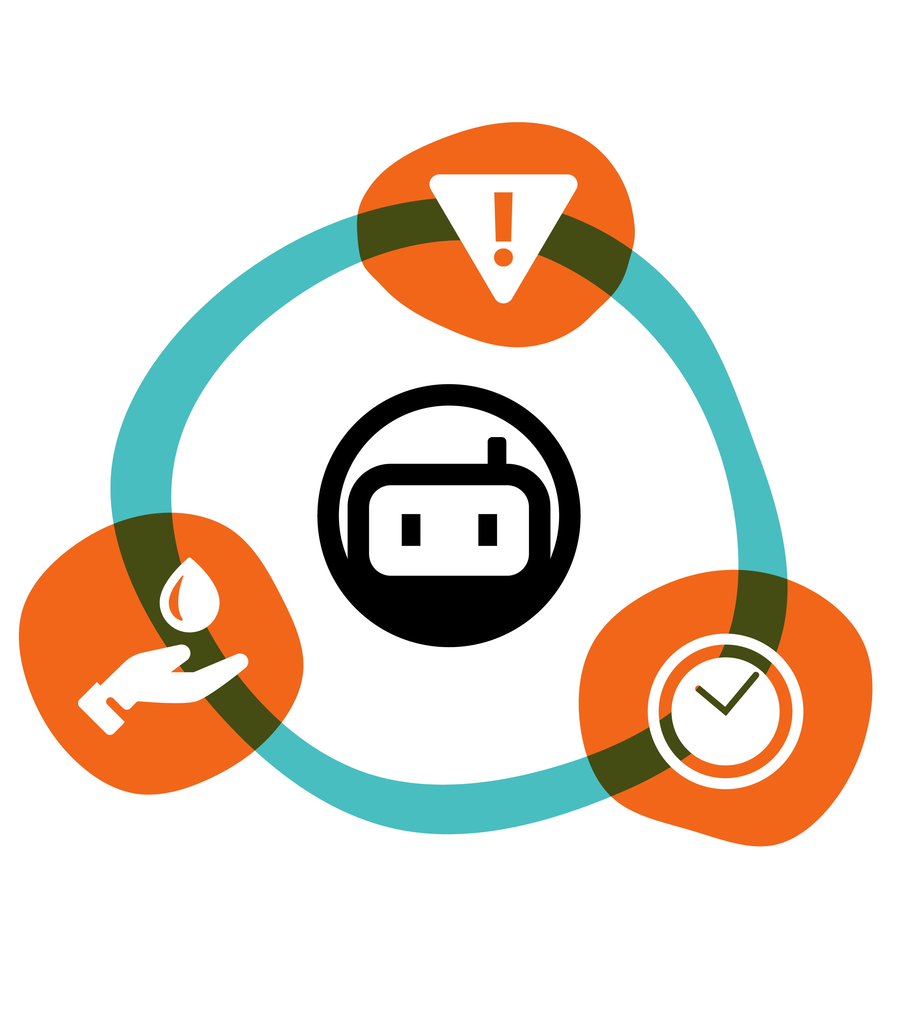
Key opportunities for water utilities
✓
Personalized and timely consumer insights: improved home water reports/portals with more actionable insights
Gamified behavioral programs: behavioral messaging, event notifications and community comparisons
Rapid leak detection: reduced water waste and a better consumer experience
Better utility billing: mid-cycle high bill alerts, option for TOU rate signals/education, consumption data matches meter
Improved program targeting: conservation programs, load management events, etc.
Granular measurement and verification: immediate and detailed data on water savings due to conservation measures
Improved utility planning: more granular load forecasting, pumping optimization, climate/resiliency planning
✓
✓
✓
✓
✓
✓

Slide 10
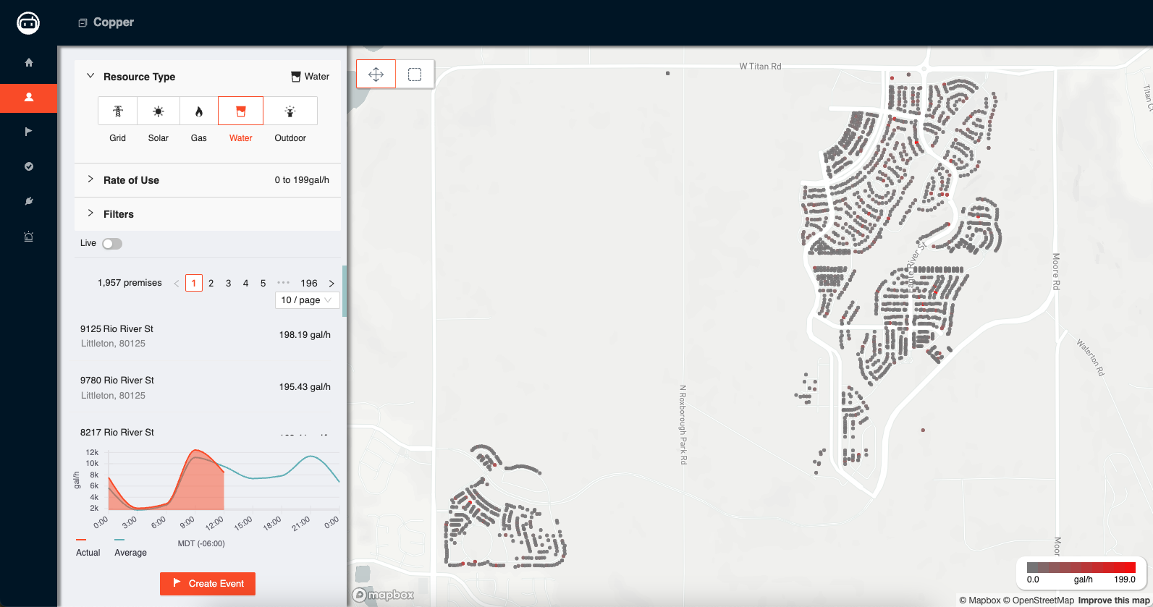
Copper’s utility portal helps utilities understand usage and manage demand

Slide 11
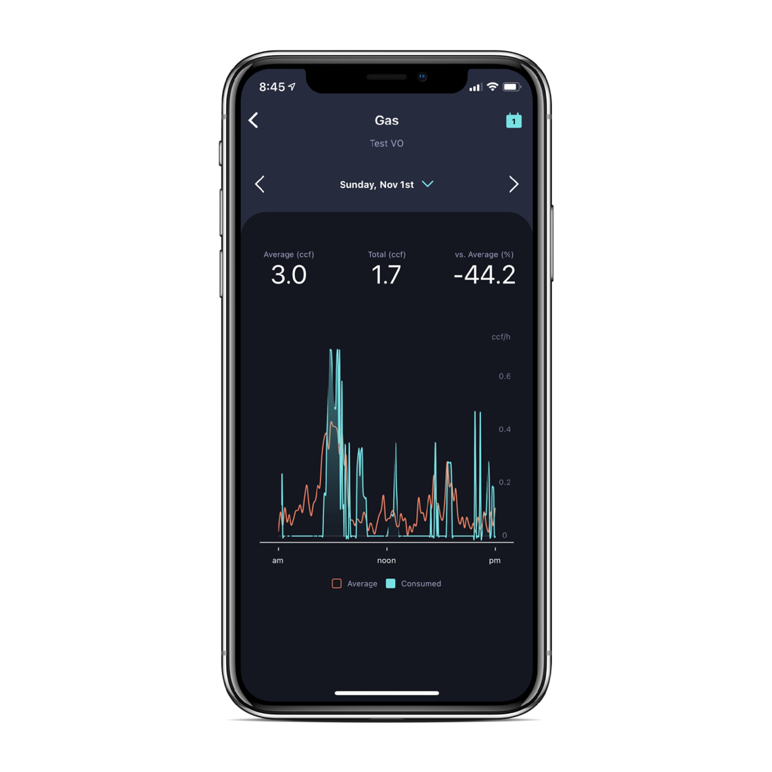
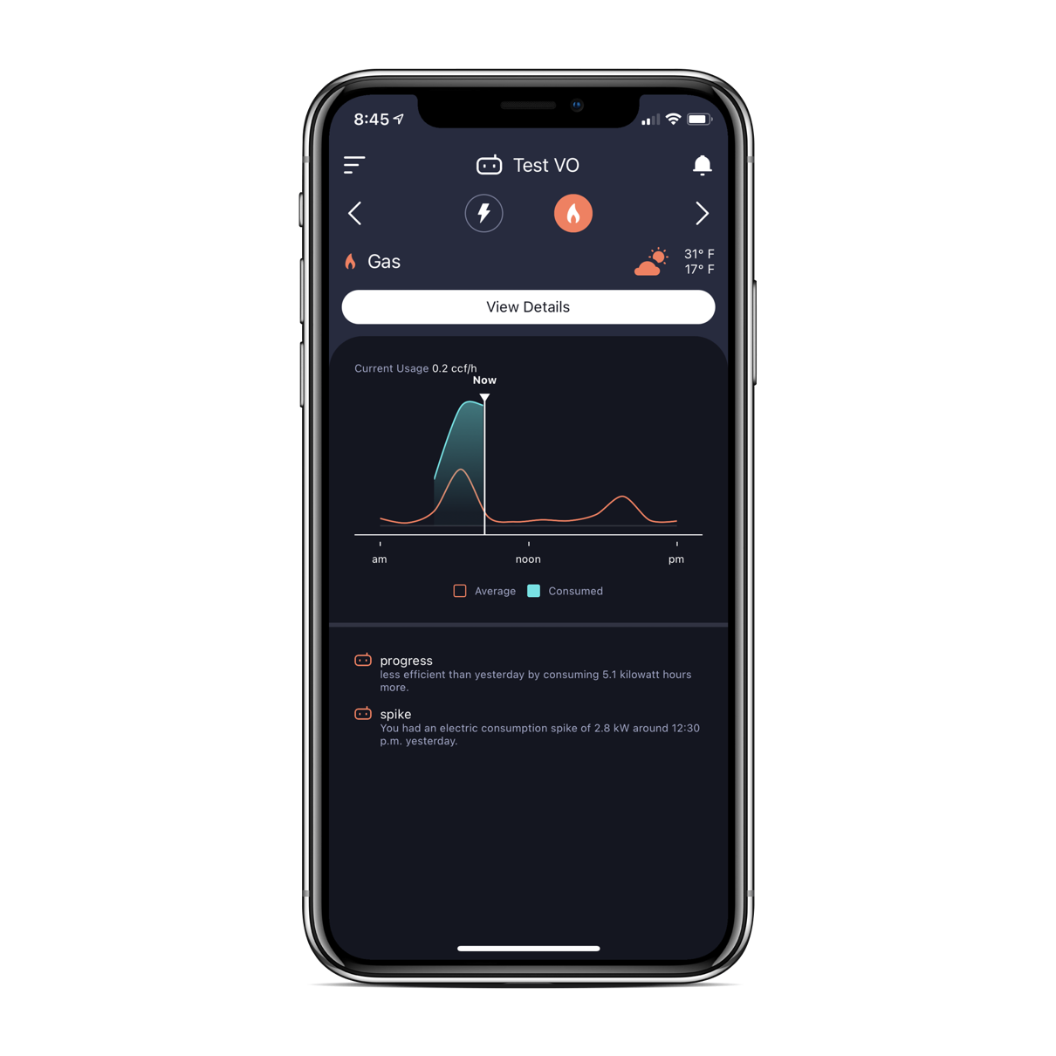
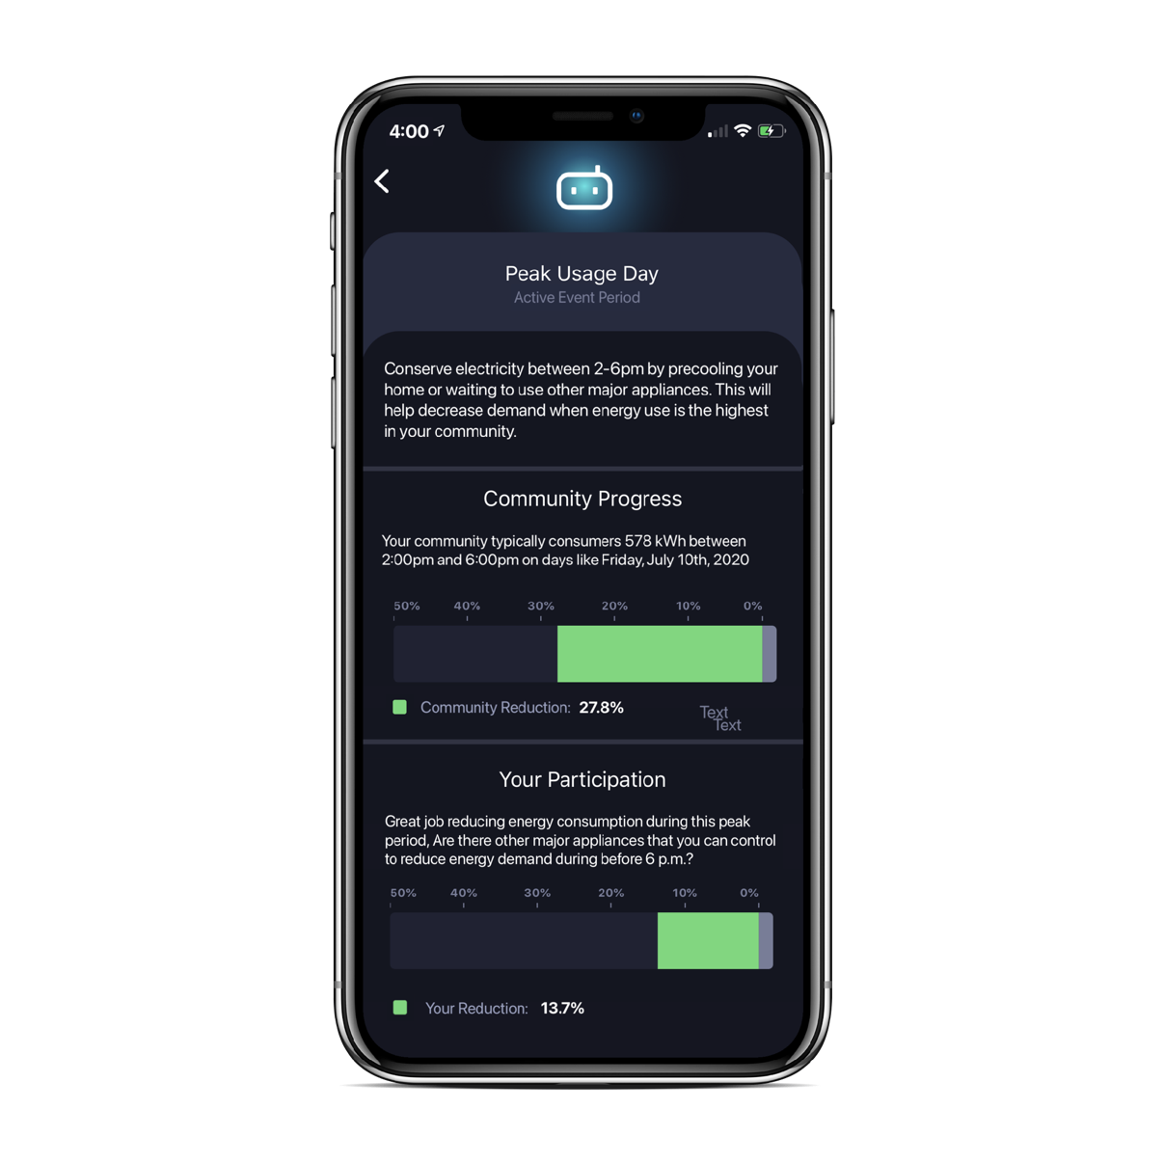
Copper’s mobile app helps utilities reach the right customers at the right time
REAL-TIME INSIGHTS
Track energy usage in real-time to identify anomalies
PERSONALIZED ALERTS
High usage alerts and goal setting helps consumers plan
PEAK SAVINGS
A new communication channel and real-time feedback for consumers
Home
Home
Today is a Peak Usage Day Please conserve natural gas between 9:00-11:00am.
Your natural gas demand peaked at more than 0.5 ccf/h this morning.

Slide 12
Proprietary networks limit the value of smart meters
PROPRIETARY NETWORKS ARE NOW STANDARD PRACTICE
Latencies in existing networks minimize real-time use cases (given often day-long delays in utility data access)
Proprietary networks lead to higher O&M costs and may lead to additional security vulnerabilities.
Forcing meters to connect with a single network leads to vendor lock-in, slowing innovation while needlessly raising costs.
New feature-laden meters often can’t be installed unless utilities also upgrade their networks or install a new network entirely.
WHY ARE THESE NETWORKS USED?
Meters use a physical network interface card (NIC) to connect with a single network.
One meter, one network means utilities generally can’t mix meter types or vintages.
Notes:
70%+ of utilities with solid-state meters in North America have chosen to work with Landis+Gyr or Itron AMI communications. These two companies use their intentionally proprietary technologies to hold the smart metering market hostage, increasing prices and slowing the rate of innovation.
NICs are like SIM cards – not true interoperability (SIM card supporting one provider with one generation of phone)
Image source: https://na.itron.com/products/nic-network-interface-card

Slide 13
What makes Copper different
BACKED BY INDUSTRY-LEADING INVESTORS
National Grid Partners
Clean Energy Ventures
Blue Bear Capital
PROVEN TECHNOLOGY & NATURAL EVOLUTION
Solution based on more than 20 years of experience in wireless standards and smart-grid technologies.
7 patents already issued, with 4 more currently pending.
Successfully deployed with 5 major electric and gas utilities across the US.
SUPPORTED BY TRUSTED INDUSTRY EXPERTS
Our team includes experts with decades of experience in meter architecture, industry regulatory issues, wireless standards, utility decarbonization, and emerging energy technologies.
Listen to this podcast with Nora Mead Brownell
(Copper Board member and former FERC commissioner, President of NARUC, and Chair of PG&E’s Board, who is actively working with Copper to increase regulatory awareness)

Slide 14
AMx adds value to existing meters
Criterion | AMR (drive-by meters) | AMI 1.0 (1st gen smart meters) | AMx
Data frequency | AMR meters often collect data as often as every 30 seconds, but data is only recorded once per billing cycle. | AMI meters can collect data at higher frequencies, but network latencies often limit utility visibility to yesterday’s 15-minute data. | AMx maximizes data granularity and timeliness from existing meters by collecting and sharing data in real-time, unlocking added value and new use cases.
Lifespan | 20-40 years, but may be replaced prematurely to get more frequent data or other features. | Often 10-15 years, due primarily to desire for new features rather than hardware degradation. | Utilities maximize the life of their equipment by letting meters just be data collectors, replacing only when core functionality is compromised.
Meter upgrades/ replacements | Low-cost and straightforward to replace. | Higher-cost, like-for-like replacements needed. | AMx enables fully mixed-meter portfolios, maximizing flexibility.
Resource visibility | Only collects data on a single resource (electricity, gas, or water). | Only collects data on a single resource (electricity, gas, or water). | Can collect and share data across multiple resources to support coordinated planning.
Notes:
70%+ of utilities with solid-state meters in North America have chosen to work with Landis+Gyr or Itron AMI communications. These two companies use their intentionally proprietary technologies to hold the smart metering market hostage, increasing prices and slowing the rate of innovation.

Slide 15
AMx can de-risk new AMI
Risk | AMI 2.0 | AMx
Technological obsolescence | “Grid edge” computation hardware built into the meter (designed to run apps) is expensive and may limit usefulness over the full meter life. | Moves computation and data analysis fully into the cloud reduces the risk of obsolescence and supports existing infrastructure.
Communication network | Proprietary, single-purpose networks limit the number and kind of meters that utilities can install, and reduces applicability for DER management and real-time load flexibility. | Faster, more timely data sharing via existing broadband can immediately unlock new use cases. Eliminating propriety networks opens the door to a wider array of meters that can be used, potentially at lower cost.
Value definition | Proposed benefits may be future-focused, unproven, or vaguely-defined. | Allows for smaller, more agile deployments of new metering hardware to prove out a particular approach or technology.
Cybersecurity | New attack vectors due to connectivity with customer networks and potential delays between security patches. | Reduces the number of potential attack vectors when data is shared with the utility and end-customer.
Resource visibility | Only provides data on a single resource (electricity, gas, or water). | Can collect and share meter data across resources to support coordinated system or decarbonization planning.
Notes:
If utilities are to maximize the likelihood of success with new metering investments and quickly realize the many potential benefits of granular, timely consumption data, AMI 2.0 by itself isn’t enough. Whether utilities are exploring AMI 2.0 or trying to unlock more value from their existing meters, an AMx framework can help to de-risk their investments and reduce costs

