Slide 1
Plenary Session Electric Rates and Affordability: Breaking it Down and Adding it Up

Slide 2
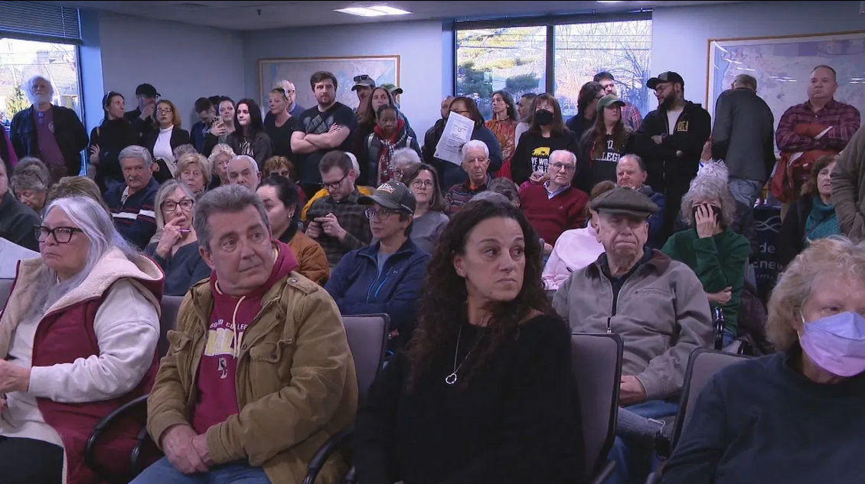
“Residents Speak Out Over Rising Energy Bills”
WJAR NBC10 News, 3/10/2025

