Slide 1
Electric Rates & Affordability Breaking it Down & Adding it Up
NECPUC Symposium
Dan Dolan, NEPGA President May 19, 2025

Slide 2
New England Power Generators Association
NEPGA members:
Employ more than 4,000 people
Own and operate roughly 27,000 MW of generation
Represents ~95% of the installed capacity in the region
A fuel and technology diverse fleet including more than
8,150 MW of non-emitting generation
NEPGA is proud to represent more clean and renewable energy in New England than any other organization.
NEPGA is the eyes, ears, and voice of the region’s power generation industry

Slide 3
New England Electricity Fuel Mix
Energy Supply
in 2024
Natural Gas
51%
Source: ISO New England https://isonewswire.com/2025/01/28/iso-ne-publishes-amounts-sources-of-electric-energy-used-to-meet-demand-in-2024/

Slide 4
New England Wholesale Energy Prices Since 2003
$123.83
$92.25
$82.39
$39.50
Source: https://www.iso-ne.com/about/key-stats/markets; Adjusted to 2024 dollars

Slide 5
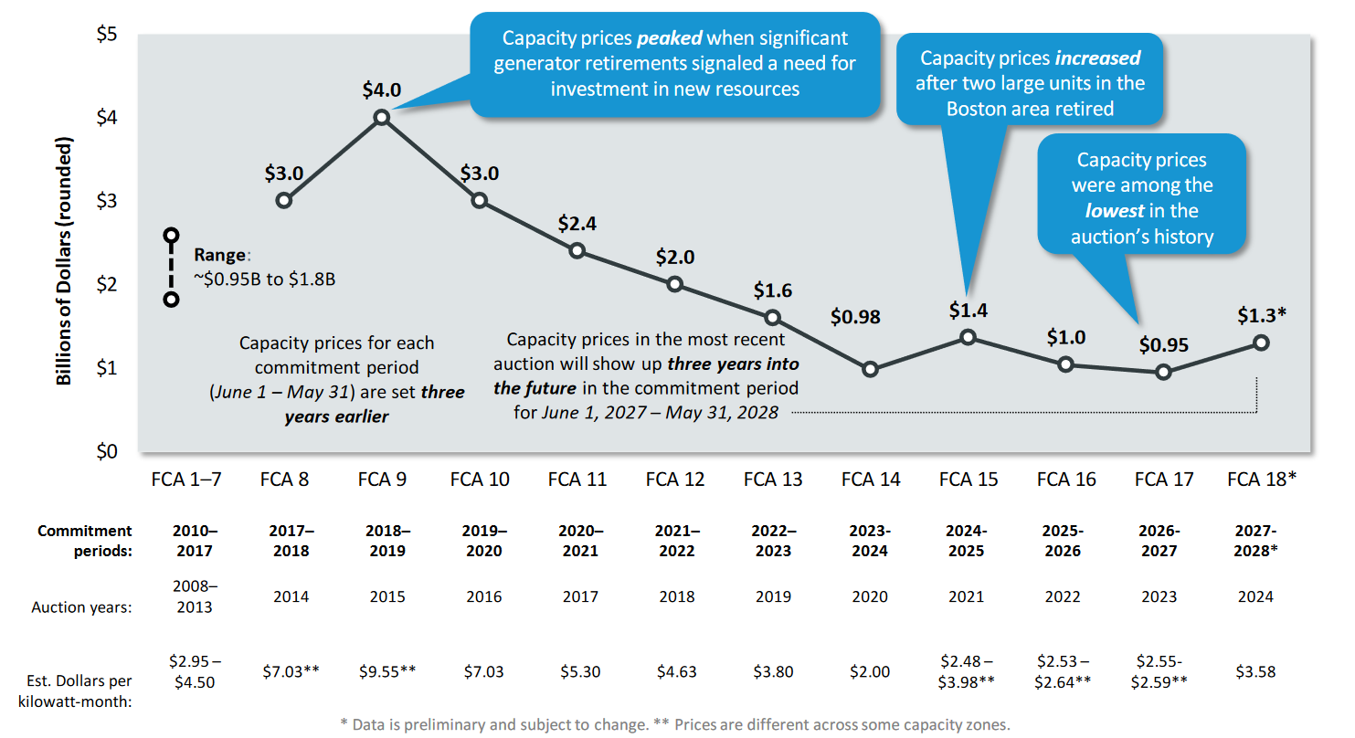
Forward Capacity Market Prices at Historic Lows
Source: ISO-NE Presentation to Consumer Liaison Group, March 6, 2024

Slide 6
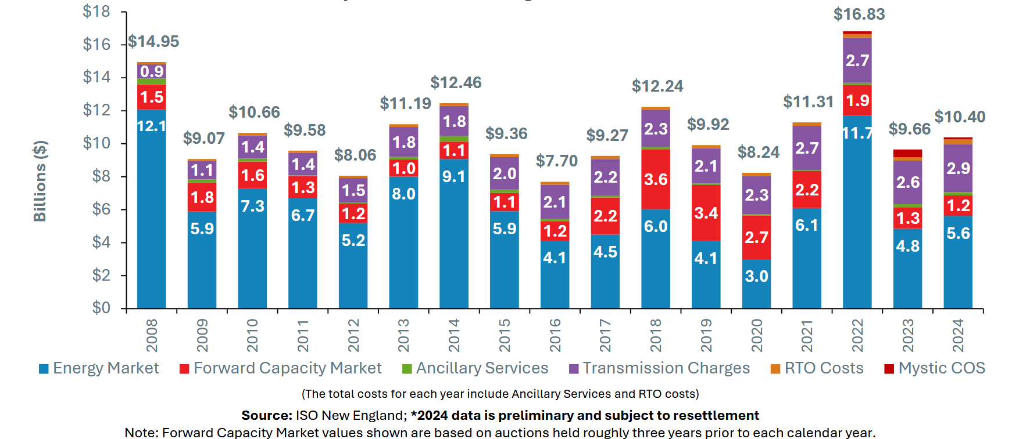
New England’s Wholesale Electricity Costs
Source: https://www.iso-ne.com/static-assets/documents/100021/clg_meeting_george_iso_new_england_update_presentation_3_27_25.pdf

Slide 7
Check out our blog, Power Lines
www.NEPGA.org
@NEPowerGen

