Slide 1
Electric Rates and Affordability: Breaking it Down and Adding it up

Slide 2
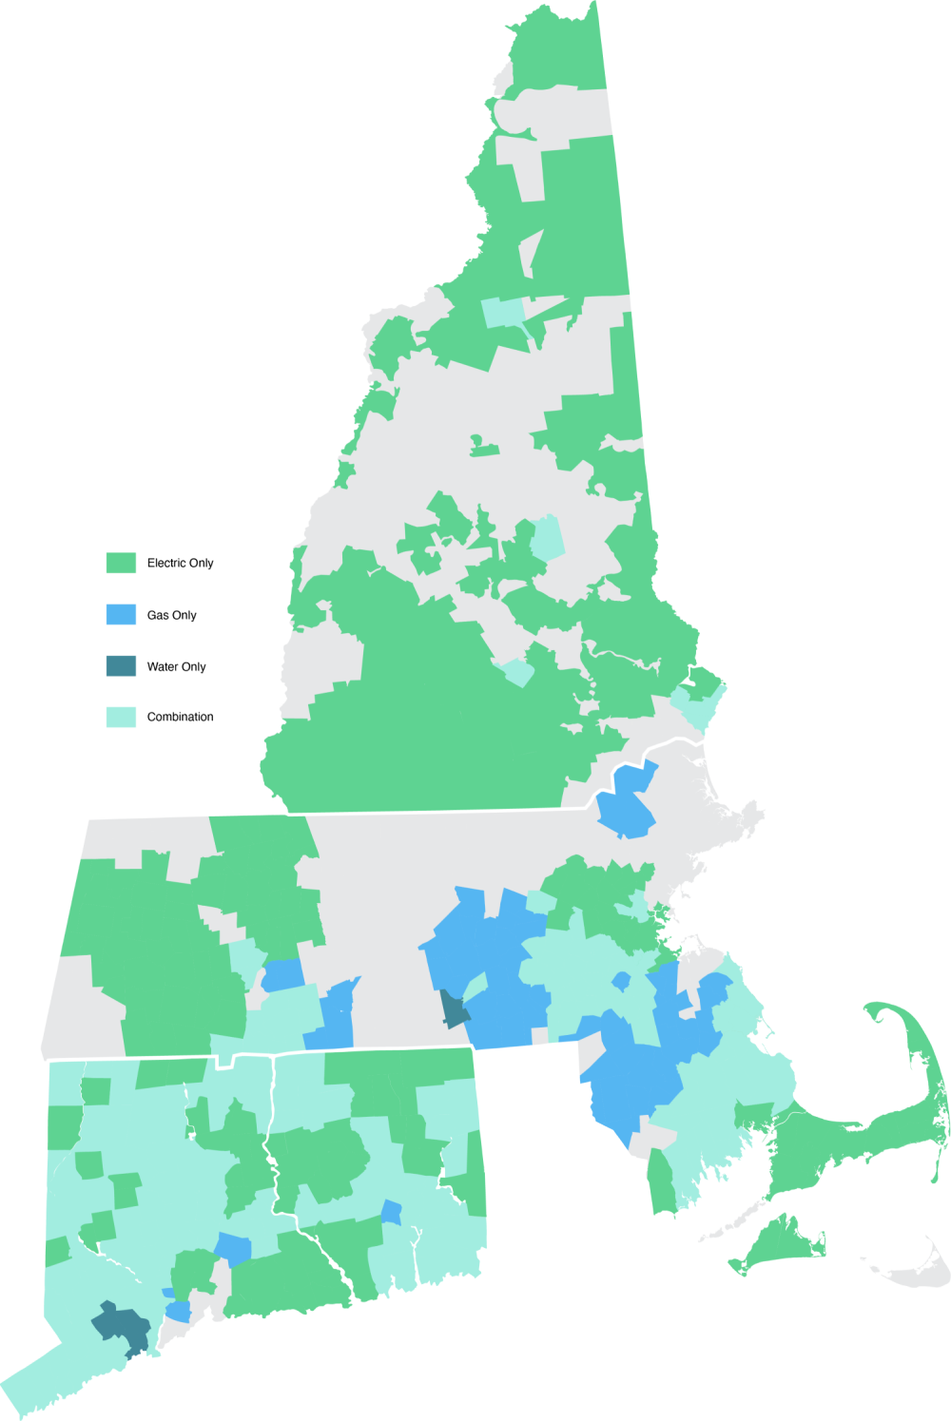
Energy Brings Us Together
We're New England’s largest energy delivery company, safely and reliably delivering energy to approximately 4.4 million customers in Connecticut, Massachusetts and New Hampshire.
Connecticut: Our electric service territory includes 157 towns, and our natural gas service territory includes 85 towns.
Massachusetts: Our electric service territory includes 159 towns, and our natural gas service territory includes 121 towns.
New Hampshire: Our service territory includes 206 towns.

Slide 3
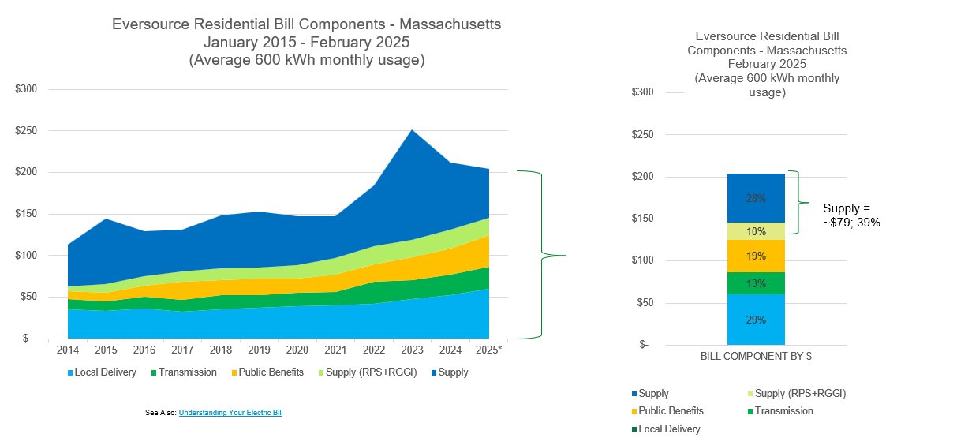
Trending bill components for the Eversource customer show that customer repayment of capital funds through distribution rates is slow and relatively stable, making it relatively affordable for customers.

Slide 4
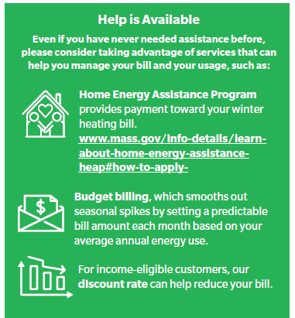
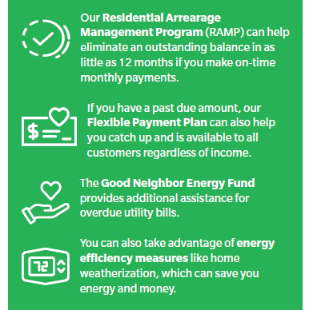
We offer numerous programs to help customers in need.
Visit eversource.com/solutions to learn more about our programs and payment plans

