Slide 1
Energy Efficiency and Customer Affordability
Maggie Molina
Executive Director, Northeast Energy Efficiency Partnerships
Presented at NECPUC 2025
May 19, 2025

Slide 2
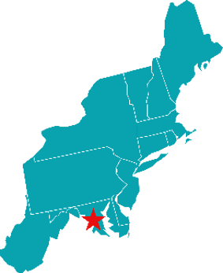
About Northeast Energy Efficiency Partnerships
Non-partisan, non-profit 501c3 organization founded in 1996
One of six Regional Energy Efficiency Organizations (REEOs)
Mission : NEEP drives regional collaboration and best practices in energy efficiency so the Northeast and Mid-Atlantic region can lower energy bills, reduce air and carbon pollution, create jobs, and improve energy and climate resilience.
Funding: Mix of federal grants & contracts, foundation grants, state partnerships, and Allies

Slide 3
Energy efficiency is a long-standing, cost-effective resource in the power sector. Ten years ago, EE was our 3rd largest resource
Data source: ACEEE, Molina et. al. 2016

Slide 4
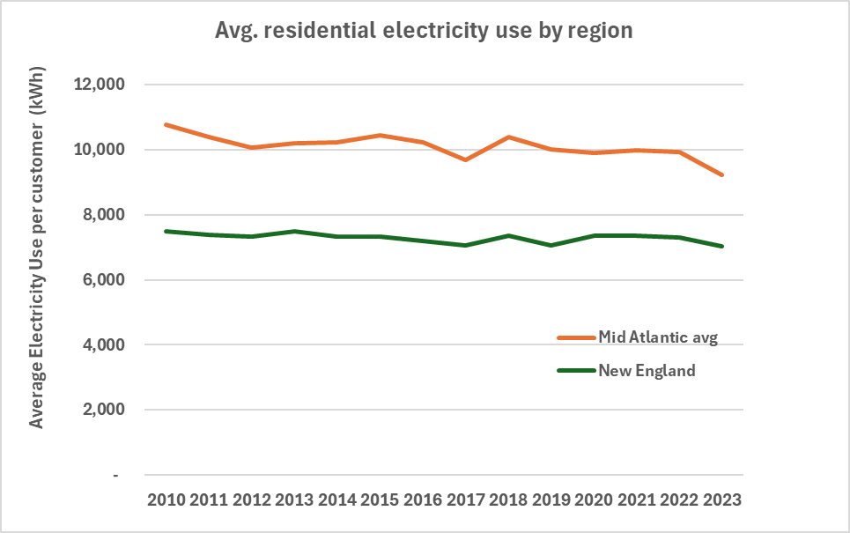
Average household electricity use has been flat across Northeast and MidAtlantic regions since 2010
Data source: U.S. EIA
Notes:
Not normalized by weather or avg. household square footage; average of state averages

Slide 5
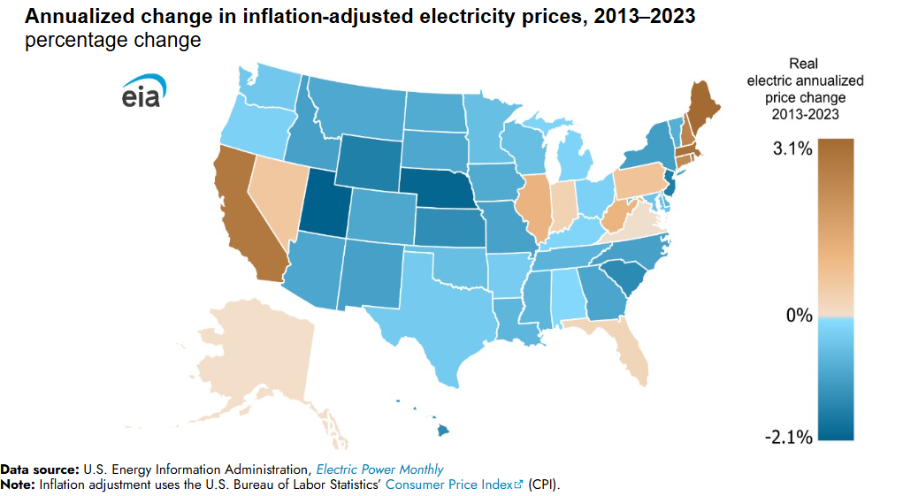
New England faced highest electricity price increases by region over past decade
https://www.eia.gov/todayinenergy/detail.php?id=63064
Notes:
“New England’s real electricity price rose from a little more than 21 cents per kWh in 2013 to the highest U.S. regional price of almost 29 cents per kWh in 2023, an annual average increase of 2.6%.
The higher costs of natural gas and fuel oil starting in 2022 (major feedstock fuels for electricity generation in New England) were significant factors influencing the trend. New England has higher transportation costs for fuels due to competition for limited pipeline infrastructure into the region.
In states that have deregulated their electricity markets (allowing consumers to select the energy portion of their electricity service) like most of New England (except Vermont), higher fuel prices directly contributed to the region’s elevated electricity retail prices. States in New England also have significant investment in RPS programs.”

Slide 6
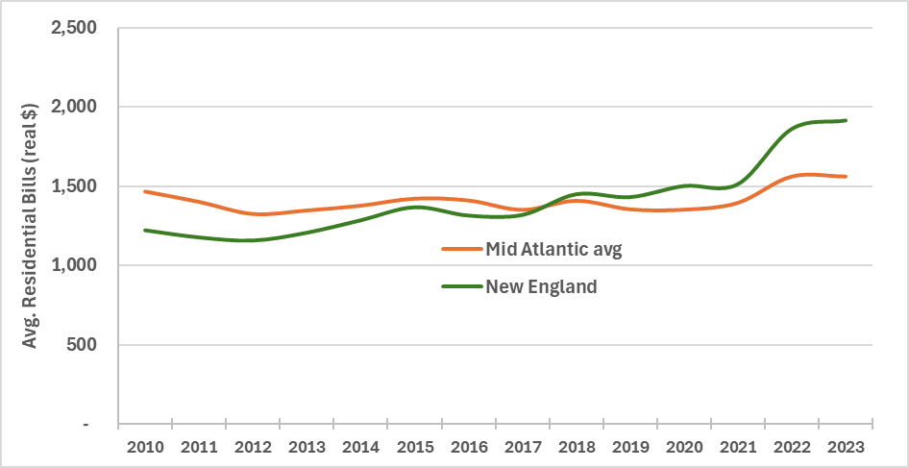
Average residential electricity bills in New England climbed 2021-2023, now exceeding bills in Mid Atlantic states
Data source: Analysis of U.S. EIA electric historical data by state

Slide 7
National trends in customer-funded energy efficiency budgets
Data source: ACEEE 2025 State Energy Efficiency Scorecard. Nominal $

Slide 8
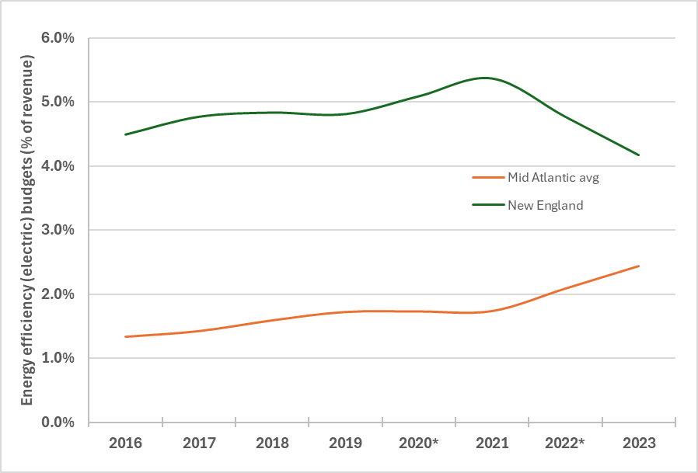
Electric energy efficiency budgets 2016-2023 (% of elec. revenue)
Electric energy efficiency budgets in New England generally declined 2021-2023
Budgets increased in Mid-Atlantic (e.g. NJ and MD)
Efficiency budgets are not correlated with recent electric bill increases
Chart does not include gas efficiency budgets
Data source: ACEEE State Energy Efficiency Scorecards

Slide 9
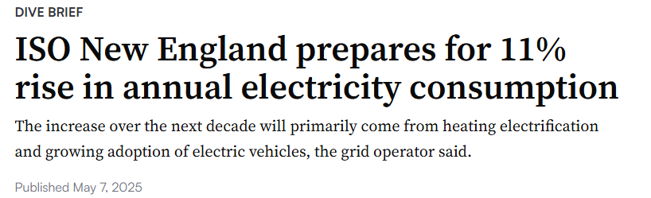


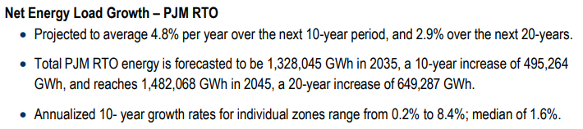
On the horizon: Regions are bracing for growth, and managing peak will be critical

Slide 10
More energy efficiency and demand side solutions are needed to keep growth in check and lower bills
Energy efficiency is the only resource that can lower use for customers
By law, efficiency investments must be cost-effective – high bar already
Policy recommendations:
  Establish multiple metrics
  Disaggregate types of resources and benefits
  Fully value benefits of demand-side resources
  Use rate design as a tool to help customers transitioning to heat pumps and electric vehicles
Evolve and expand programs to meet the needs of the next decade:
  Target customers with highest use
  Leverage consumer financing for market-rate customers
  Reach underserved customers in multifamily buildings, mobile homes, and renters
  Incorporate temporal and location-based values of efficiency in program design
  Integrate efficiency and peak demand offerings
Provide state and local leadership to fill gaps as federal standards and programs backslide

Slide 11
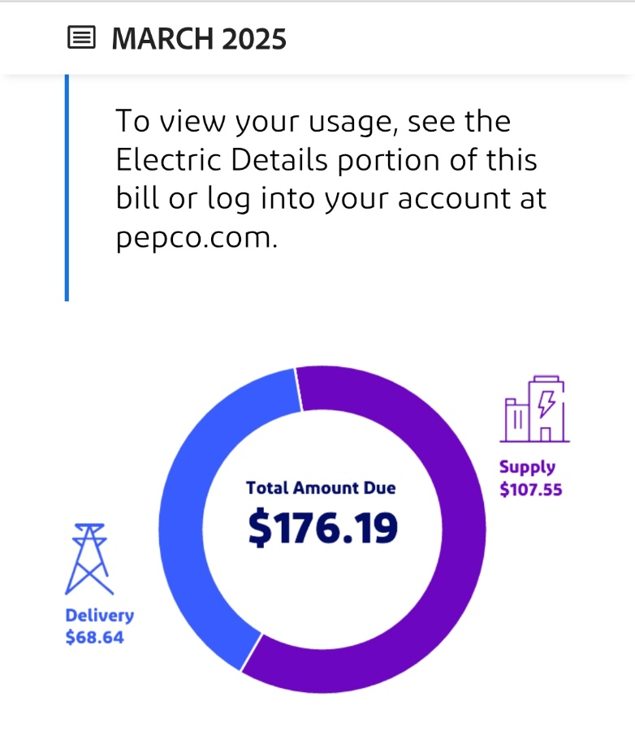
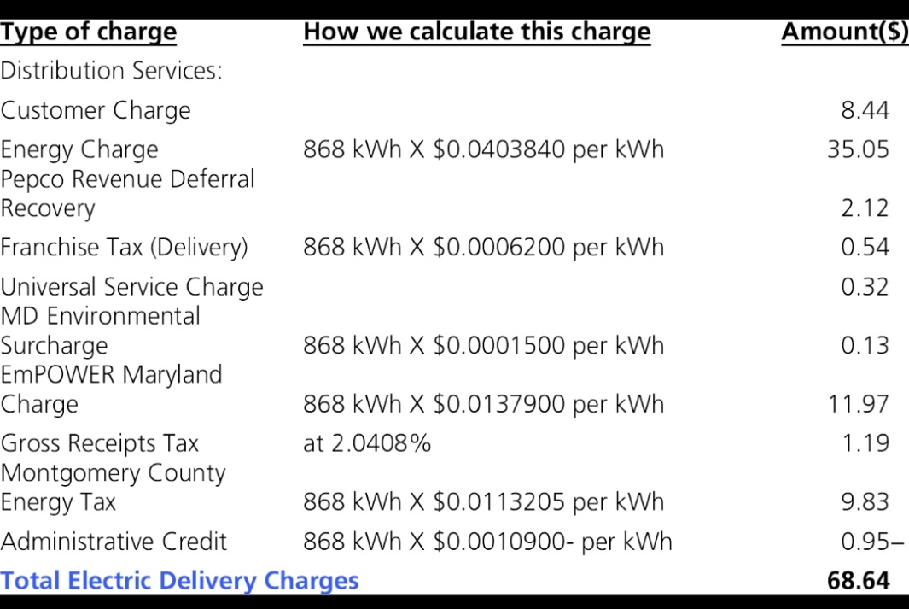
Be careful marketing efficiency as a “surcharge” instead of a resource with benefits
Monthly bill charges for efficiency vary, e.g. $5-$18 per month on average electric bills
  based on review of 3 leading states with programs
  Does not include gas bill analysis
Showing these costs as surcharges without benefits is imbalanced
Benefits typically exceed costs by 2 or 3:1
Other electricity resources not itemized on bills

Slide 12






The Many Benefits of Energy Efficiency
Health and Safety
Comfort
Cost/Energy Savings
Resilience
Cleaner Environment
Reduced Greenhouse Gases

Slide 13


Staying in touch with NEEP
Maggie Molina
mmolina@neep.org
Stay Informed
Subscribe to NEEP Notes neep.org

