Slide 1

Concurrent Session
The RPS in New England After 25 Years:
Just Getting Started, or Time for Something Different?

Slide 2
Renewable Portfolio Standards in New England
Connecticut |  | Maine |  | Massachusetts
48% by 2030 |  | 80% by 2030 |  | RPS: 100% by 2050 |  | Other Programs
Category | Eligible Technologies | Category | Eligible Technologies | Category | Eligible Technologies | Category | Eligible Technologies
Class I 2% in 2006 to 40% by 2030 | Biomass Fuel cell Geothermal Hydroelectric Landfill gas/Biogas Solar Tidal Wind | Class I/IA (New after September 1, 2005) 1% in 2008 to 50% by 2030 | Anaerobic digestion Biomass/Landfill gas Fuel cell Geothermal Hydroelectric Solar Tidal Wind | Class I (New after 1997) - Solar Carve-Out I & II Additional 1% every year | Anaerobic digestion Biomass Geothermal Hydroelectric (small) Landfill gas Marine / hydrokinetic Solar PV/Thermal Wind | Alternative Portfoio Standard 5% in 2020 and increasing by 0.5% annually afterward | Class I and II resources CHP Flywheel Storage Paper-Derived Fuel Renewable Thermal Fuel Cell Thermal Waste-to-energy
 |  |  |  |  |  | Clean Peak Energy Standard 1.5% in 2020 to 34% by 2034 and increasing by 1.5% annually afterward | New Class I resources Existing Class I and II resources when paired with qualified storage
Class II 2% in 2006 to 4% by 2018 | Trash-to-energy | Class II (Existing before September 1, 2005) 30% from 2008 onward | Class I/IA resources Cogeneration | Class II - Renewables (Existing 1997 or older) Adjustable percentage | Class I resources | Clean Energy Standard - Existing (2010 or older) percentage determined by formula | Hydroelectric Nuclear
Class III 1% in 2007 to 4% by 2030 | CHP Waste heat Conservation and load management DSM projects | Thermal REC 0.4% in 2021 to 4% by 2030 (Not included in electric RPS goals) | Heat, steam, hot water, or other useful thermal energy | Class II - Waste Energy (Existing 1997 or older) Fixed percentage | Trash-to-energy | Clean Energy Standard (New after 2010) 16% in 2018 to 80% by 2050 | Class I resources Technologies meeting certain GHG emission limits

Slide 3
Renewable Portfolio Standards in New England
New Hampshire |  | Rhode Island |  | Vermont
25.2% by 2025 |  | 100% by 2033 |  | 100% by 2030
Category | Eligible Technologies | Category | Eligible Technologies | Category | Eligible Technologies
Class I (New after 2005) 0.5% in 2009 to 15% by 2025 | Anaerobic digestion Biomass Geothermal Hydrogen Methane gas Marine / hydrokinetic Solar Thermal Wind Sub-targets for thermal energy and biodiesel production | Renewable energy resources - New (after 1997) 1% in 2007 to 98% by 2033 | Biomass Fuel cell Geothermal Hydroelectric (small) Marine / hydrokinetic Solar Wind Waste-to-energy | Tier I (Total renewable energy) 55% in 2017 to 100% by 2030 | Technology that relies on a resource that is being consumed at a harvest rate at or below its natural regeneration rate.
 |  |  |  | Tier II (Distributed Generation) 1% in 2017 to 20% by 2032 | Tier I resources Hydroelectric (small)
Class II (New after 2005) 0.04% in 2010 to 0.7% by 2025 | Solar | Renewable energy resources - Existing (1997 or older) 2% from 2007 onward |  | Tier III (Energy Transformation) 2% in 2017 to 10.66% by 2032 | Tier II resources Energy transformation projects
Class III (Existing 2005 or older) 3.5% in 2008 to 8% by 2015 | Biomass Methane |  |  | Tier IV (New renewable energy) 4% in 2027 to 20% by 2035 | Tier I resources - 2010 or newer
Class IV 0.5% in 2008 to 1.5% by 2015 | Hydroelectric (small) |  |  | Tier V (Load growth) 50% in 2025 to 75% by 2035 | Tier I resources with higher requirements for load growth from 2024 levels

Slide 4
Estimated 2023 Cost of RPS Compliance
State | Cost of Compliance | Load (MWh) | Cost per MWh
Connecticut | $ 330,555,275 | 26,820,000 | $ 12.32
Maine | $ 83,222,891 | 11,956,880 | $ 6.96
Massachusetts | $ 1,022,999,877 | 52,689,000 | $ 19.42
New Hampshire | $ 67,613,925 | 11,333,000 | $ 5.97
Rhode Island | $ 63,761,529 | 7,654,000 | $ 8.33
Vermont | $ 20,906,620 | 4,927,000 | $ 4.24
Total | $ 1,589,060,116 | 115,379,880 | $ 13.77
Vermont REC prices calculated based on 2024 Annual Report on the Renewable Energy Standard. Maine load and REC prices sourced from 2025 Annual Report on New Renewable Resource Portfolio Requirement. Load for all other states except Maine based on ISO New England 2023 Net Energy for Load; REC prices for Connecticut, New Hampshire, and Rhode Island from S&P Capital IQ, used by permission.

Slide 5
Renewables Portfolio Standards: What are They Good For?
New England Conference of Public Utilities Commissioners Symposium
Mystic, CT
May 19, 2025
Arne Olson, Senior Partner

Slide 6
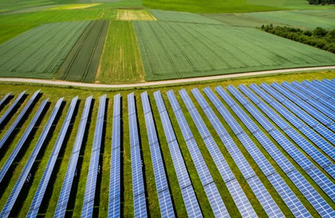

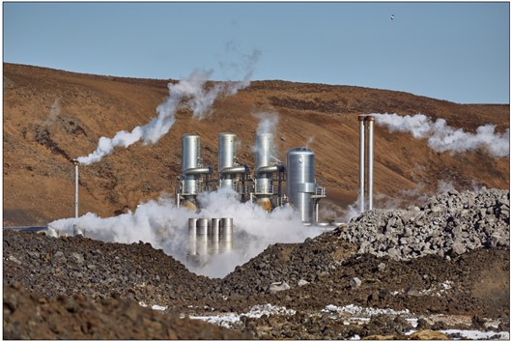


What are Renewables Portfolio Standards good at?
RPS policies are effective at spurring the development of renewable energy!

Slide 7
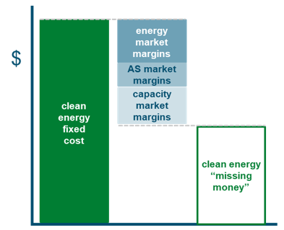
Clean energy attribute fundamentals: a review
  Clean Energy “Missing Money” Problem
“Demand-pull” policies have been needed to drive clean energy adoption because clean energy has been more expensive than conventional energy
  Demand-pull policies such as RPS solve the clean energy “missing money” problem by creating additional compliance value
  RECs represent the missing money or “green premium” that clean energy projects need to compete with conventional energy
  REC prices provide a visible value signal for clean energy developers

Slide 8
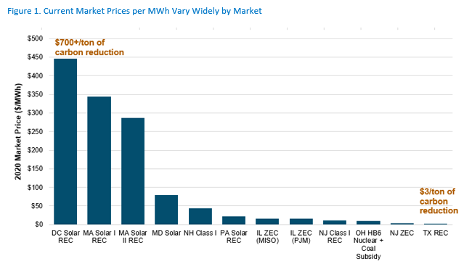
What are the limitations and issues with RPS policies?
RPS policies tend to be narrowly focused on specific types of resources (SRECs, “Buckets”)
  Market is highly fragmented and inefficient
  May exclude non-emitting resources like nuclear or hydro
REC values are not easily monetizable by project developers
  Long-term PPAs are still needed in most cases, which can be a problem in restructured markets
Reforms are needed to make policies more effective for carbon reduction
  Broader geographical and technological eligibility
  Promote market liquidity and price transparency
Flexible Options for Trading Energy Transition Credits (ETCs)
National ETC market could be the “Henry Hub of RECs”!

Slide 9
But do “attribute” purchases really save carbon?
The purchase of a clean energy attribute leads to additional clean energy as long as there is scarcity in the attribute market
Marginal emissions reductions are generally similar across time and space because natural gas generation is almost always the marginal emitting resource
Price of clean energy attribute
($/MWh)
1
Incremental demand
Market Supply
Clean Energy Quantity
(TWh)
2
Incremental clean energy
Scarcity in attribute market means that incremental clean energy demand does
lead to incremental supply

Slide 10

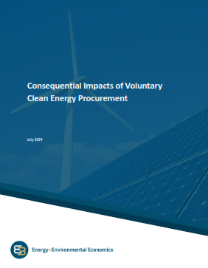
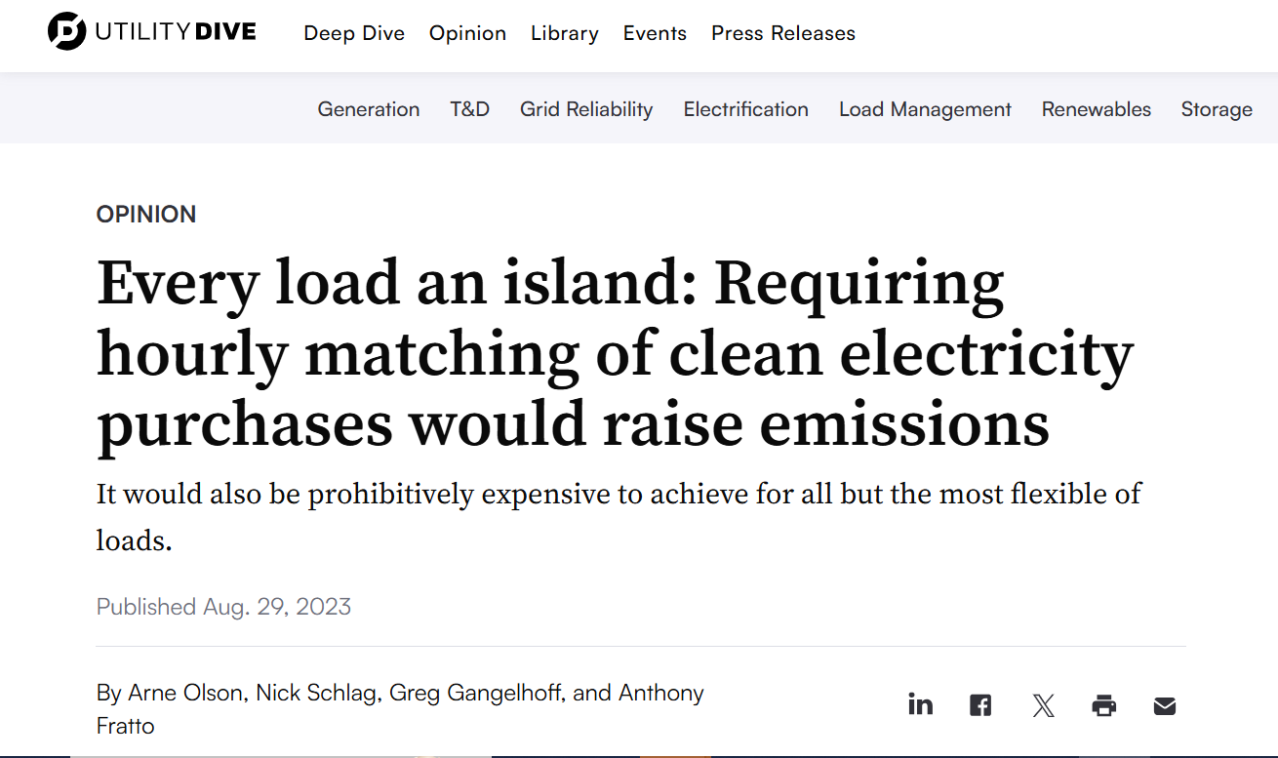
E3 publications related to clean energy market design
Every Load an Island
E3 Op-Ed in Utility Dive
https://www.utilitydive.com/news/hourly-matching-clean-electricity-renewable-energy-purchases-e3/692099/
Scalable Markets for the Energy Transition E3 White Paper partially funded by EPSA
https://www.ethree.com/scalable-markets-for-the-energy-transition-a-new-e3-report/
Consequential Impacts of Voluntary Clean Energy Procurement
E3 Study partially funded by Meta https://www.ethree.com/meta-voluntary-clean-energy/

Slide 11
Thank you!
Arne Olson, Senior Partner (arne@ethree.com)

Slide 12
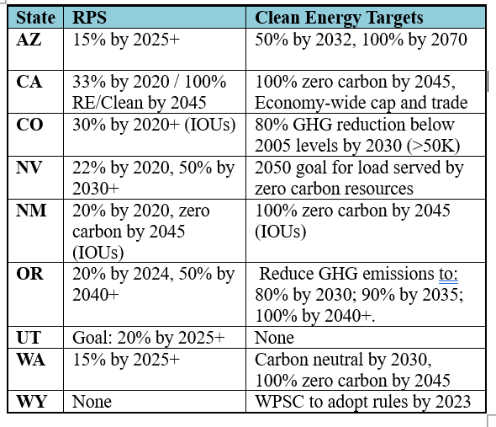
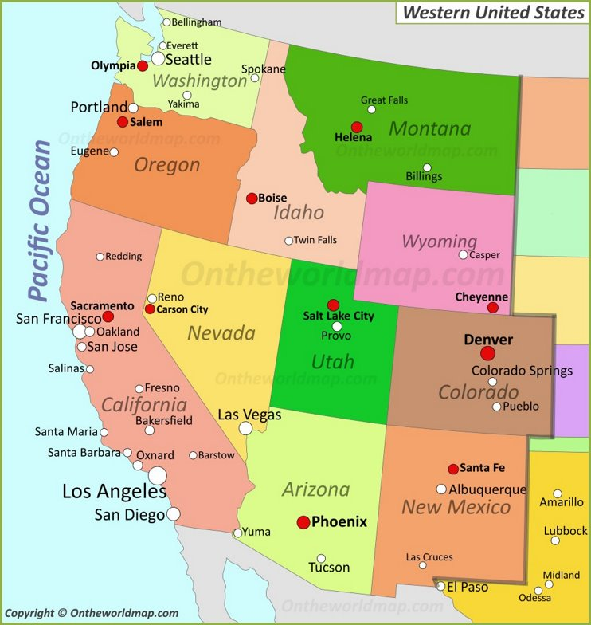
Western RPS and Clean Energy Laws
Spees, Grove, Tsoukulakis, and Lam, Greenhouse Gas and Clean Energy Accounting Methodology Catalog,
The Brattle Group, June 2023

Slide 13
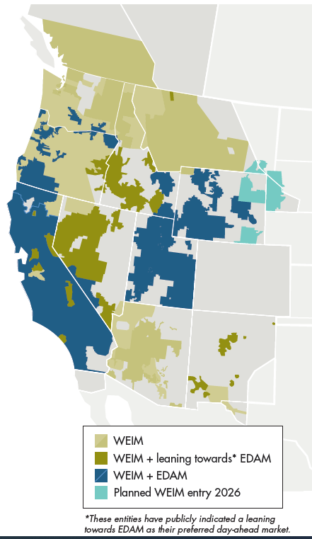
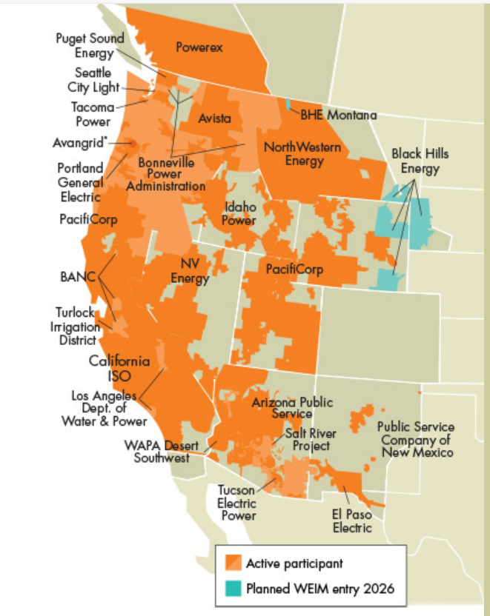

Western Electricity Markets
Western EIM
CAISO EDAM
SPP Markets+

Slide 14

A brief history of the Forward Clean Energy Market (FCEM)
  Concept: A centralized platform for states and voluntary buyers to procure clean energy and capacity on a competitive basis
New England Developments:
  State-requested NEPOOL process on Integrating Markets and Public Policy (2016-2017), and market Pathways (2018-2021)
  New England Energy Vision (2020-2021), including in the Visioning Report to the Governors
  Massachusetts 2022 Climate Act (Section 85) that required assessment of and authorized participation of regional FCEM. MA DOER review resulting in most recent New England FCEM proposal
PJM Interconnection
  New Jersey Board of Public Utilities Resource Adequacy Investigation (2020-2022), including 2021 staff report and 2022 progress report
  PJM Interconnection Clean Attribute Procurement Senior Task Force (2022-2023), including PJM modeling analysis of centralized clean energy procurement mechanisms
  Organization of PJM States, Inc. (OPSI) Forward Energy Attribute Market Working Group (2023-2024), including OPSI positions on governance structure and market design
See Full Proposal: New England FCEM Design

Slide 15
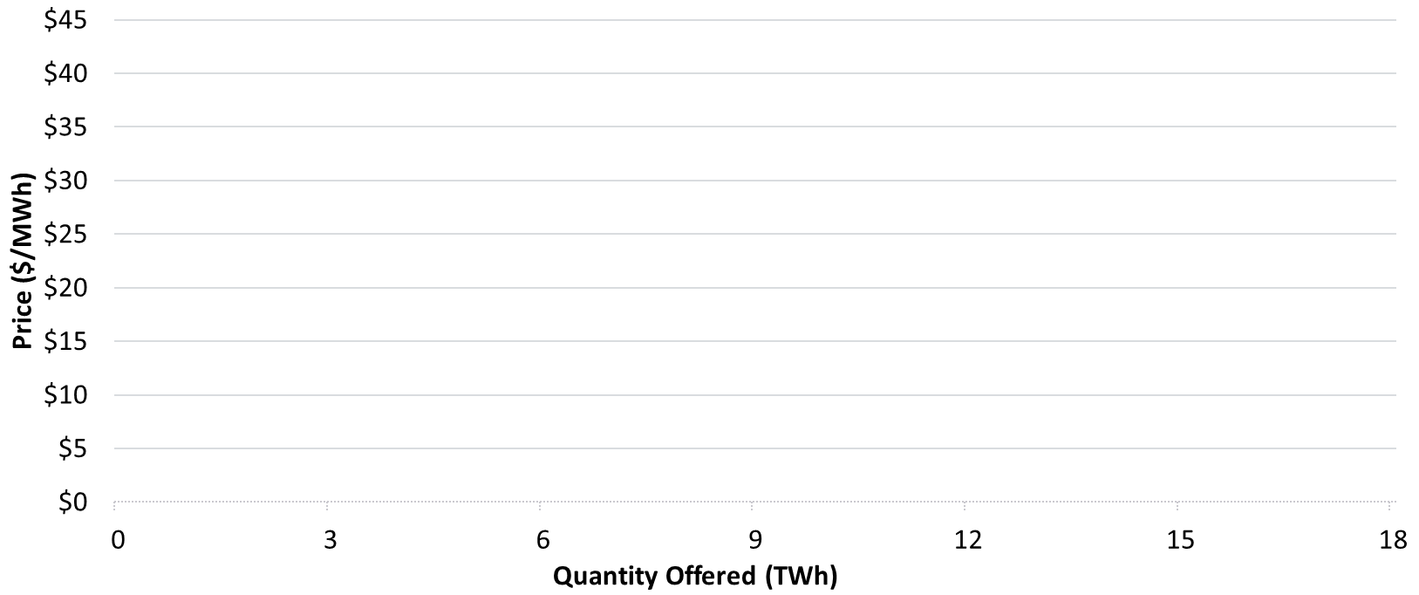
FCEM: Design structured to attract investment at competitive prices
Fills the unmet needs of states and consumers that require increasing influence over resource mix and pace of decarb, while leveraging the benefits of competitive markets
  Products: Region-wide REC (MWh of RECs) and clean capacity products (MW of ISO capacity commitments), plus option for states to list state-specific products
  Term: 1 year for existing resources, 7-15 year commitments for new supply
  Buyers: Submit demand bids as price-quantity pairs expressing volume, maximum willingness to pay ($/REC), eligible technologies. Can submit different prices for new resources under multi-year term vs. existing resources
  Sellers: Submit minimum price & volume
  Clearing Price: Set at the intersection of supply & demand. Co-optimized clearing to maximize benefits of trade across multiple products, and reduced the joint cost of RECs+capacity
  Schedule: Annual auction, held 3 years in advance of delivery
FCEM Auction Clearing
Uncleared supply & demand
Demand Bids
Auction clearing price is mutually attractive to all winning buyers & sellers
State Agencies
Utilities
Supply Offers
Price ($/REC)
Towns
Universities
Corporate
Quantity (RECs)

Slide 16
What is the role of FCEM compared to other policies & contracts?
Platform would be flexible for states to rely on FCEM purchases either in a small way (e.g. topping up needs from existing supply), or could be scaled up as the primary means of attracting large-scale clean energy investment & managing fleet transition
Example: A State Clean Energy Supply Plan
FCEM Purchases
(New or Existing)
State determines share of clean energy supply needs to procure via FCEM, potentially increasing reliance over time as market gains maturity
Total Energy Demand
FCEM New Resource Purchases
A share of FCEM purchases can be earmarked for 7-15 year new resource commitments (transitions to eligibility as existing supply after initial term)
Clean Energy Demand
State Energy Demand (TWh)
Other State Contracts & Policies
New contracts and state policies will continue to be used by states, e.g. to pursue objectives not addressed by FCEM such as local employment, DEI, environmental justice (transparency in FCEM can inform better resource selection & pricing)
Existing Contracts
As existing contracts expire, resources become eligible to compete in FCEM
2030 | 2035 | 2040 | 2045 | 2050

