Slide 1
Concurrent Session Offshore Wind: Where are We Headed, and How Quickly?

Slide 2
May 19, 2025| Groton, CT
Offshore Wind: Where are We Headed and How Quickly?
Al McBride
Vice President, System Planning

Slide 3
Increased Electrification is Expected to Drive Steady Growth in Net Annual Energy Use Following two decades of decreased net energy use as a result of state policies incentivizing solar PV and energy efficiency
Source: ISO New England 2025-2034 Forecast Report of Capacity, Energy, Loads, and Transmission (2025 CELT Report) (May 2025)

Slide 4
Average Annual Buildout Necessary to Achieve State Goals by 2050
1,293 MW
per year of offshore wind
955 MW
per year of solar
268 MW
per year of land-based wind
952 MW
per year of batteries
Source: Economic Planning for the Clean Energy Transition: Illuminating the Challenges of Tomorrow’s Grid

Slide 5
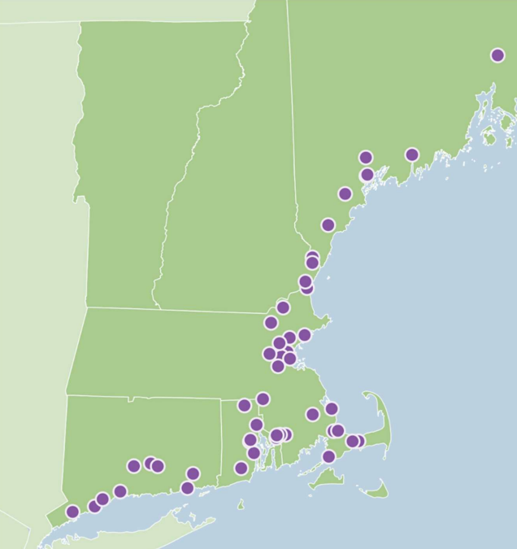
2050 Transmission Study: Offshore Wind Analysis
In March, ISO published a 2050 Transmission Study: Offshore Wind Analysis
Stakeholders requested the OSW analysis as a follow-up to the 2050 Transmission Study (Feb 2024), which identified high-likelihood concerns, roadmaps, and estimated costs to inform stakeholders of transmission infrastructure needed to provide reliable, cost-effective energy to NE throughout the clean energy transition
The analysis examined 50 possible interconnection points within 20 miles of the coast, and simulated the regional transmission system under a variety of electrical demand conditions in which potential wind farms operated at full output
While the study refers to potential interconnected resources as OSW, the injections studied could represent any resource type

Slide 6
2050 Transmission Study: Offshore Wind Analysis Key Takeaways
The report highlights the importance of holistic planning and coordination between states in the construction of OSW within the existing transmission system
Connecting some of the initial study’s hypothetical future OSW further south could reduce necessary upgrades
~9,600 MW of OSW may be able to interconnect in the region and operate simultaneously without major transmission upgrades or significant curtailment
~20 substations near New England’s coastline may be suitable for interconnecting 1,200 MW of OSW without new or upgraded transmission infrastructure
Relocations

Slide 7
Offshore Wind and Winter Reliability
The Operational Impact of Extreme Weather Events study examined how the region’s power system would fare under stressful future weather and operational conditions
The study created a framework for ongoing assessments: the Probabilistic Energy Adequacy Tool (PEAT) will help identify circumstances that could lead to an energy shortfall, giving the region’s stakeholders advance warning and the opportunity to take steps to avert it
Sensitivity analysis of 2032 worst-case scenarios indicates an increasing energy shortfall risk profile between 2027 and 2032
Timely additions of solar, offshore wind, and incremental imports are critical to mitigate energy shortfall risks that result from significant winter load growth and retirements
OSW resources can be a steady source of energy that is injected directly into major load centers in New England, and their production profile during the winter can help offset the effects of the constraints on the gas pipeline system

Slide 9
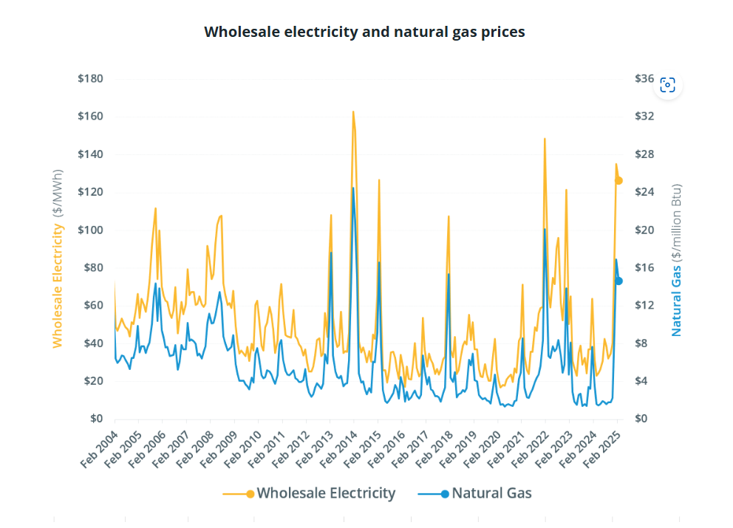
Winter 2024/2025: The role of Offshore Wind in Regional Energy Mix
Average wholesale power price in February 2025: $126.40/ MWh (real-time energy market)
Up 301% compared to prior year
Resource mix: Natural Gas 50.7%, Nuclear 28.5%, Renewables 13.5%
Increasing offshore wind can offset winter peaks
High-level assessment for 2017/18 cold spell
Just 400 MW of OSW could have avoided $20-25M in production costs
600 MW of OSW up to $80-$85M in production costs avoided
Decrease in day-ahead LMP
2025 analysis from New York estimated savings of $80M for January 2025
Sources: ISO-News Wire March 26, 2025 (Chart) available at Monthly wholesale electricity prices and demand in New England, February 2025 - ISO Newswire; ISO NEWSIRE December 18, 2018 ISO-NE analyzes potential impact of offshore wind during historic cold spell - ISO Newswire; Aurora Energy Research – Meeting New York’s Energy Needs: Reliability & Offshore Wind, Commissioned by ACENY May 2025
Notes:
Wholesale power prices averaged $126.40 per megawatt-hour (MWh) in the Real-Time Energy Market in February 2025, up 301% compared to the previous year.¹ Day-Ahead Energy Market averages were $130.39/MWh, up 256% from February 2024.

Slide 10
Big Picture: How Offshore Wind works with overall generation mix
Energy generation resources across the board are facing increasing costs and timelines
New Natural Gas
Timeline: 2030+
Cost: $85-$115/ MWh*; estimate of $2300/kW in 2030
Small Modular Nuclear Reactors
Timeline: 2030+
Cost: Start at $8,500/kW (fall to 5,500/kW in 2050)
Recent example in Ontario: 3GW for $5.5B, expected online in 2030
Expansion of Existing Nuclear - Georgia Vogtle 3&4:
Timeline: Online in 2024 (seven years behind schedule)
Cost: $31B
Sources: NextEra 2025 March Investor Deck.pdf; ISO-NE 2024 Economic Study (March 19, 2025 PAC Presentation) ; SMR numbers from ISONE Economic Planning for the Clean Energy Transition; RTOInsider Ontario Greenlights OPG to Build Small Modular Reactor; Georgia nuclear rebirth arrives 7 years late, $17B over cost | AP News
Notes:
Not considering costs of new pipeline, likely on higher end to build in our region
Lead time for gas turbine orders reaching up to 37 months
Commercial SMRs face resource, supply chain, labor bottle necks
Vogtle- that is even with federal loan guarantees

Slide 11
Big Picture: Offshore Wind and Energy Policy Objectives
ISO-NE policy sensitivity analysis finds that without OSW the total annualized build costs increased by $26B
Takeaway is that New England needs new OSW resources to meet state emission goals at the lowest cost
Additional benefits for region
Reducing demand for land for onshore resources
Complements a future winter peaking system
Improved air quality in the region

Slide 12
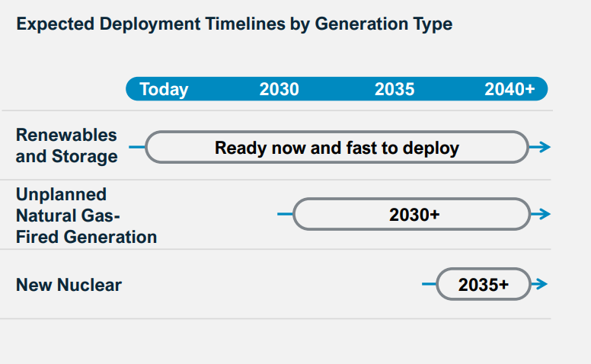
Gas Timelines
Sources: NextEra First Quarter 2025 Earnings Conference Call at 4 (April 23,2025);

