Slide 1
Concurrent Session Water Utilities & Cybersecurity Issues

Slide 2
2025 NECPUC SYMPOSIUM
Water Utilities – Cybersecurity

Slide 3
Introducing
H2O America
New brand for parent company, formerly known as SJW Group
We protect what’s precious.
Water is local—and so are our roots. Through our four regional water utilities—Connecticut Water, Maine Water, San Jose Water, and Texas Water—we proudly serve 1.6 million people across the country. Together, we protect what’s precious.

Slide 4
San Jose Water

Slide 5
Mission, Vision and Values
Mission
We sustain life by providing high-quality water and exceptional service while also investing in the health and vitality of the communities we serve.
Vision
Thriving communities, built on reliable water and world-class service - today and for generations to come.
Values
Do it right.
We uphold the highest standards of integrity. We make the right choices, even when they’re hard, and foster a culture of transparency and accountability with straight talk.
Do it together.
We believe in the power of partnership – because we’re stronger together. We respect each other’s expertise and collaborate with trust and teamwork to reach better outcomes for all.
Do it with heart.
We serve with compassion, positivity and purpose. By actively listening, delivering solutions, and making a lasting impact, we strive to be a force for good in our communities and beyond.

Slide 7
Mitigating Cyber Risk in Operations

Slide 8
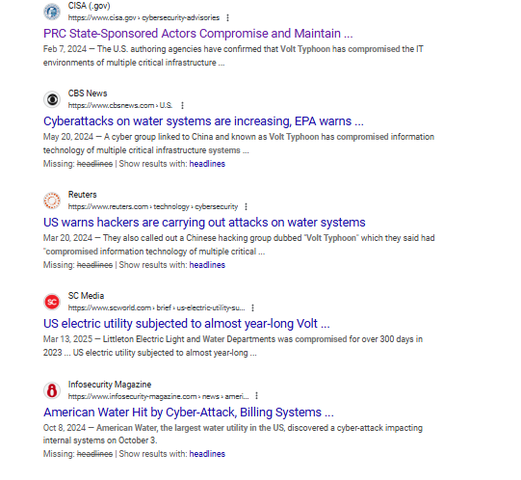
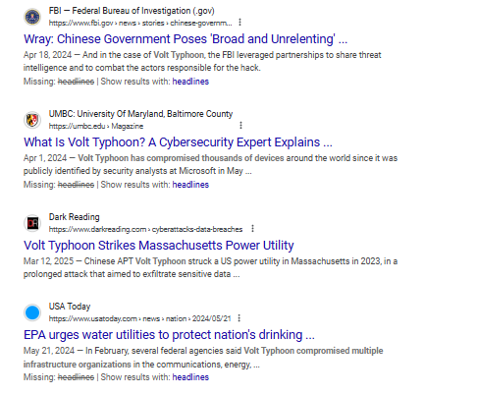
Why the Focus

Slide 9
Recovery and Mitigation
Critical Infrastructure - Target of interest
Public Trust and Confidence -
- Preparedness and Communication
- Automation and manual operations
- People and culture
Role of Regulators - Proactive role in coordination of state and federal resources, programs expertise like CISA, regional risk assessments, advocating for funding

Slide 10
Framework, Governance, Accountability
Coordinated Oversight - Force accountability and action
Regional Collaboration – Cyber mutual aid assistance framework
Investment - Investment is needed in both tools and people

