Slide 1
Concurrent Session You’ll Never Know if You Don’t Try: Considering Innovative Technologies for Broader Uses

Slide 2
Regulatory Sandboxes
Curing ‘Pilotitis’
Matthew McDonnell, Current Energy Group

Slide 3
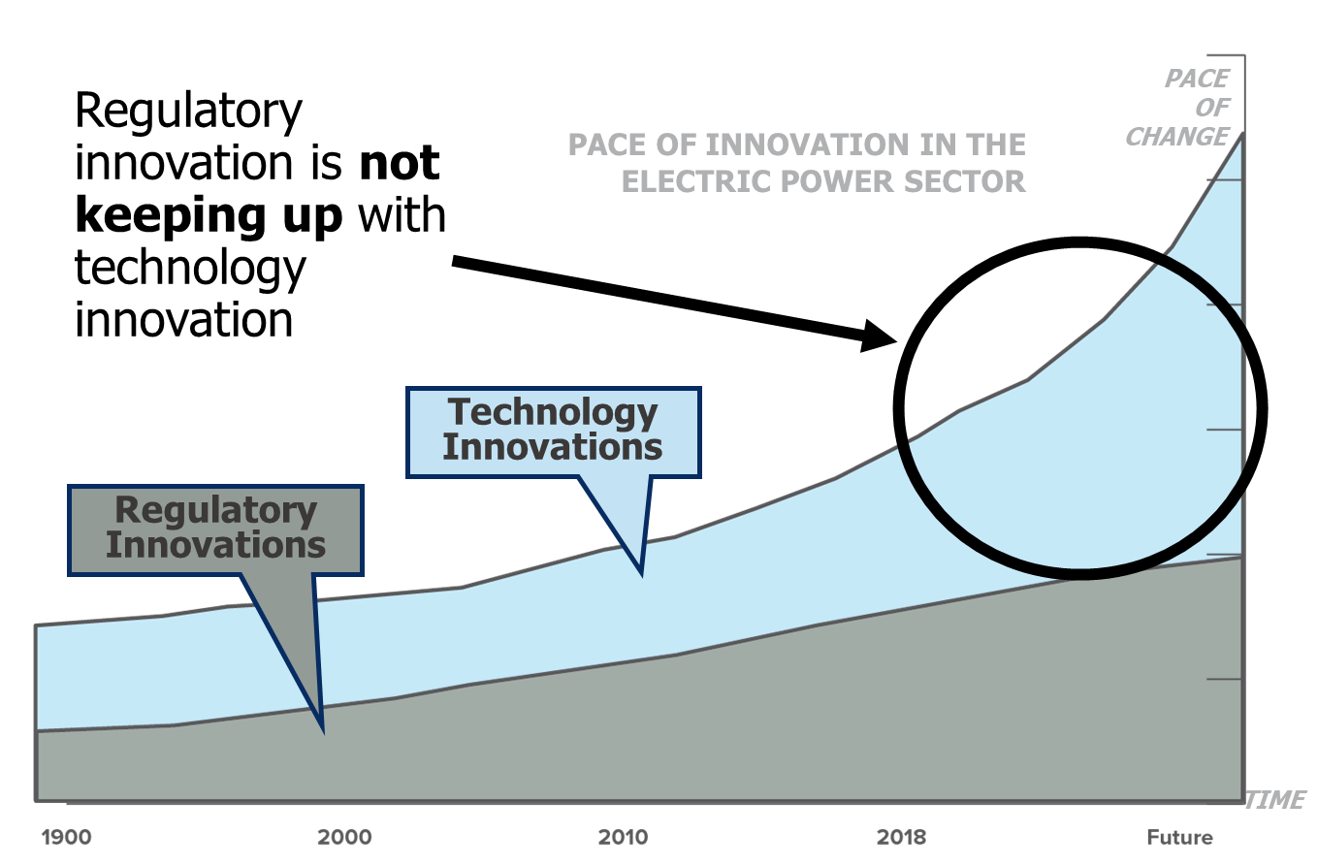
Regulatory Innovation Imperative

Slide 4
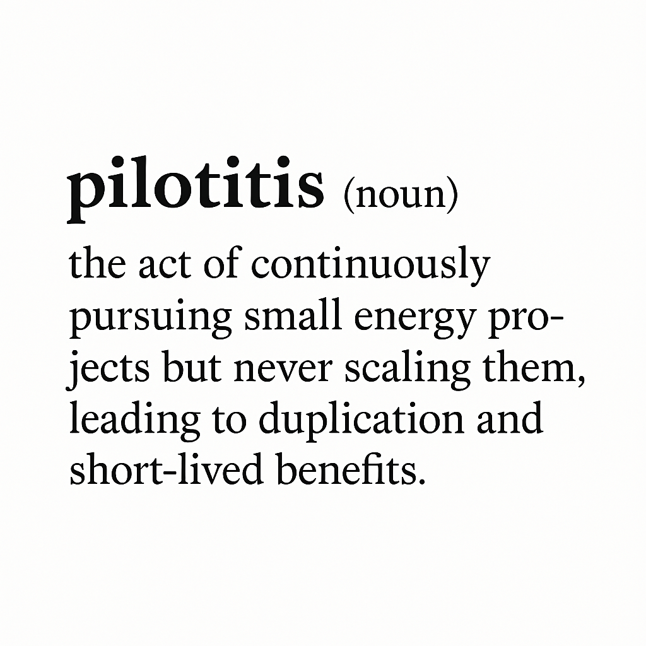
Regulatory Innovation Imperative

Slide 5
Regulatory Innovation Imperative
Curing ‘pilotitis’
Common shortcomings with traditional pilot approaches:
Utility as sole gatekeeper of innovation
Length of time from pilot application, approval, and deployment
Lack of scaling opportunities, even when successful
Opaque data collection and sharing/learning opportunities
‘Field of Dreams’ Theory – if you build it, will they come?

Slide 6
Connecticut: Innovative Energy Solutions Program
Purpose
Deploy high-value project solutions that might not otherwise be possible or expedient within the current regulatory environment
Participation Pathways
Program Structure
EDC-led
Third-party developer-led
Partnerships between EDCs and third parties
4 phases over a 2-year cycle
New cohort of projects each year
Support the Public Utilities Regulatory Authority’s framework for an Equitable Modern Grid

Slide 7
Connecticut: Innovative Energy Solutions Program
Phase 1: Ideation & Screening
Solicit ideas from innovators that could be suitable for the Innovative Pilots Framework program
Screen out projects that are not suitable for the program and send to an alternate program, as appropriate
Phase 4: Assessment & Scale
Review performance from projects
Identify projects to potentially scale and retire projects that have served their purpose
Identify opportunities for improvement and/or goals for next program cycle
Phase 2: Prioritization & Selection
Evaluate potential projects based on criteria such as value delivery, customer impact, potential to scale, alignment with EMG objectives, etc.
Select portfolio of projects that can test various unique elements of design
Phase 3: Project Deployment
Establish scope, scale, and duration of projects
Establish tracking and performance metrics to be used through implementation
Core design element is to break away from traditional ‘pilotitis’ and affirmatively accelerate successful pilots to full-scale deployment

Slide 8
Connecticut: Innovative Energy Solutions Program
Pathway 1:
Developer-Led Projects
Pathway 2:
EDC-Led Projects
Pathway 3:
Collaborative Projects
Focus on innovative mechanisms for deploying hardware and/or software solutions
E.g., innovative solutions that help maximize grid and end-use flexibility
Focus on innovative tariff structures
E.g., critical peak pricing for commercial & industrial customers; bring your own device (BYOD) programs that may enhance demand-side flexibility
Focus on deploying hardware and/or software, paired with innovative tariff structures
E.g., smart thermostat demand response program that pays out directly to customer bills

Slide 9
Matthew McDonnell
Managing Partner
mmcdonnell@currentenergy.group

Slide 10
About Piclo
Our mission is to decarbonize the world’s grids
Piclo develops software solutions that make our energy networks smarter, flexible and more sustainable
Enable DER Providers and Flex Service Providers (FSPs) to capture new revenue opportunities
350,000
2.6 GW
$100m
Flexible assets registered
Flexible capacity procured
Of flexibility contracts awarded
Enable Utilities, Retailers, and Grid Operators to procure flexibility at scale
26 GW
6
14
Flexible capacity registered
Countries
live
Active
grid operators
Provide independent insight to help shape the future of flexibility

Slide 11
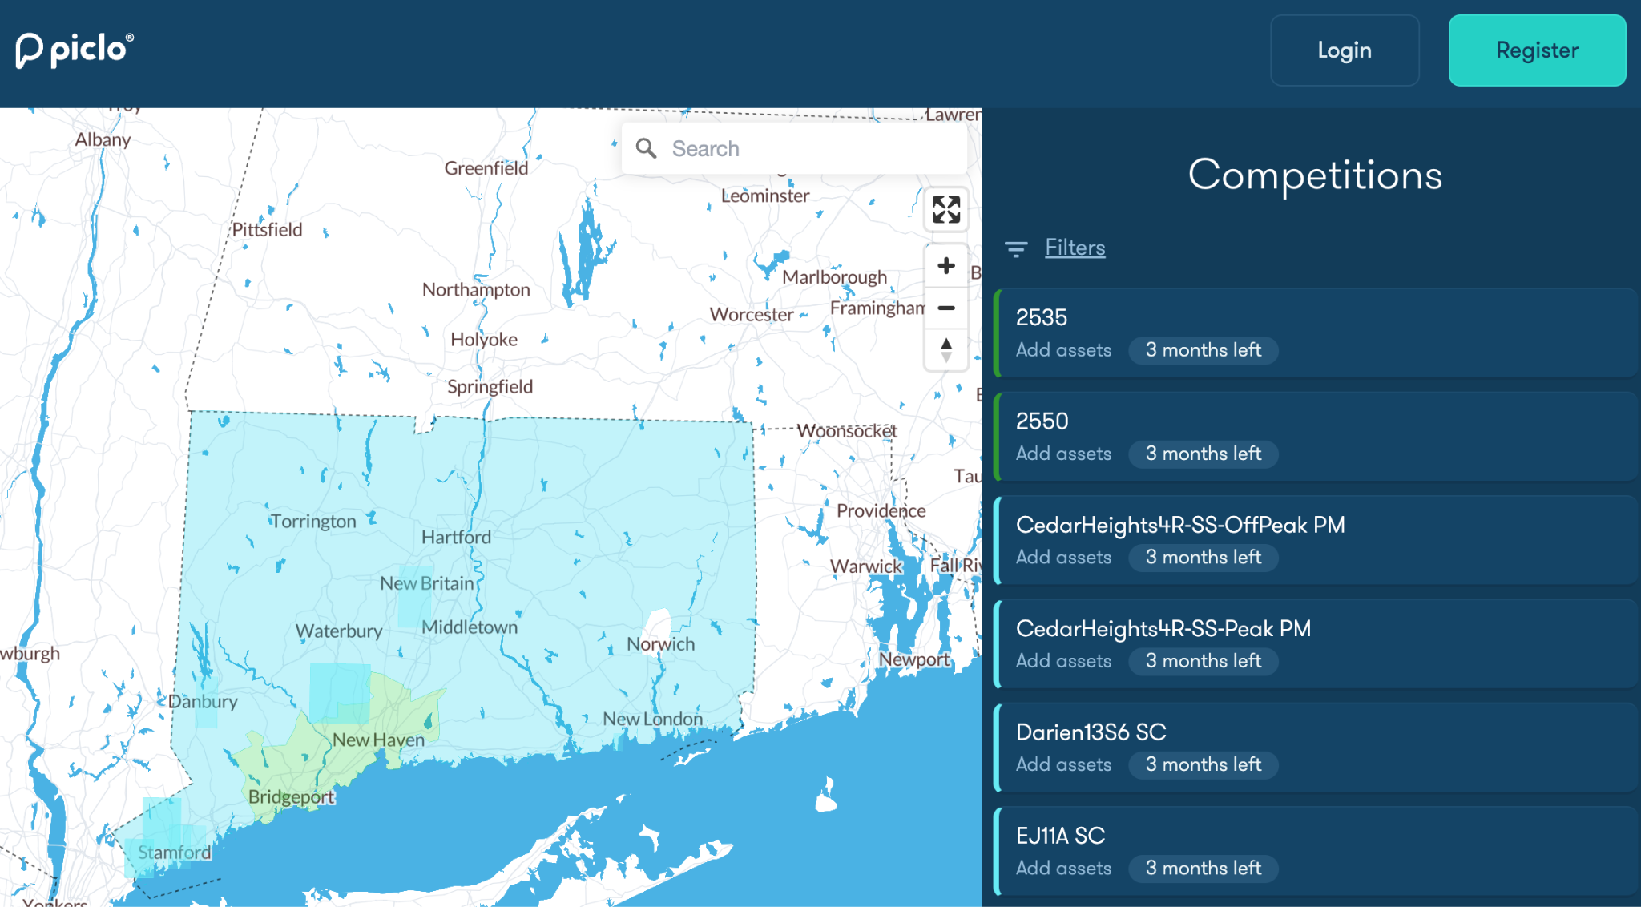
New England’s first DER grid flexibility marketplace
Piclo launched the first DER marketplace in New England with Eversource and United Illuminating (part of Avangrid) in Connecticut in early 2024
Awardees from Innovative Energy Solutions Cycle 1, established via Connecticut’s Public Utilities Regulatory Authority (PURA) to pilot and scale technologies that support a decarbonized, affordable, and equitable electric grid
Piclo played a key role in defining the market design, eligibility, use cases, incentive structure, contracting, and provider engagement strategy
Coordinated across DER and DR program managers to ensure communication with customers and flexibility partners (e.g., EV charging providers, C&I aggregators), and coordination with other program activities
Eversource and UI territories on the Piclo marketplace
Market Milestones
April ‘24 – Marketplace launched in CT
July - Sep ‘24 – Provider qualification period
Oct - Nov ‘24 – Bidding and contracting period
Dec ‘24 - Feb ‘25 – Winter dispatch season
Feb - Mar ‘25 - Spring qualification, bidding, contracting
Apr - May ‘25 – Spring dispatch season
Key Outcomes
67 DER Providers registered on the platform
20 competitions posted by Eversource and UI
>8k assets and 67 MW uploaded to platform
6 unique DER providers actively bidding and dispatching

Slide 12
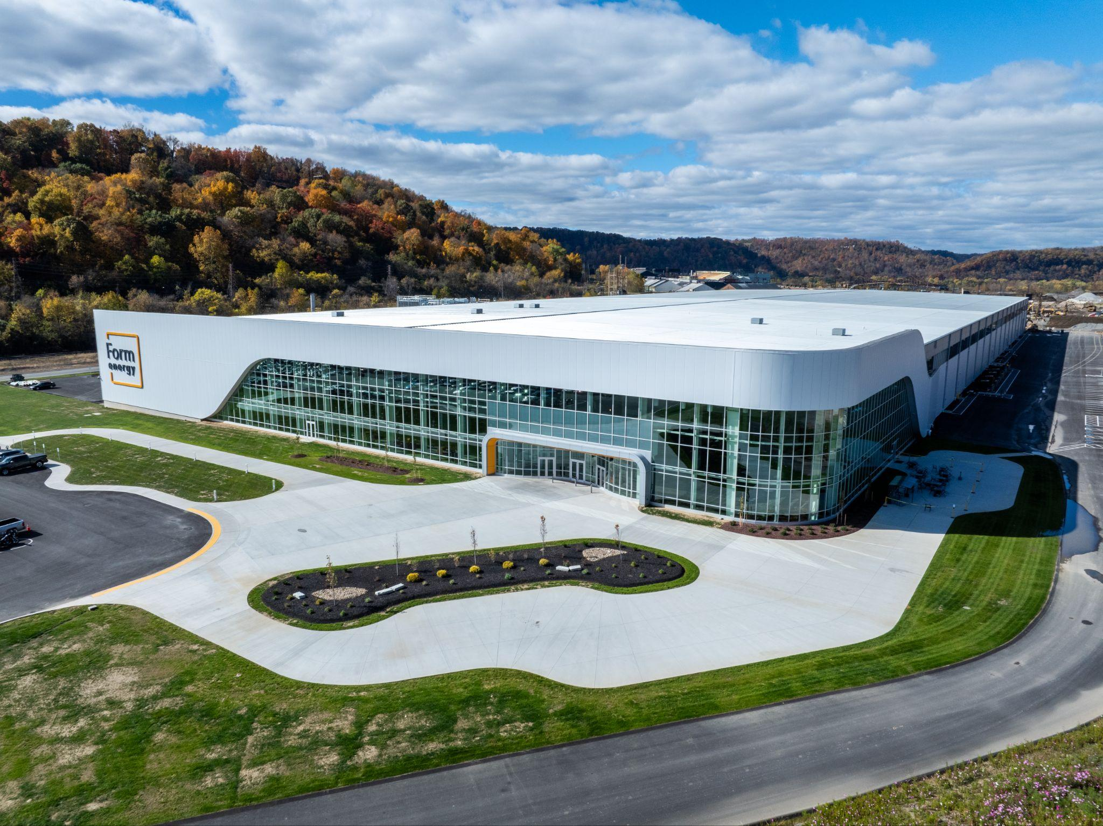
BREAKTHROUGH LOW-COST,
MULTI-DAY
ENERGY STORAGE
NECPUC Annual Meeting
Sarah Jackson
May 20, 2025

Slide 13
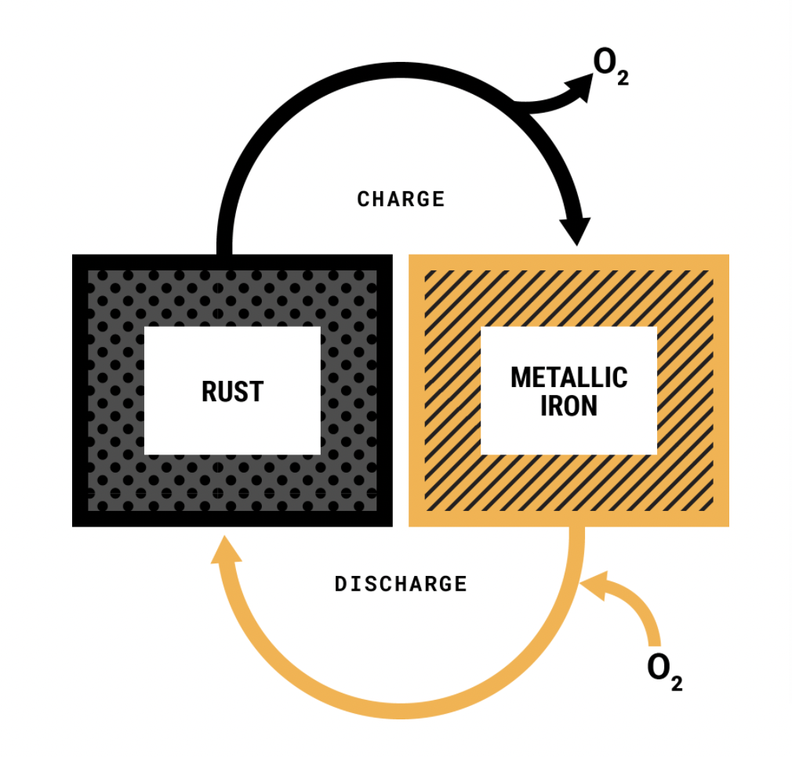
Rechargeable iron-air is the best technology for multi-day storage
Reversible Rust Battery
COST
Lowest cost rechargeable battery chemistry.
Less than 1/10th the cost of lithium-ion batteries
SAFETY
Non-flammable aqueous electrolyte. No risk of thermal runaway.
SCALE
Uses materials available at the global scale needed for a zero carbon economy. High recyclability.
RELIABLE
100+ hr duration required to make wind, water and solar reliable year round, anywhere in the world.

Slide 14
Multi-day Storage is a low-cost energy reservoir for the electricity grid
Multi-day
Storage
Example: 100 hr Iron-air Battery
Intra-day
LDES
Example: 12 hr Flow Battery
Short-duration storage
Example: 4 hr Li-ion Battery
Comparison
Energy capacity / duration
How much energy can the reservoir hold?
Multi-day storage holds 25x more energy than short-duration storage with the same MW capacity
1 MW =
100 MWh stored energy =
100 hours of continuous energy supply
1 MW =
12 MWh stored energy =
12 hours of continuous energy supply
1 MW =
4 MWh stored energy =
4 hours of continuous energy supply
Cost
How much does the reservoir cost, in terms of energy (duration) and capacity (max output)?
~$20 per kWh of energy
(reservoir size)
~$2,000 per kW of power
(reservoir max output)
~$150 per kWh of energy
(reservoir size)
~$2,000 per kW of power
(reservoir max output)
~$250 per kWh of energy
(reservoir size)
~$1,000 per kW of power
(reservoir max output)
Multi-day Storage stores energy at ~1/10th the cost of a short-duration battery

Slide 15
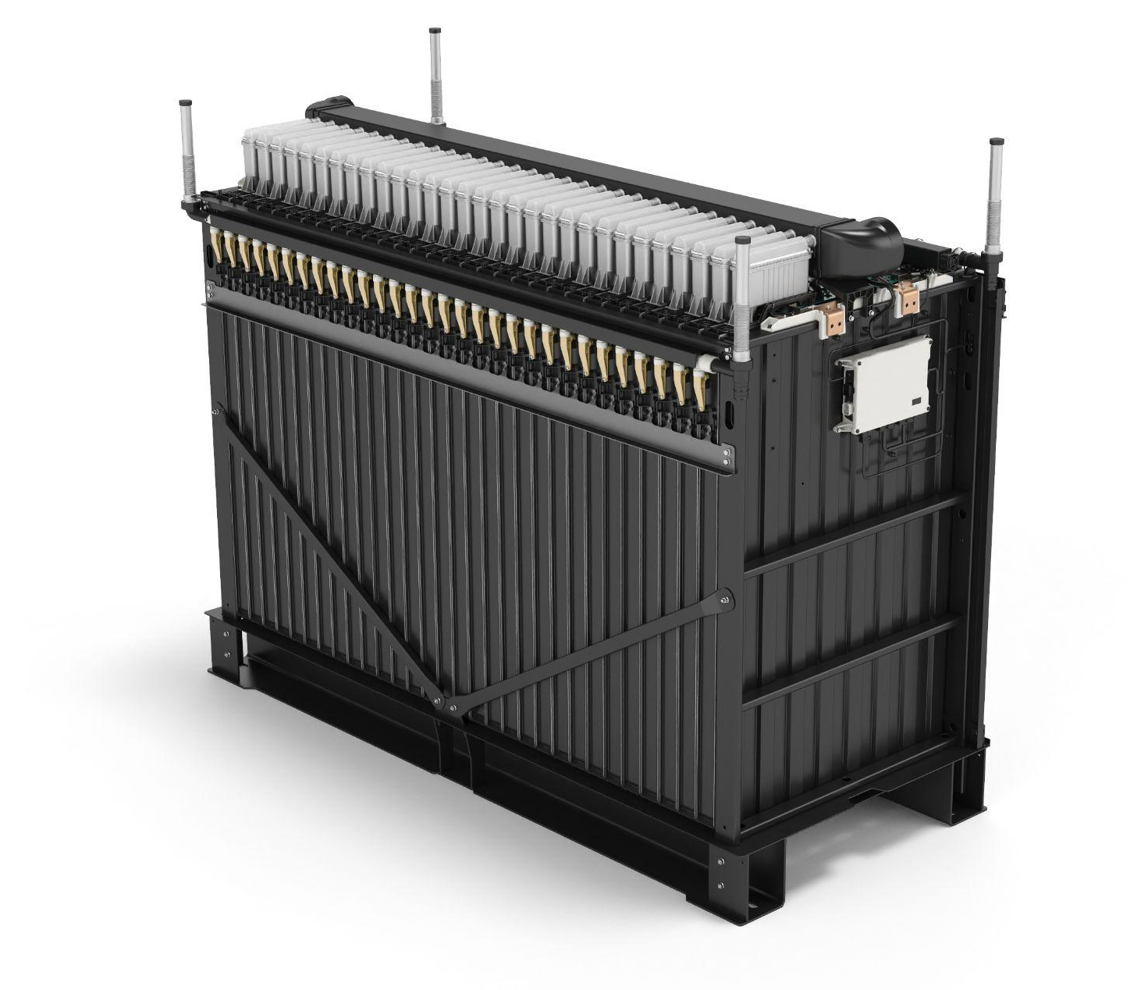
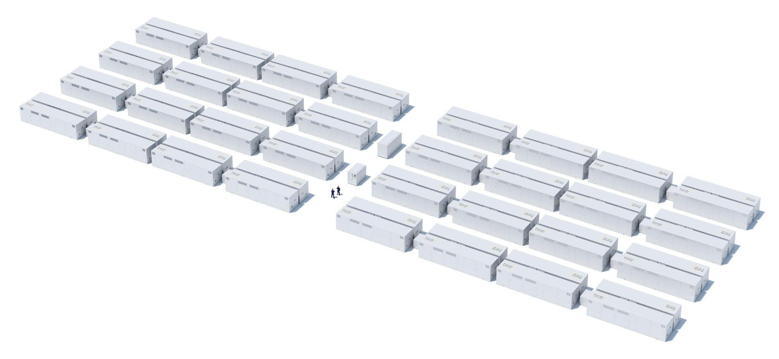
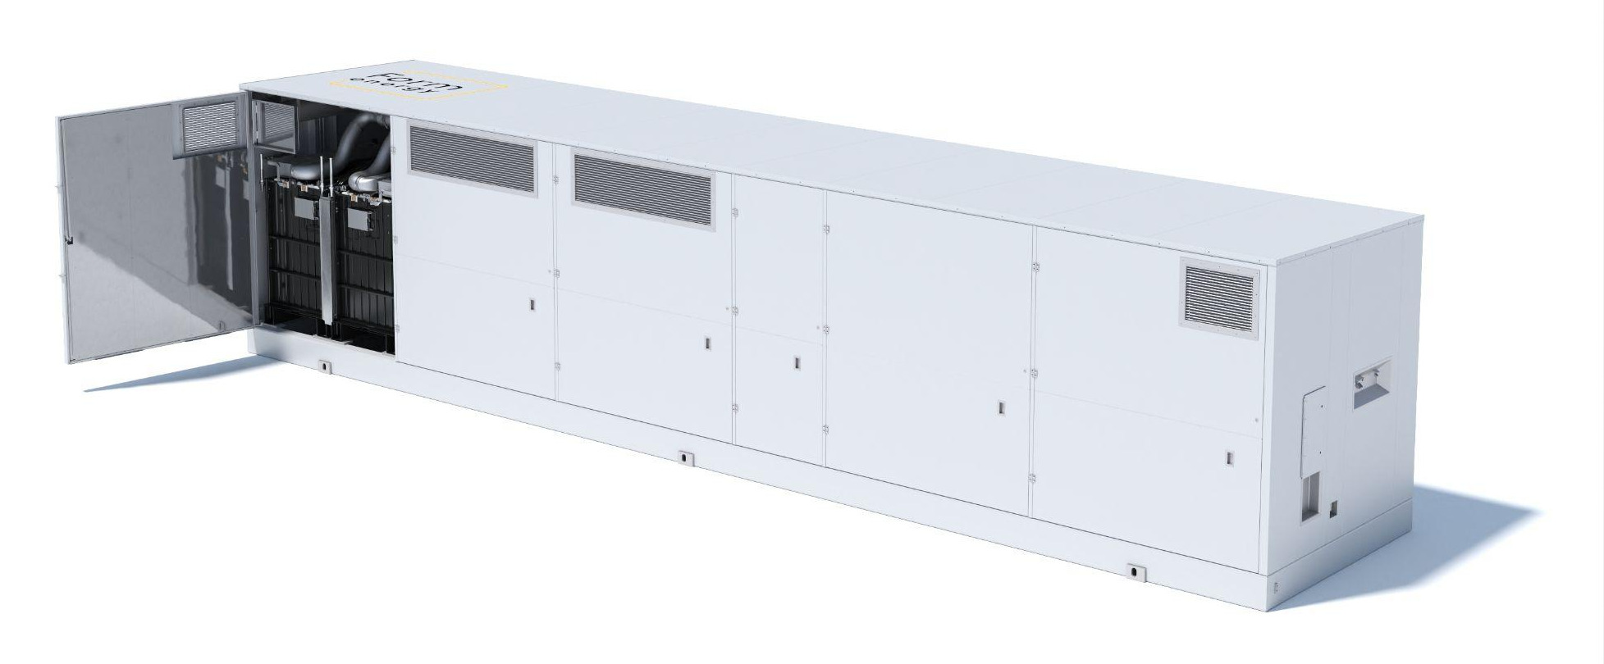
What makes up a Form Energy system
Modular design enables easy scaling to GWh systems
Cell
Battery Module
Enclosure
Power Block
System
~0.15 kW / 15 kWh
~1.37m x 0.94m x 70mm
Electrodes + electrolyte
Smallest electrochemical functional unit
~4.5 kW / 450 kWh
~1.8m x 1m x 2.5m
30 cells
Smallest building block of DC power
~45 kW / 4,500 kWh
~9.5’ x 8’ x 40’
10 modules
Product building block with integrated auxiliary systems
~2.9 MW / 290 MWh
<2 acres
64 enclosures
Smallest independent system and AC power building block
10+ MW / 1000+ MWh
5+ acres
Many power blocks
Commercial intent system

Slide 16
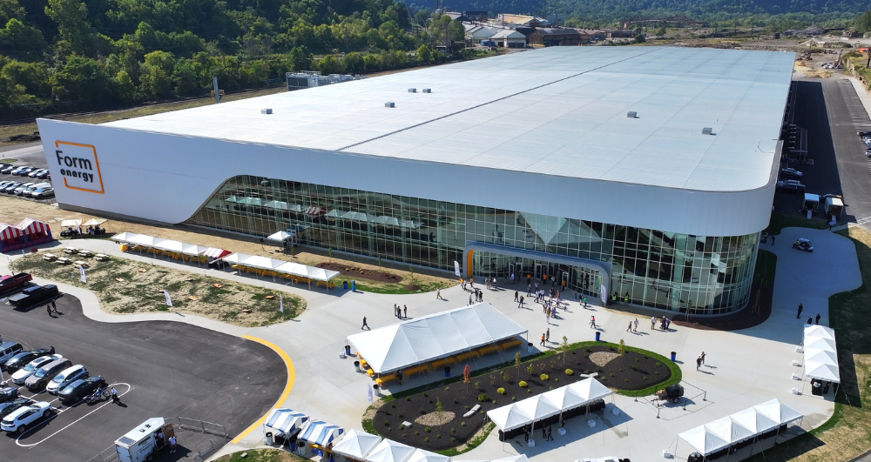
Form Factory 1: Commercial-Scale Manufacturing
Transforming Weirton Steel Land for Battery Manufacturing in West Virginia
Production Capacity: 500 MW / 50 GWh annual
Trial Production Start: September 2024
Commercial Production Start: 2025
Investment & Jobs
Total local investment: $760 million
Jobs: Minimum of 750 full-time jobs
Location Benefits
Close to our existing pilot manufacturing facility in PA
Strong natural infrastructure
Local manufacturing know-how
Factory Function
Semi-to-fully automated cell, module, & enclosure assembly
Ability to scale production in modular blocks

