Slide 1
New Ideas on Siting and Permitting Clean Energy Infrastructure
NECPUC Symposium
May 20, 2025
Staci Rubin Zeryai Hagos Michael Judge Theresa Hopkins-Staten Rachel Goldwasser
MA Department NY Department of MA Energy and Eversource, Eversource Key Capture
Of Public Utilities Public Service Environmental Affairs Energy Foundation Energy

Slide 2
RAPID Act Proposed Regulations: Streamlining the Siting of Major Renewable Generation and Electric Transmission Projects
Zeryai Hagos, Executive Director
Office of Renewable Energy Siting & Electric Transmission
May 20, 2025

Slide 8
Thank you

Slide 9
Siting and Permitting Reform in Massachusetts

Slide 10
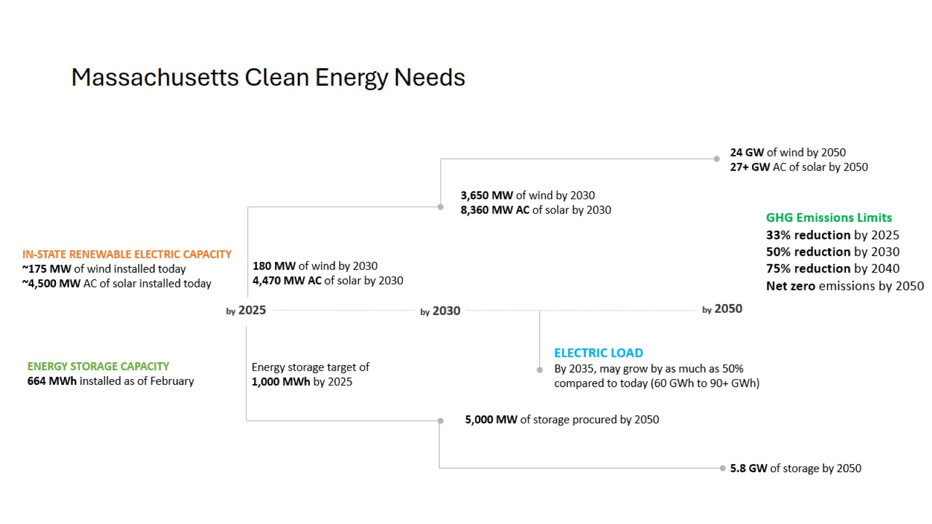
Massachusetts Clean Energy Needs

Slide 11
Commission on Energy Infrastructure Siting and Permitting

Slide 12
Consolidated State Permitting

Slide 13
Consolidated Local Permitting

Slide 14
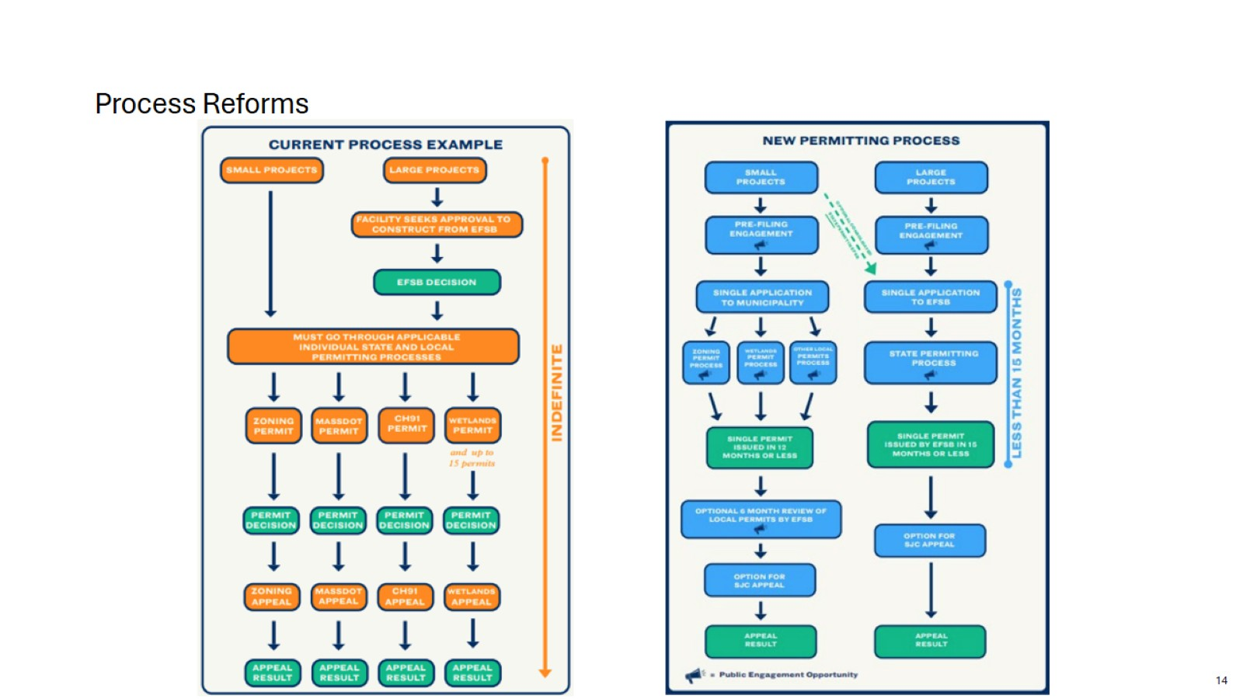
Process Reforms

Slide 15
More Meaningful & Just Community Engagement

Slide 16
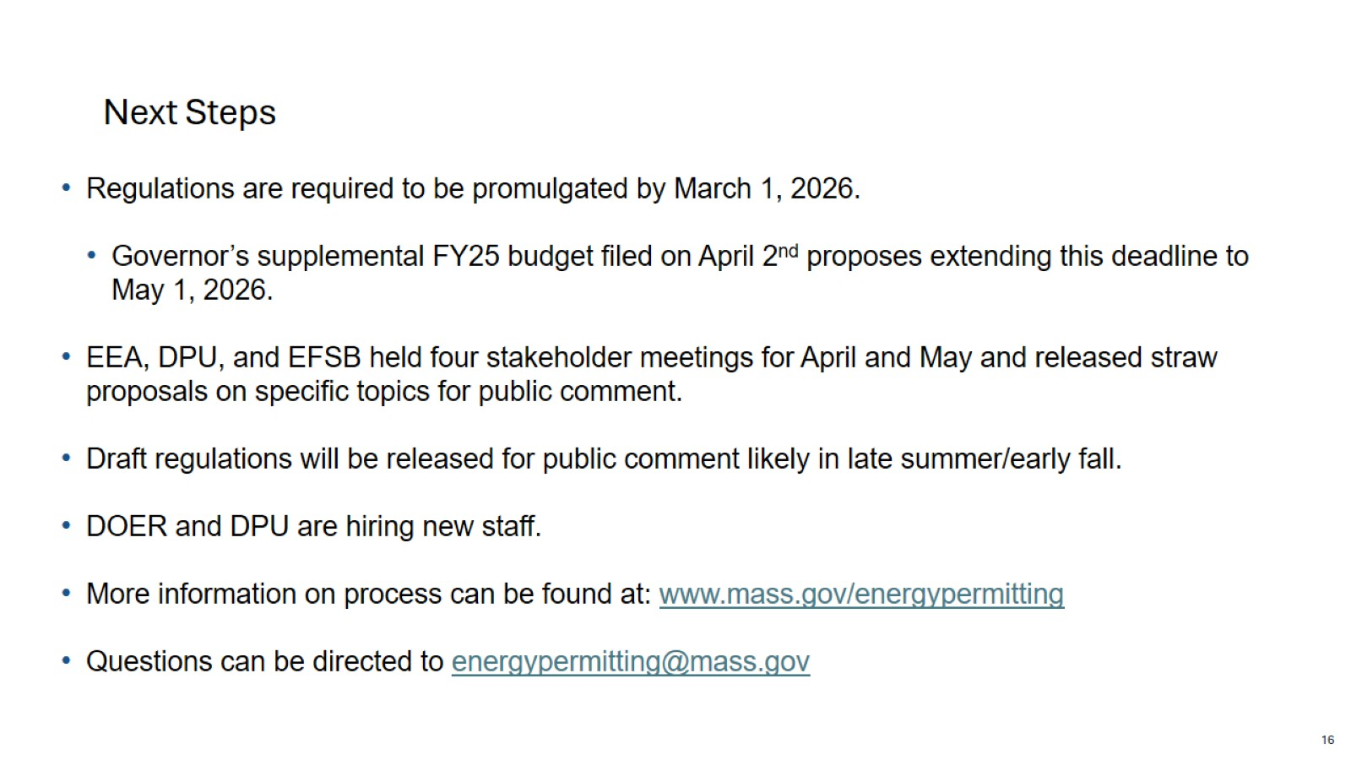
Next Steps

Slide 17
2025 NECPUC Symposium New Ideas on Siting and Permitting Clean Energy Theresa Hopkins-Staten Vice President, Corporate Citizenship & Equity President, Eversource Foundation
2025-05-20

Slide 19
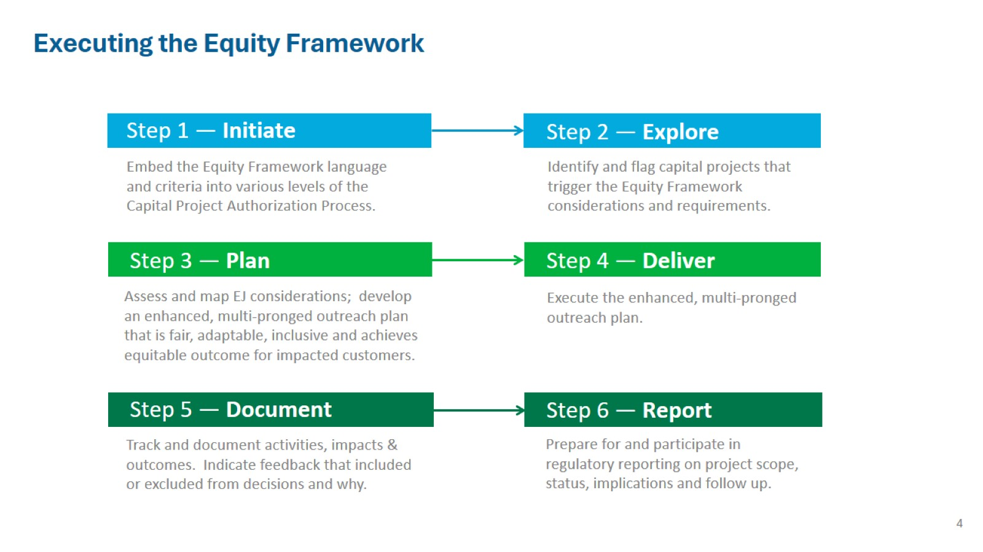

Slide 20
Community Engagement Principles

Slide 21
Community Engagement Tactics

Slide 22
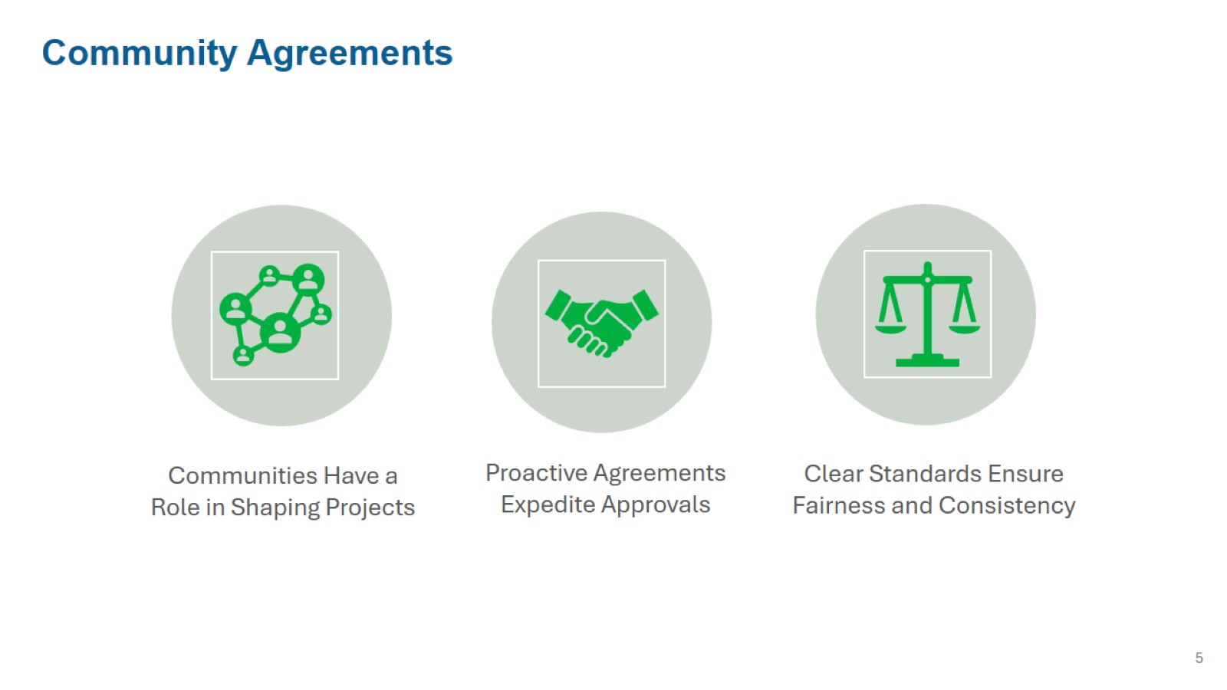

Slide 23
NECPUC Symposium

Slide 24
Introduction to Key Capture Energy

Slide 25
Siting: Who leads the process?

Slide 26
Siting: Some Considerations

Slide 27
What is Good Development?

Slide 28
Communicating About Risk

Slide 30
Discussion
New Ideas on Siting and Permitting
Clean Energy Infrastructure
Staci Rubin Zeryai Hagos Michael Judge Theresa Hopkins-Staten Rachel Goldwasser
MA Department NY Department of MA Energy and Eversource, Eversource Key Capture
Of Public Utilities Public Service Environmental Affairs Energy Foundation Energy
Commissioner Executive Director Undersecretary Vice President General Counsel
ORES of Energy Corporate Citizenship EVP Regulatory Affairs

