Slide 1
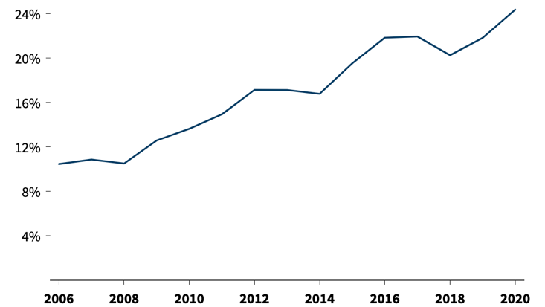
Consumer bills for transmission are rising rapidly
Portion of Residential Bill Spend on Transmission & Distribution
Transmission and distribution costs now make up 24% of customer bills, compared to 10% in 2005
Transmission spending hit an all-time high in 2023¹
Source: RMI Utility Transition Hub
¹ Nathan Shreve et al., Fewer New Miles: The US Transmission Grid in the 2020s, Grid Strategies with support from Americans for a Clean Energy Grid, July 2024, https://cleanenergygrid.org/wp-content/uploads/2024/07/GS_ACEG-Fewer-New-Miles-Report-July-2024.pdf

Slide 2
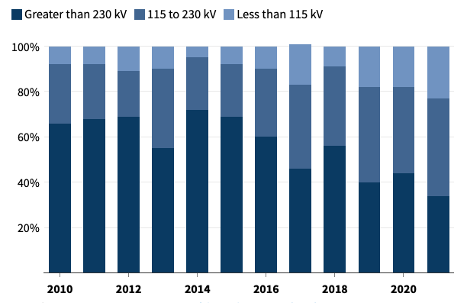
But the US has seen fewer dollars spent on high-voltage transmission
Share of US Transmission Spend by Voltage
The percent of spending on high-voltage (>230 kV) projects has declined from 72% in 2014 to 34% in 2021²
The US added an average of 350 miles/year of transmission in the early 2020s, compared to 1700 miles/year in the early 2010s¹
90% of recent transmission spend has been on lower-voltage reliability upgrades³
Source: FERC State of the Markets 2021 report
² State of the Markets 2021, Federal Energy Regulatory Commission, April 21, 2022, https://www.ferc.gov/media/report-2021-state-markets
³ Johannes Pfeifenberger, “Ensuring Cost Effective Transmission in Support of a Clean Energy Transition,” presentation to New England States Committee on Electricity, The Brattle Group, August 9, 2024, https://www.brattle.com/wp-content/uploads/2024/08/Ensuring-Cost-Effective-Transmission-in-Support-of-a-Clean-Energy-Transmission.pdf

Slide 3
Local transmission investments are becoming increasingly frequent
In ISO-NE, spending on Asset Condition projects has steadily increased to 70% of total transmission spend by last year
Asset Condition projects are planned separately by transmission owners without significant input by ISO-NE or integrated, holistic consideration of regional needs
Share of ISO-NE Transmission Spend by Project Type
Data is presented as a 3-year rolling average based on projected in-service year using most recent cost estimates.
Source: ISO-NE Final RSP Project List and Final Asset Condition List, March 2025

