Slide 1
Efficiency Maine's EV Charging Programs Background
2023: Launched DERMS-based program based on event calling during summer capacity season
  New enrollments 2023-2024: 94
  New enrollments 2024-2025: 97
2025: Switched to "Off-Peak Charger" incentive
  Chargers commissioned (12 months of program running) = 1,000+

Slide 2
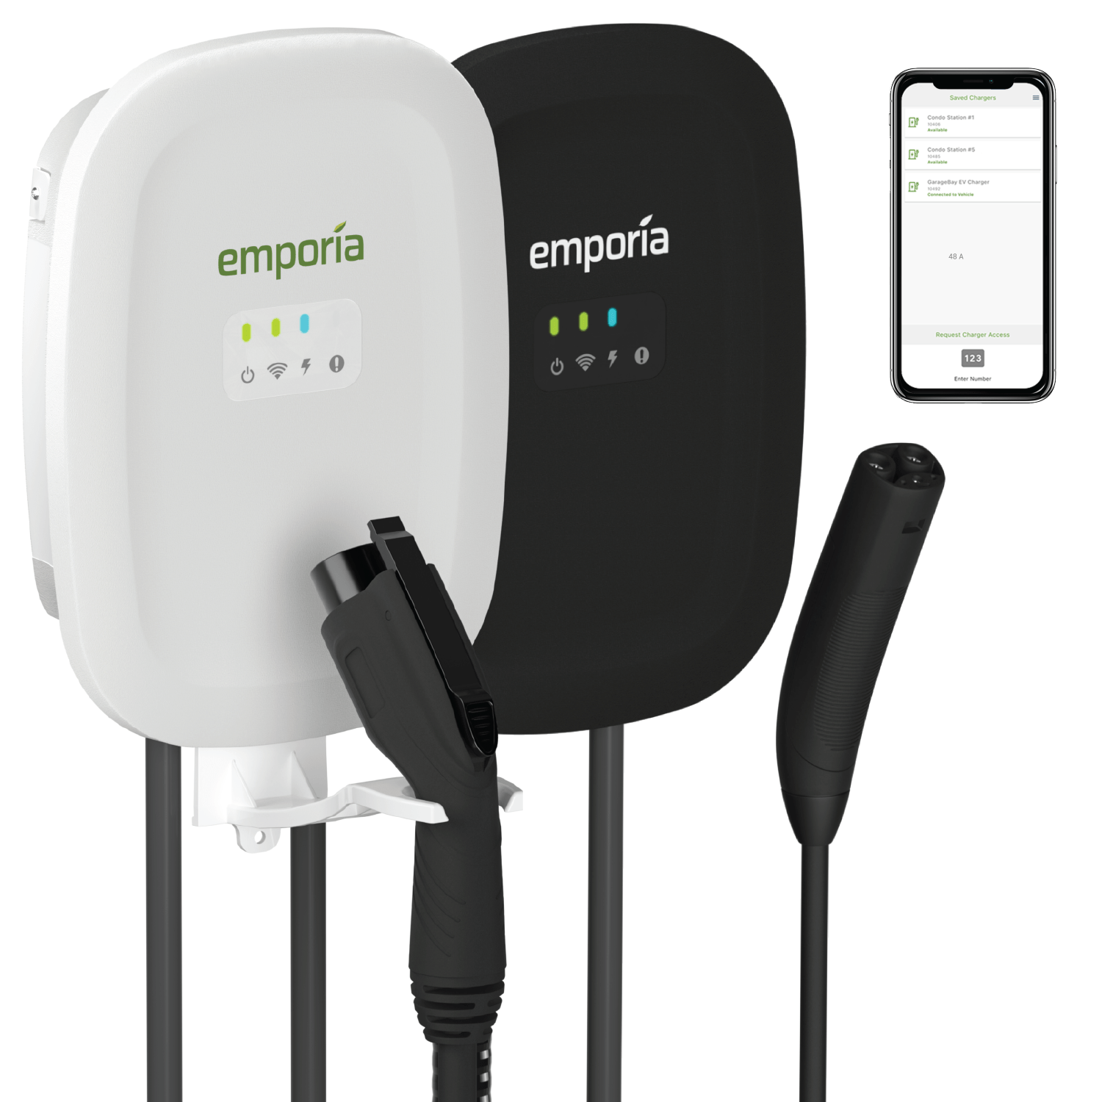
Off-Peak Chargers
Instant discount on purchase of equipment + bonus after charger is set up
Charger automatically pauses charging from 5PM to 9PM on weekdays after device is connected to the internet.
Customer can override the schedule at any time, but the schedule will revert back to normal the following day.

Slide 3
Efficiency Maine vs. CELT 2026 Managed Charging Forecast
ISO-NE: Final 2026 Electric Vehicle Forecast
https://www.iso-ne.com/static-assets/documents/100034/transfx2026final.pdf

