Slide 1

Reforming Utility Incentives to Build a More Affordable Distribution System
NECPUC
Cara Goldenberg, Principal, RMI
May 19, 2026

Slide 2
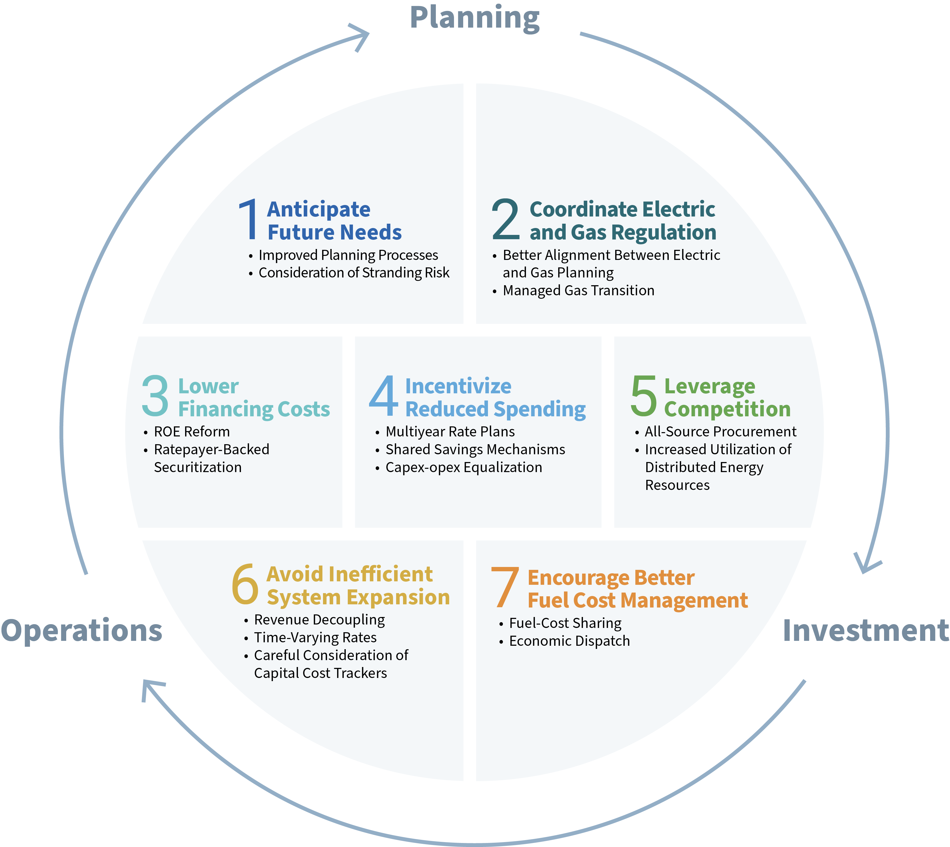
Containing costs on the distribution system requires a range of reforms
Regulatory reforms across utility planning, investment, and operations are necessary to effectively support cost containment on the distribution (Dx) system.
However, without changes to utility financial incentives, other reforms are likely to have a more limited impact on rates than they otherwise could.
Incentive reform can:
Improve cost efficiency,
Level the playing field between capex and opex solutions, and
Direct utility attention to targeted outcomes.
Source: RMI, A Strategic Framework for Utility Cost Control, 2025.

Slide 3
Reforming utility incentives can improve cost efficiency
Multi-year rate plans
Smarter management of cost trackers
Well designed multi-year rate plans can incentivize utilities to contain costs on the Dx system by:
  Increasing utilization of existing Dx assets
  Avoiding inefficient system expansion
  Improving and better aligning Dx planning, programs, and operations
  Prioritizing strategic investments to minimize unnecessary spending
Cost trackers* run the risk of exacerbating Dx affordability challenges. Strategies to support cost containment include:
  Understanding the size of the problem
  Reintroducing the risk of disallowance when appropriate
  Introducing incentives to reduce costs
  Strengthening the burden of proof in authorizing new trackers
* Also known as riders, reconciliations mechanisms, balancing accounts, etc.

Slide 4
Reforming utility incentives can level the playing field between capex and opex solutions
Rapid growth of capex on Dx systems requires consideration of all available solutions to grid needs.
Under the traditional utility business model, utilities have a financial incentive to invest in capex solutions over opex-based alternatives.
Capex-opex equalization strategies include a number of regulatory tools designed to reduce or eliminate capex bias.
Narrow in Scope
Broad in Scope
Opex capitalization
Calibrated earnings carryover mechanisms
Performance incentive mechanisms
Modified clawback mechanisms
Shared savings mechanisms
Totex ratemaking

Slide 5
Reforming utility incentives can direct utility attention to targeted outcomes
Traditional
Emerging
DERs
Line Losses
Grid Modernization
Interconnection Times
Affordability
Demand Flex
Energy Efficiency
Safety
Reliability
Resilience
Peak Demand Reduction
Electrification
Customer Engagement
Reliability
Equity
Program Participation
Electrification of Transportation
System Utilization
Cost Control

Slide 6
Thank you!
Cara Goldenberg
Principal, RMI
cgoldenberg@rmi.org

Slide 7
RMI Resources on Cost Control and Affordability
A Strategic Framework for Utility Cost Control
Energy Poverty Policy Simulator
Fixing Multiyear Rate Plans
RMI Affordability Hub
Utility Disconnections Handbook
A Smarter Approach to Cost Trackers
Electricity Affordability Toolkit
How to Restructure Utility Incentives

