Slide 1
DER and Flexibility Compensation Mechanisms
Presented by
Akhilesh ramakrishnan
May 2026

Slide 2
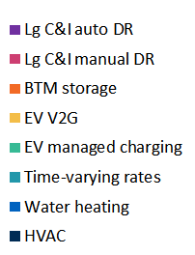
Flexibility can be a large cost-effective resource
New Yorks’s Grid Flexibility Potential
(GW, % of NY’s peak demand)
8.5 GW
21%
How to deploy?
How to compensate?
How to optimize utilization?
3.0 GW
11%
1.4 GW
4%
Current
(Summer)
2030
(Summer)
2040
(Winter)

Slide 3
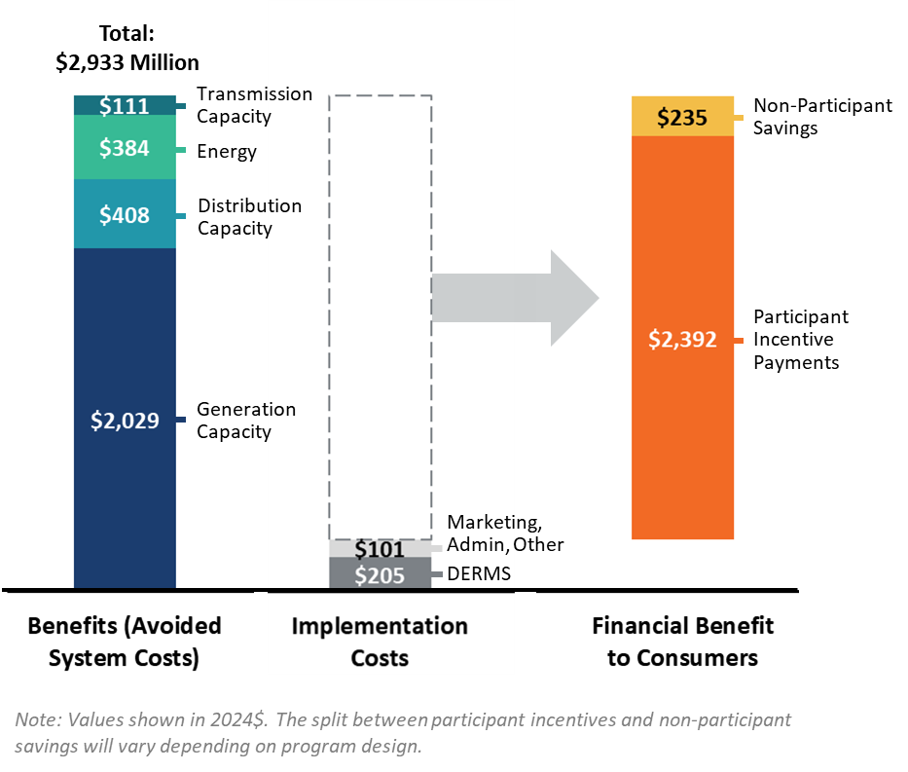
Compensation mechanisms will determine allocation of benefits
Benefits and Costs of Grid Flexibility Potential in NY by 2040
The value of grid flexibility in 2040
  Nearly $3 billion/year in avoided system costs (capacity, energy, distribution, transmission)
  Only ~$300 million/year in implementation costs (systems, admin, marketing)
  Potentially over $2 billion/year in cost savings returned to customers, with portion of value also retained as savings for non-participants

Slide 4
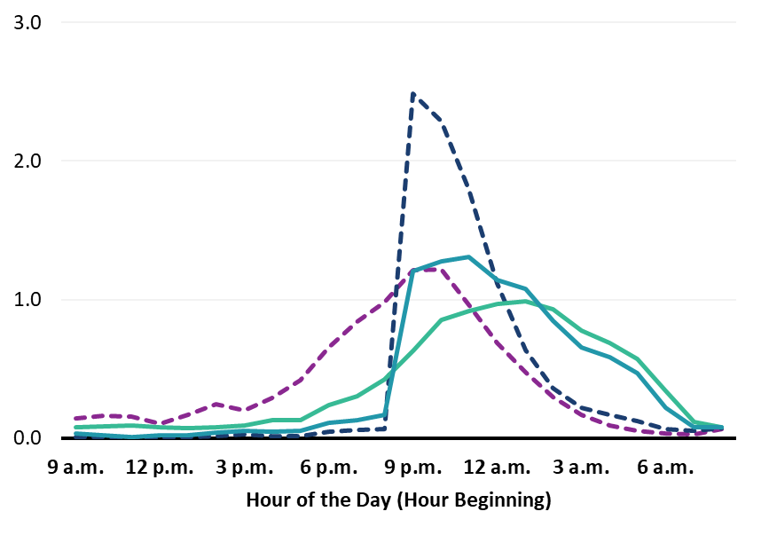
Compensation mechanisms can optimize operation (or not)
AGGREGATE PEAK LOAD PER EV
kW per EV
AVERAGE DAILY CHARGING LOAD SHAPE
kWh per EV
 | Strategy | Aggregate Peak per EV
BASELINES | Unmanaged Charging | 2.2 kW
 | Passive TOU | 3.3 kW
ACTIVE MANAGEMENT | TOU + Load Limit Strategy | 1.7 kW
 | Wholesale + Load Limit Strategy | 1.5 kW
TOU On-peak period
▬ Passive TOU Baseline ▬ Unmanaged Baseline
▬ TOU + Load Limit Strategy ▬ Wholesale + Load Limit Strategy

Slide 5
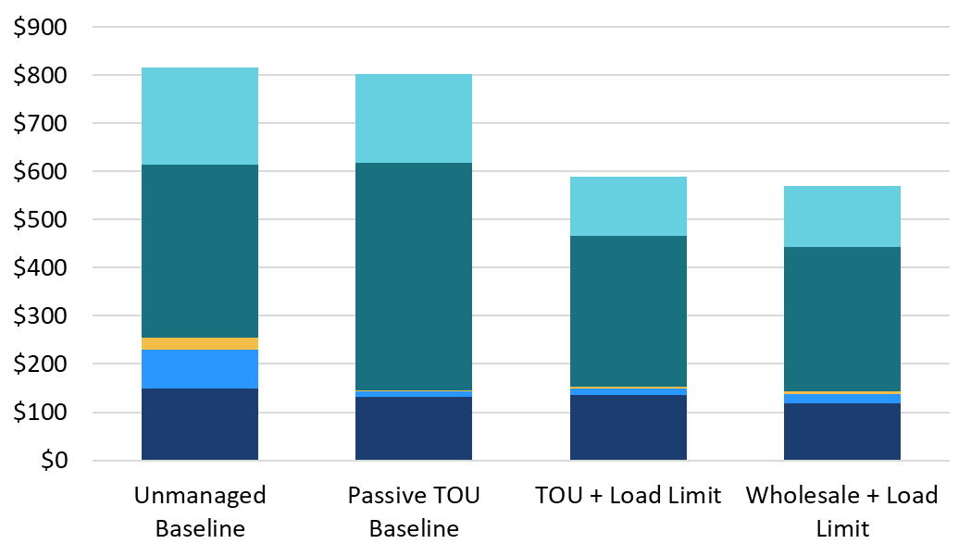
System cost implications can be significant
ELECTRIC SYSTEM COST PER EV
$/year
Cost savings of $214-$245 per actively managed EV.
$815
$802
$589
$570
Secondary Distribution
Primary Distribution
Transmission Capacity
Generation Capacity
Energy

