Slide 1

Energy Supply: What Can Be Done to Bend the Curve?
Richard Levitan
rll@levitan.com
May 19, 2026

Slide 2
Canary in the Coal Mine: PJM Capacity Prices Explode
BRA price outbreak has triggered social upheaval
Pay out $16.4 billion in 2027/28 (~$14 billion more than 2023/24)
Auction delays contributed to run-up
Geometry of the demand curve bodes poorly regarding affordability
Recent PJM Base Residual Auction Clearing Prices

Slide 3
Capacity Market Outlook in ISO-NE
New England is long not short
  Coal retirements 3 GW (~50-60 GW in PJM)
  Since 2013, ~7 GW total retirements in New England (nuclear, oil, coal)
  Demand growth comparatively tame
Affordability goals on trial through ISO Capacity Auction Reforms
  Uncertainty regarding effect on FCA prices
  Seasonal capacity markets
  Marginal Reliability Impact (MRI) based accreditation principles
  Gas deliverability / fuel-security
  Fuzz about Net CONE building block assumptions

Slide 4
Delivered Gas Prices Drive Electricity Prices in New England
Algonquin Citygates is key driver
Gas constraints jack-up delivered gas prices
Unprecedented oil use and LNG reliance during Winter Storm Fern
Monthly Average Electricity and Gas Prices

Slide 5
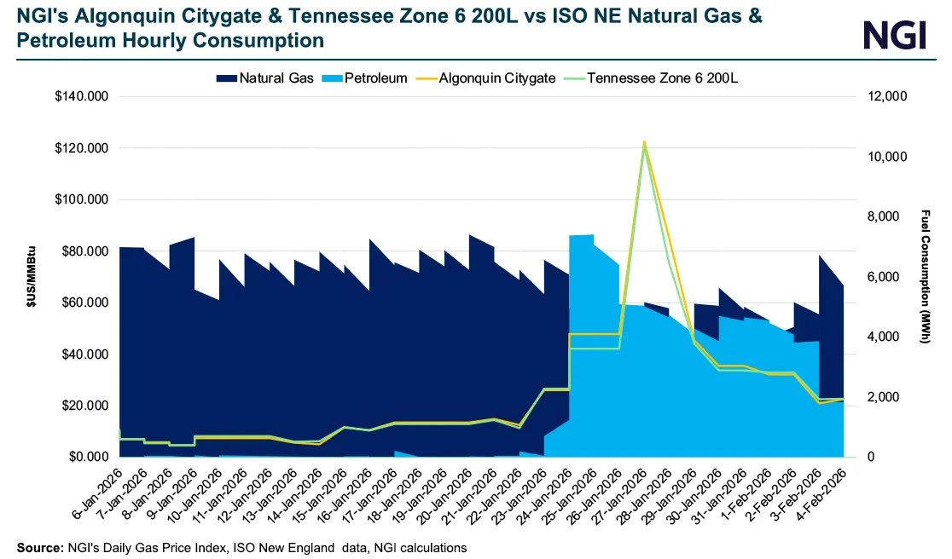
Forensics on Winter Storm Fern

Slide 6
New Pipeline Build in the Greater Northeast
Substantial new pipeline capacity in New England is required to reduce winter gas prices
  OSW entry indefinitely delayed
Major P/L improvements into and in NE may be reconsidered
  New P/L infrastructure at odds with decarbonization goals but may align with affordability
Small, incremental enhancements in NE debottleneck constrained segments but do not yield price benefits
Transco’s 400 MDth/day Northeast Supply Enhancement Project yields high dividend payout
  Payment obligations range from $2.1 B - $2.6 B (Present Value, 15-year term)
  PV benefits exceed $6 B (downstate $2.75 B)

Slide 7
Electric Supply Cost Components
Wholesale supply ~40%
T&D components ~43%; public benefits ~17% (not shown)
Supply comprised of energy, RPS, capacity, other
Supply Cost Components
Other Component Breakdown

Slide 8
Unanswered Questions
How best to balance the inherent tradeoffs regarding affordability, reliability, decarbonization goals and who's responsible for the juggling act?
Who counts what?
Who pays and when?

