Slide 1

Factors Influencing Recent Trends in Retail Electricity Prices in the United States… …and in New England
Ryan Wiser, Galen Barbose, Will Gorman, Eric O’Shaughnessy, Sydney Forrester, Paul Donohoo-Vallett, Peter Cappers, Jeffrey Deason
Lawrence Berkeley National Laboratory
Ryan Hledik, Long Lam
The Brattle Group
May 2026
This work was funded by the U.S. Department of Energy under Contract No. DE-AC02-05CH11231. The views and opinions of the authors expressed herein do not necessarily state or reflect those of the United States Government or any agency thereof, or The Regents of the University of California.
Image source: OpenAI DALL-E

Slide 2
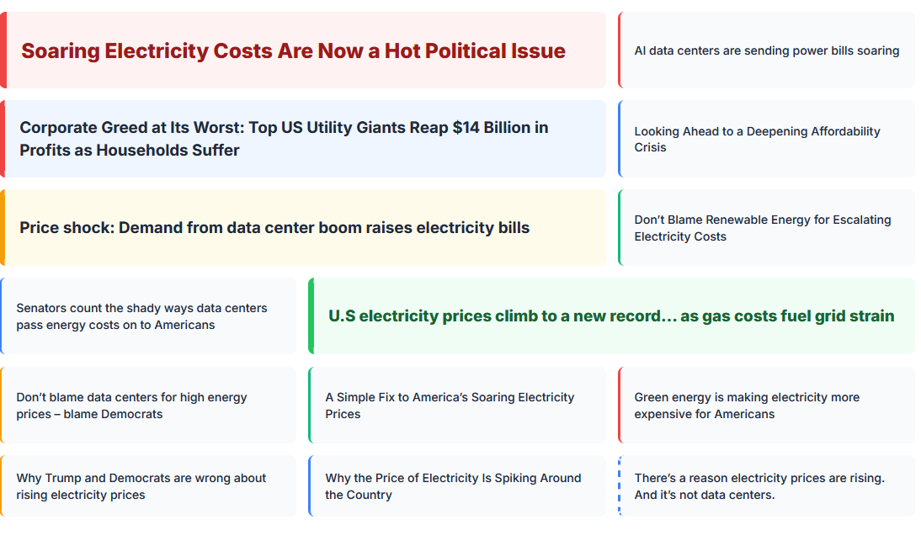
Media attention is prone to overly-simplified soundbites and scapegoating

Slide 3
Goal: Add nuance to discussions about the “affordability crisis” and the scapegoating that often occurs when identifying causes of that “crisis”
Study scope
STUDY SCOPE
Summarize recent retail electricity price trends
National- and state-level price trends, since 2010, 2019, and 2024
Assess drivers of recent retail electricity price changes
Most-likely drivers of state-level price changes, 2019-2025 and 2024-2025

Slide 4
Trends – Level-setting on historical retail prices

Slide 5
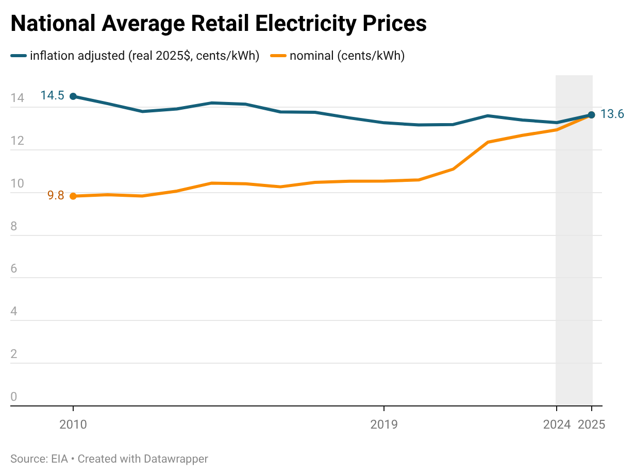
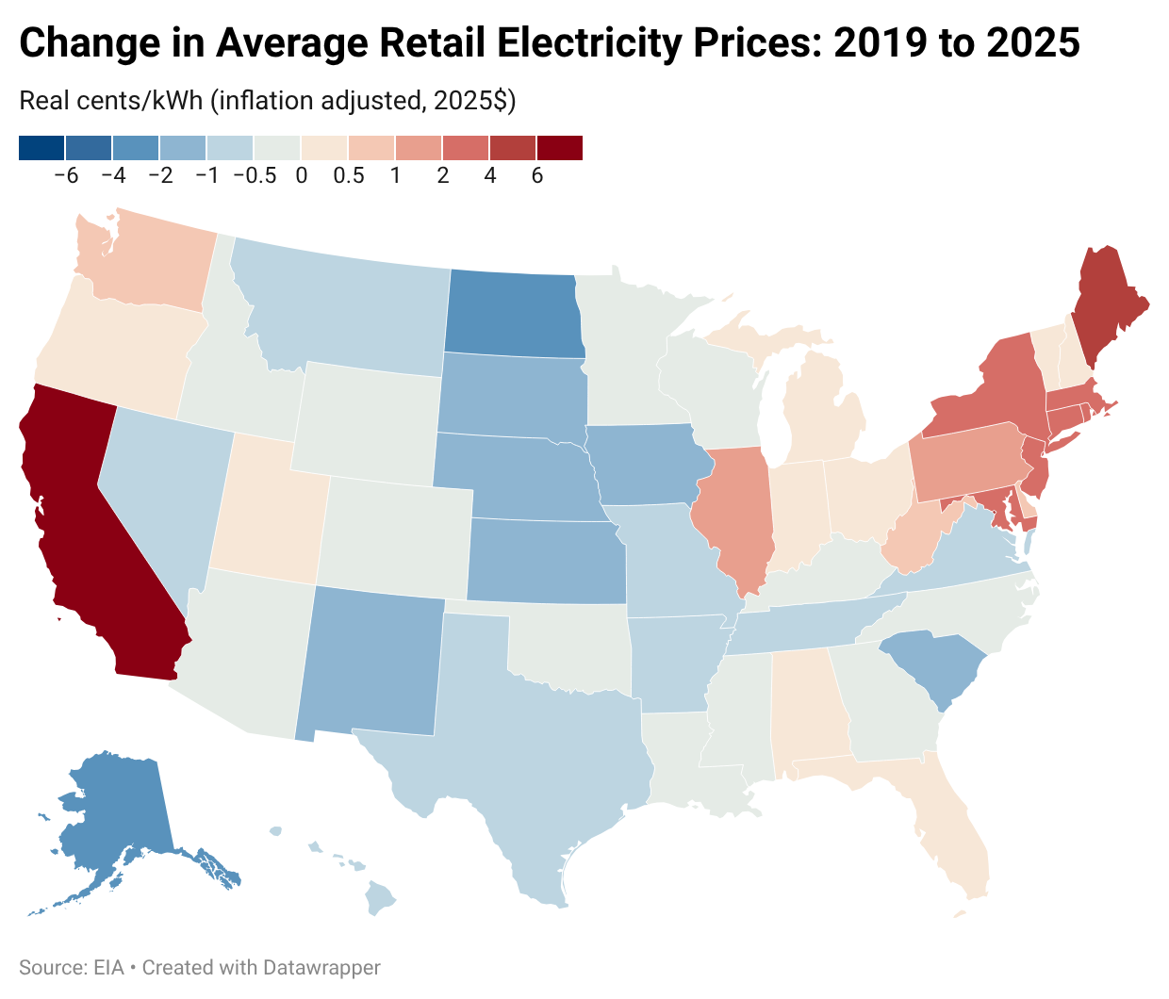
Average nominal retail electricity prices have spiked in recent years nationally, largely tracking inflation… but with a bump 2025
trends: National all-sector average PRICE trends
All-sector national avg. retail prices increased in 2025
  5.3% in nominal terms, 2.6% in inflation-adjusted terms
On a longer-term basis:
  Nominal: avg. prices up 29% since 2019, 39% since 2010
  Real: prices 3% higher than 2019, 6% lower than 2010
29 states saw reductions in inflation-adjusted avg. retail prices from 2019 to 2025
But: New England is outside the national average
Represents the “all-in” price, equivalent to total customer bills divided by total retail electricity sales

Slide 6
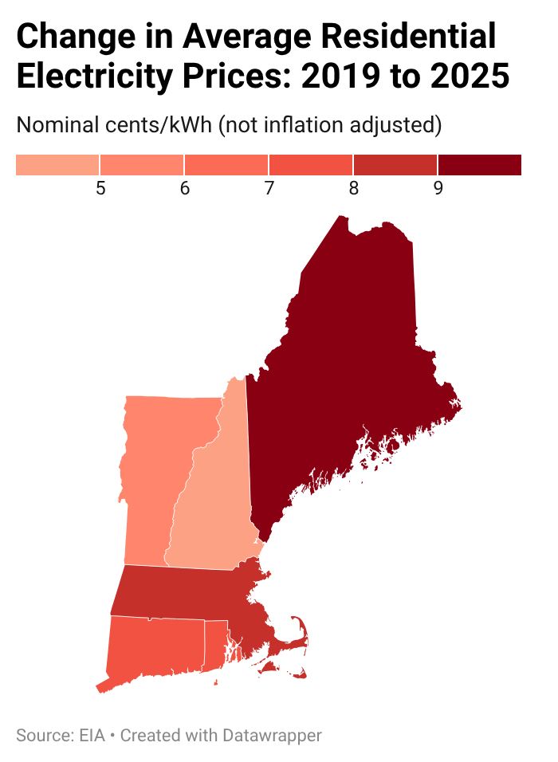
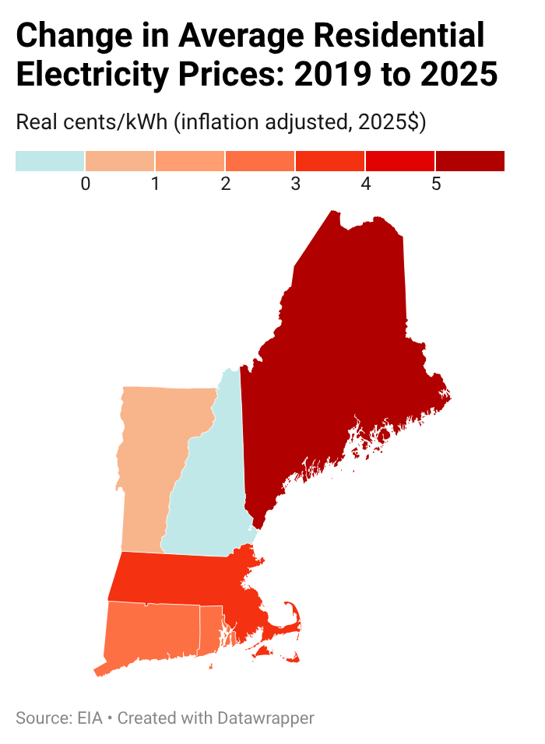
Challenges with electric affordability are hidden behind national averages:
New England saw rapid increases in residential prices from 2019 to 2025
trends: New England residential price trends
Residential Price Changes: Not inflation-adjusted
Inflation-adjusted
Price increases from 2019 to 2025, not adjusting for inflation (nominal terms)
NH: 4.5 ¢/kWh
VT: 5.2 ¢/kWh
CT: 7.5 ¢/kWh
RI: 7.7 ¢/kWh
MA: 8.6 ¢/kWh
ME: 9.9 ¢/kWh

Slide 7
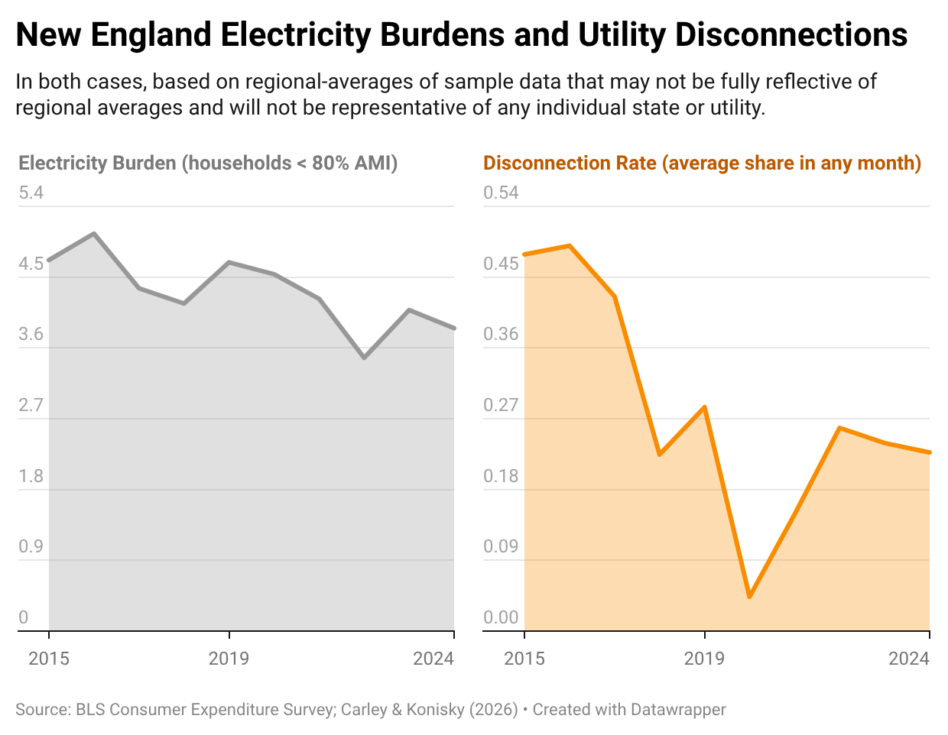
Electricity bills are a major hardship for some households in New England: two indicators suggest improvements… until the last few years
trends: household affordability in new England
Electricity burden focuses solely on bills relative to income for lower-income households (not other energy costs)
  Rising incomes and expanded bill assistance programs lowered burdens through 2022, but they have since increased
Avg. disconnection rates have generally declined, plummeting with COVID-era protections
  But disconnections up since 2020, back to pre-COVID levels
Data are sample, only through 2024 – likely worsened in 2025

Slide 8
Drivers – Understanding New England Trends, 2019-2025
Focus on: T&D costs, natural gas prices, state policies

Slide 9
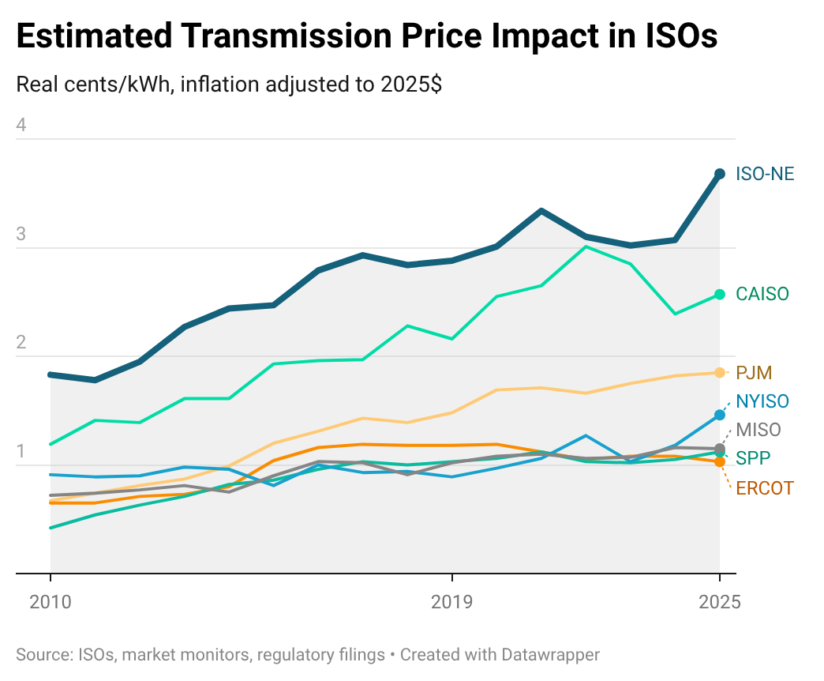
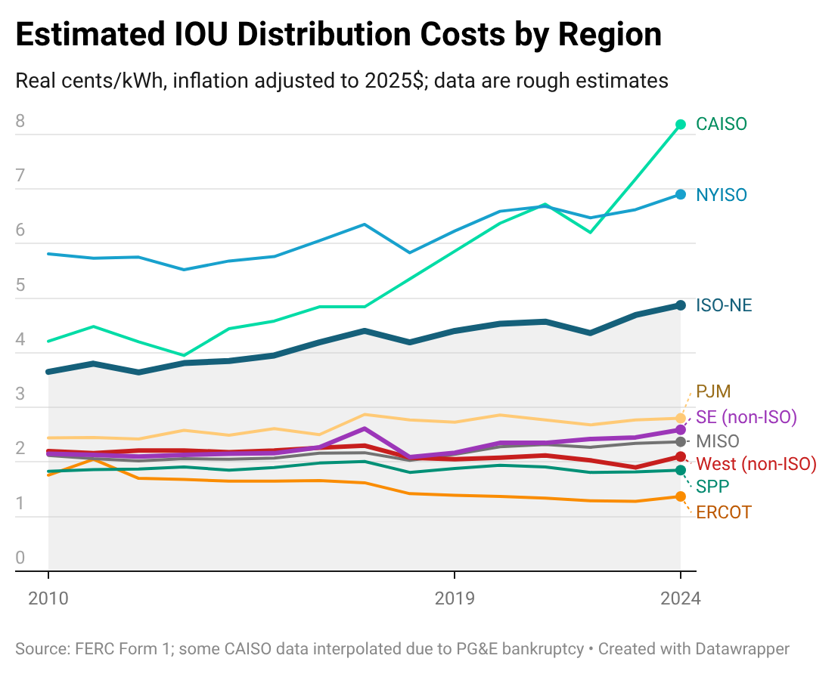
Transmission & distribution expenditures contributed to recent retail price increases, especially in California, New England, New York, Mid-Atlantic
MEDIUM-term relationships: transmission and distribution costs
DIRECT IMPACT OF TRANSMISSION ON ALL-SECTOR AVERAGE PRICES
ESTIMATED IMPACT OF DISTRIBUTION
ON ALL-SECTOR AVERAGE PRICES

Slide 10
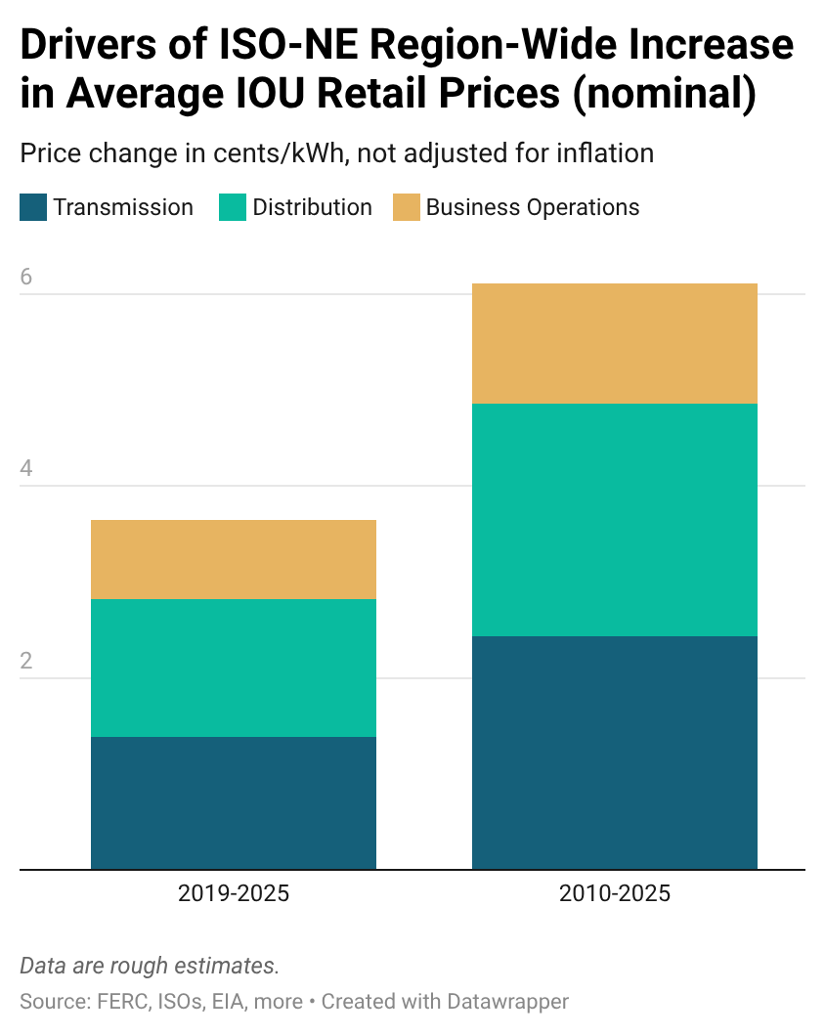
Transmission, distribution and business operations costs were significant contributors to retail price increases in ISO-NE
MEDIUM-term relationships: transmission, distribution, business operations
Combined, transmission, distribution and business operations represent ~50-60% of the total increase in ISO-NE-wide average IOU retail prices (in nominal dollars) from 2019-2025 (left) and 2010-2025 (right)
Major drivers of these cost increases:
      Aging-asset replacement
      Equipment hardening
      Storm cost recovery
      And some expansion
    Price impact exacerbated by:
      Low growth / load contraction
      Highly elevated equipment costs

Slide 11
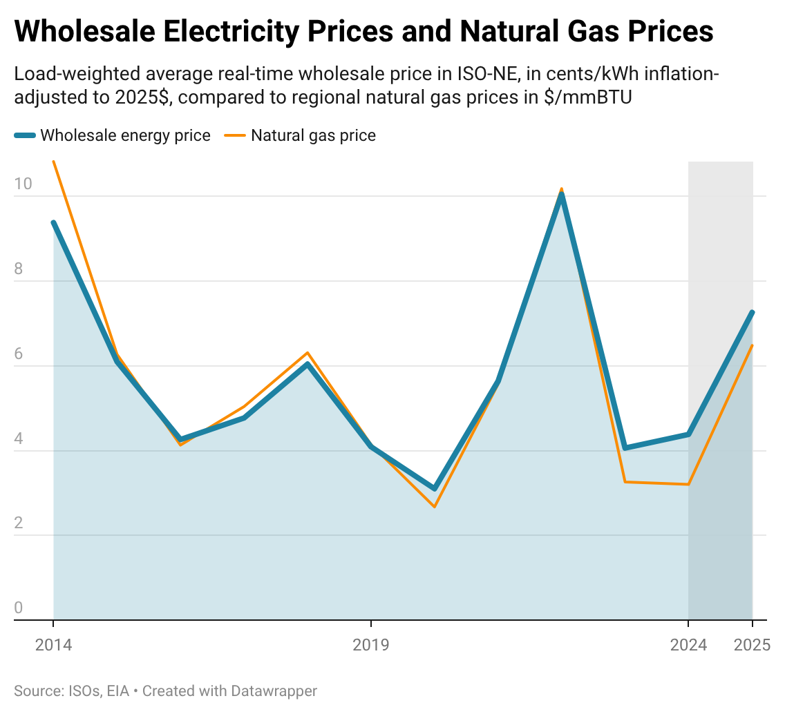
The availability of low-cost natural gas has historically placed downward pressure on retail prices, but increased volatility—especially in ISO-NE
MEDIUM-term relationships: fuel and WHOLESALE POWER PRICES
Over a longer period: technological advances have resulted in reductions in inflation-adjusted natural gas prices and therefore also lower wholesale and retail electricity prices
But natural gas is also a driver of volatility in wholesale and retail prices—and especially in New England due to pipeline constraints
Since 2019, wholesale prices in ISO-NE have been on a roller coaster, due to gas:
  >4 ¢/kWh at onset of Ukraine-Russia war
  2.9 ¢/kWh increase in 2025 vs. 2024
  3.2 ¢/kWh increase from 2019 to 2025

Slide 12
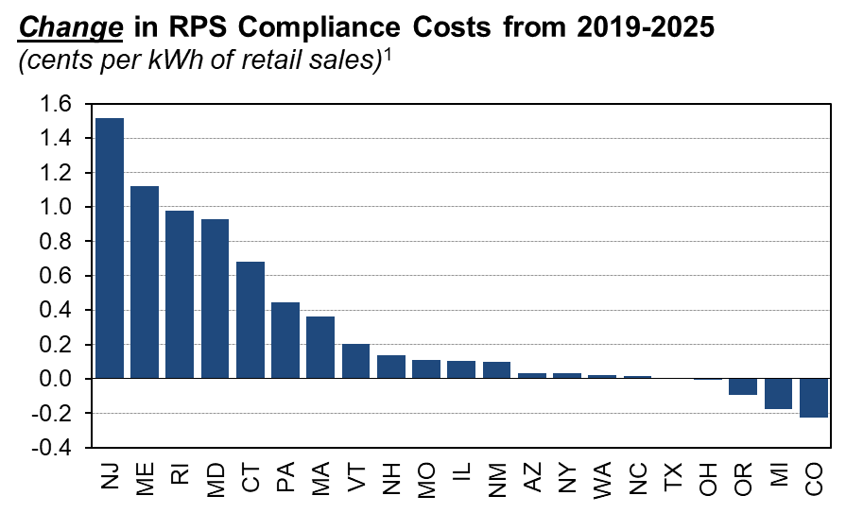
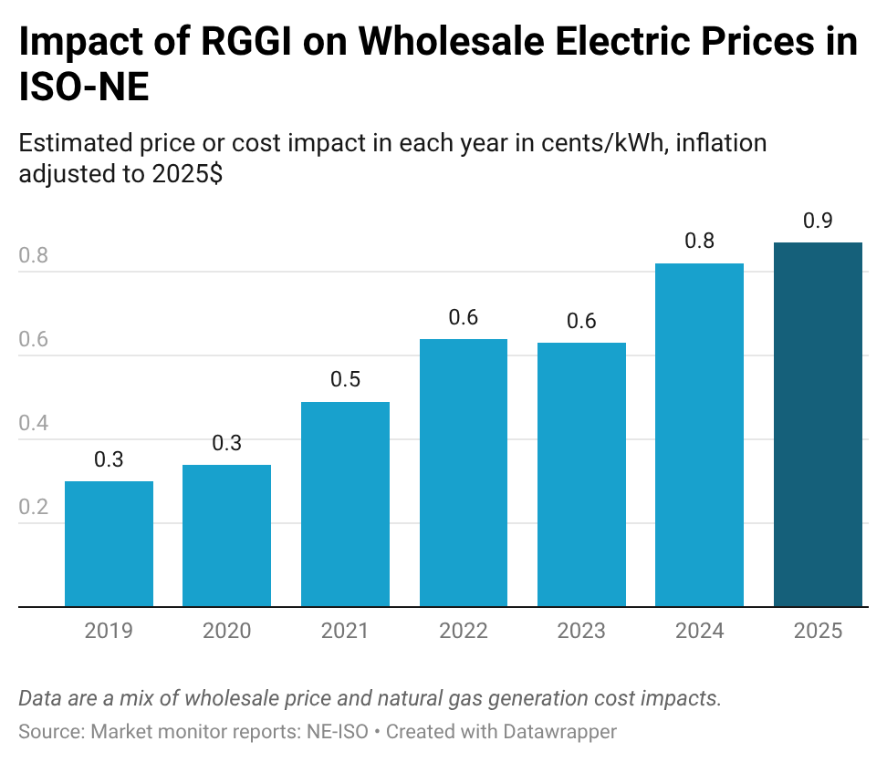
State policies have often also increased prices, including RPS, RGGI, and net metering – with larger impacts in New England than many other regions
MEDIUM-term relationships: State RPS POLICIES, RGGI, and NET-ENERGY METERING
  RPS: Compliance costs from 2019 to 2025 equate to an average price increase of ~0.3 ¢/kWh nationally; in some New England states as much as ~1 ¢/kWh
  RGGI: Impact on wholesale prices of ~0.5 ¢/kWh from 2019 to 2025; retail impacts depend on revenue recycling
  Net metering: Analysis suggests <0.5 ¢/kWh in ~40 states, as high as ~1.5 ¢/kWh in NE

Slide 13
Early 2026 price indicators: IOU rate requests – What’s coming down the pike

Slide 14
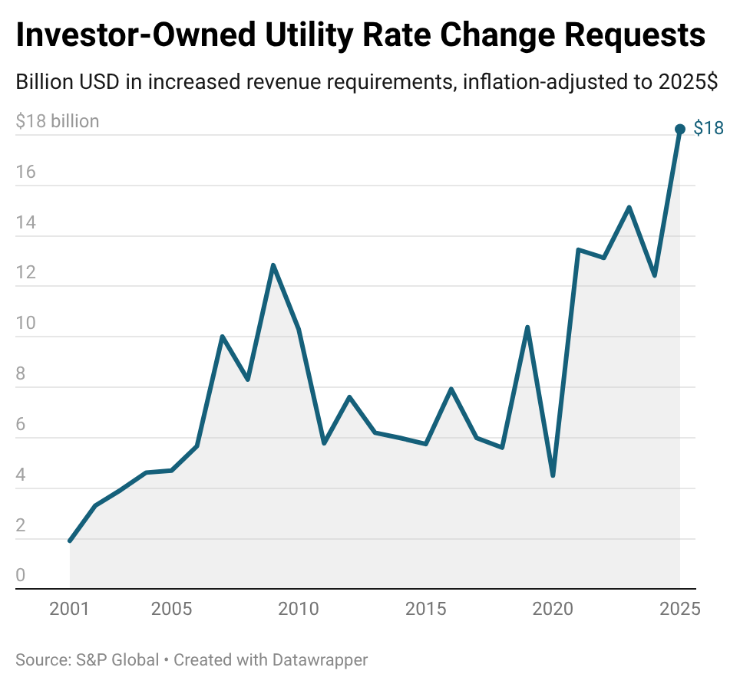
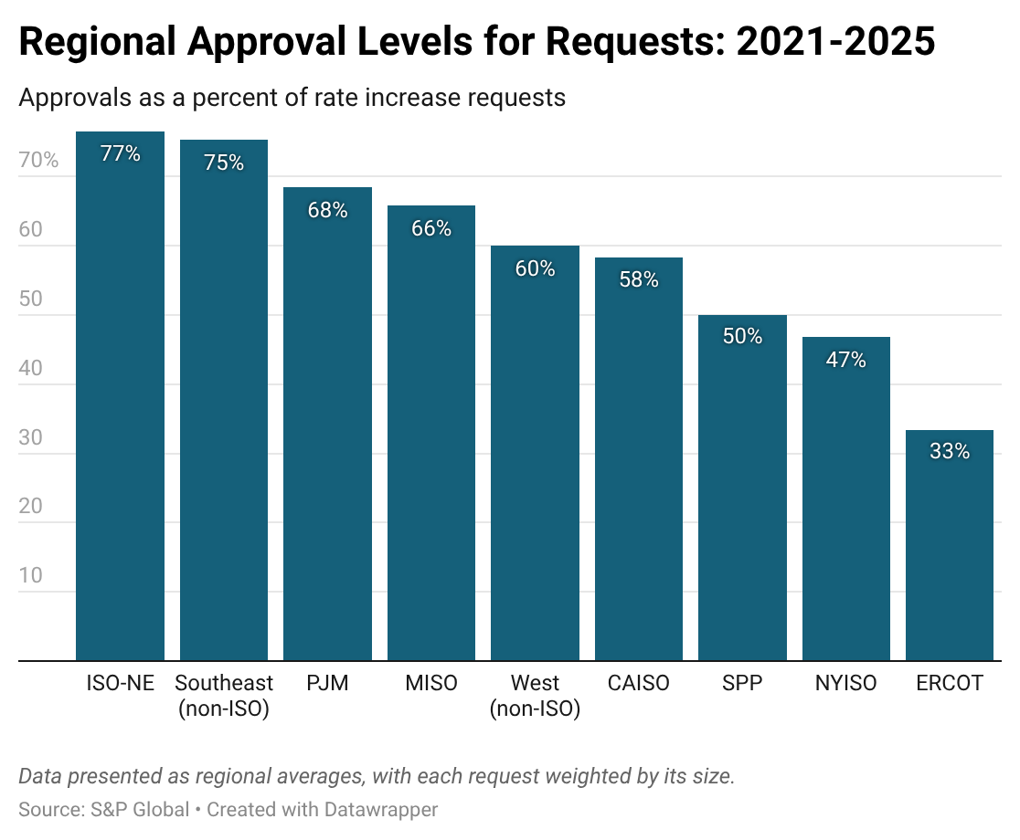
Nationally, IOU rate increase requests in 2025 were higher than experienced in decades; acceptance levels have been high, especially in New England
Looking ahead: rate increase requests and approvals
Does not include wholesale price increases, which will impact default service in 2026
Average 77% approval in New England is higher than from 2011-2020 (63%) or 2001-2010 (47%)

Slide 15
For more information

Slide 16
Acknowledgements:
This work was funded by the U.S. Department of Energy’s Office of Critical Minerals and Energy Innovation under Contract No. DE-AC02-05CH11231.
Disclaimer
This document was prepared as an account of work sponsored by the United States Government. While this document is believed to contain correct information, neither the United States Government nor any agency thereof, nor The Regents of the University of California, nor any of their employees, makes any warranty, express or implied, or assumes any legal responsibility for the accuracy, completeness, or usefulness of any information, apparatus, product, or process disclosed, or represents that its use would not infringe privately owned rights. Reference herein to any specific commercial product, process, or service by its trade name, trademark, manufacturer, or otherwise, does not necessarily constitute or imply its endorsement, recommendation, or favoring by the United States Government or any agency thereof, or The Regents of the University of California. The views and opinions of authors expressed herein do not necessarily state or reflect those of the United States Government or any agency thereof, or The Regents of the University of California.
Ernest Orlando Lawrence Berkeley National Laboratory is an equal opportunity employer.
Copyright Notice
This manuscript has been authored by an author at Lawrence Berkeley National Laboratory under Contract No. DE-AC02-05CH11231 with the U.S. Department of Energy. The U.S. Government retains, and the publisher, by accepting the article for publication, acknowledges, that the U.S. Government retains a non-exclusive, paid-up, irrevocable, worldwide license to publish or reproduce the published form of this manuscript, or allow others to do so, for U.S. Government purposes
This Overall Project Currently Includes Multiple Products
For more information, contact: Ryan Wiser (rhwiser@lbl.gov)
Annual and periodic data updates
Highlights a subset of the trends through 2024, with a focus on statistical analysis of broad drivers
Data visualization tools
Compiles and synthesizes data as it becomes available, including this update
Peer-reviewed journal article
Allows users to explore some of the data compiled under this research effort
These products can all be found at: https://emp.lbl.gov/retail-electricity-price-trends-and-drivers

Slide 17
Policy options

Slide 18
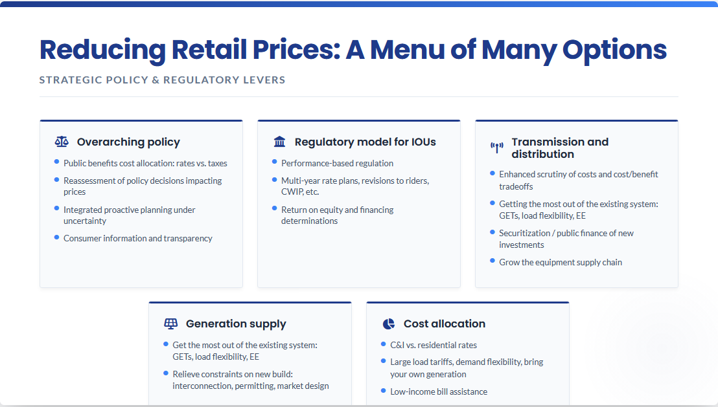
17

